Slide 1
NRA CCW Version Control Worksheet Rev. 7-19 (This slide is hidden and should not show in the presentation to students)
Added Version Control Worksheet
Complete redesign of the slides’ design and formatting to better align with NRA E&T program future
Added CCW Opening Slide
Added Revision Date to Footer of Slides
Changed all “Dry Fire” references to “Dry Practice”
Verbiage change to “dry press the trigger…” from, “dry-fire it…”
Verbiage change to “when the trigger is dry pressed” from “dry-fired”
Removed Dry Practice from Instructor Notes for redundancy
Slide 98 – Added “(Rack, Rack, Rack)” to instructor notes & TR&A definitions
Slide 93 – Verbiage consistency for Objectives
Slide 103 - Verbiage consistency for Objectives
Slide 29 – Labels more in-line with BoPS
Slide 34 – Re-ordered the primary Factors for selecting a pistol
Slide42 – Added “Owner’s Manual” TPI question to Instructor Notes
Slide 45 – Change “Cartridge” to “Bullet” to better align with the image
Slide 98 – Verbiage to include “level to ground” reloading for range safety
Slide 101 – Title Change for consistency
Slides 100/101 – Added slides for Practical reloading & Stoppage exercises
Slide 89 – Added Instructor Note for Drawing Practical, for Closed Front garment
Slide 8 - Verbiage consistency for Objectives
Slide 44 – Added question “What are reasons for testing self defense ammunition in your firearm?” with Instructor Notes
Added Slide 11, “Additional Gun Safety Rules”
Added notes to Slide 65
Changed the Design Layout to align with future of NRA PPT program slides
Background color more neutral, so it is not so bright in a dark room. (pure white created glare)
Added Hyperlinked Lesson # menu to left side of slide deck, accessible from the slideshow.
Added Slide 30 – Three main parts to a pistol
KNOWN ISSUES
Lesson 6: Need 2 additional Failure slides (Battery & Eject)
Notes:
THIS SLIDE IS HIDDEN AND SHOULD NOT BE SEEN BY YOUR STUDENTS

Slide 2
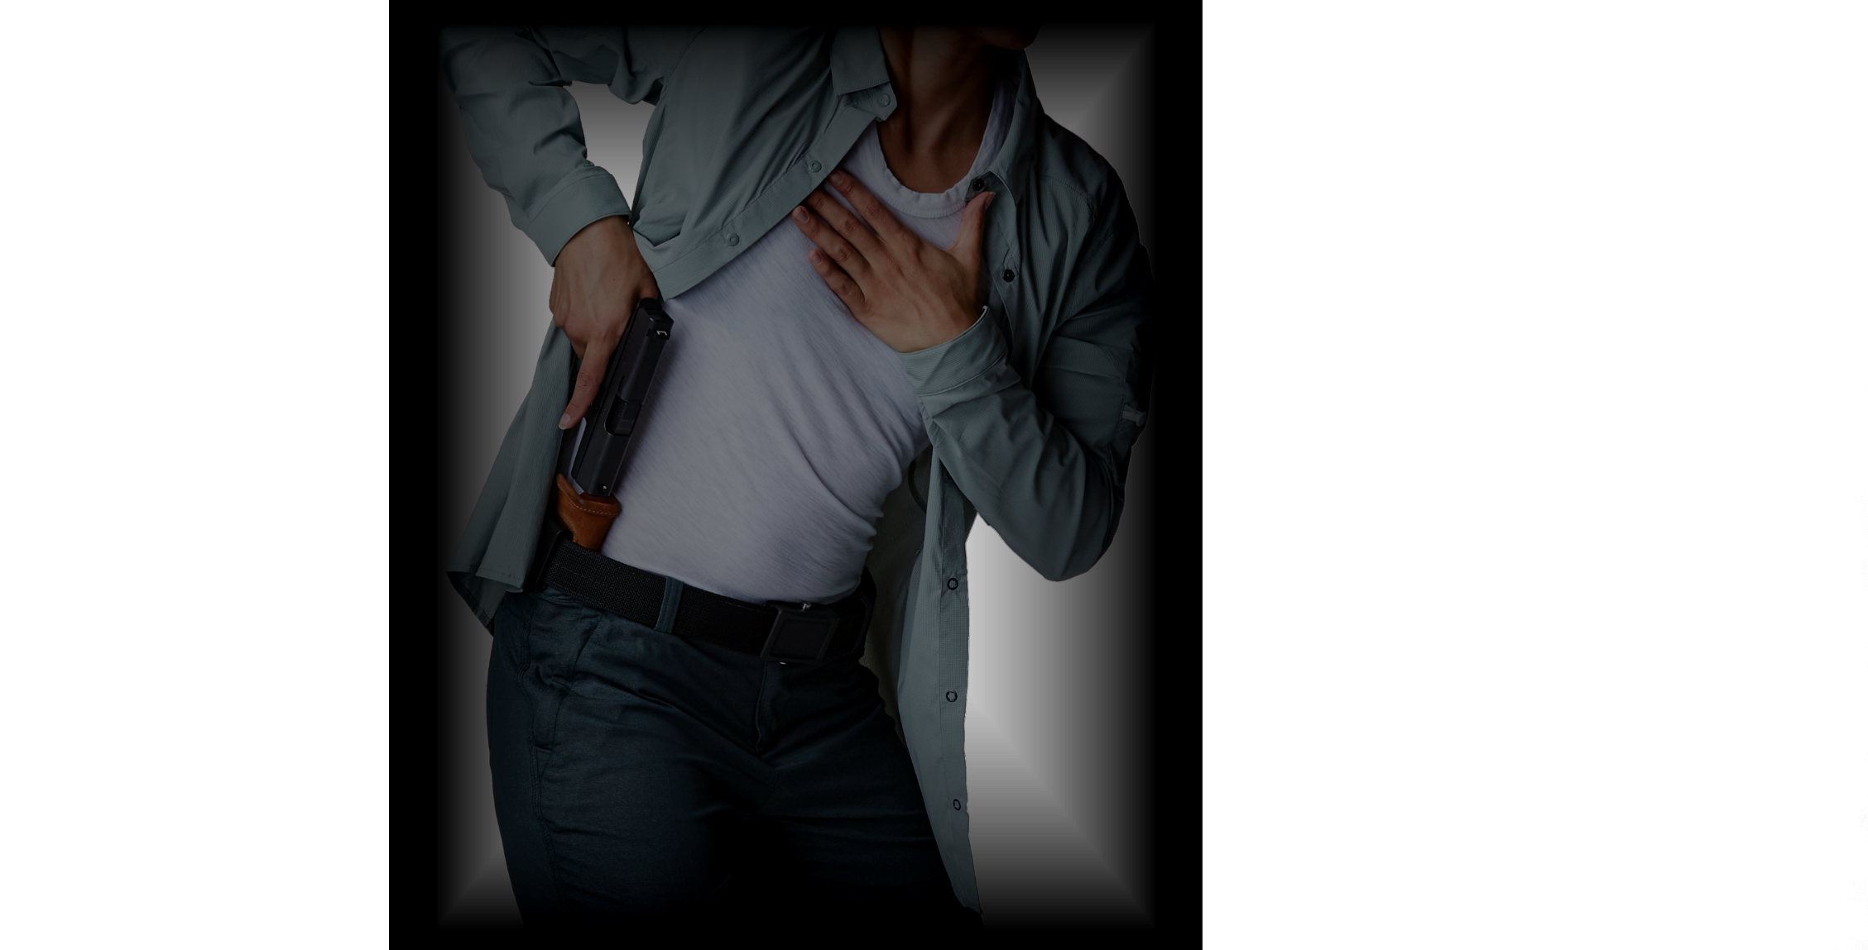
NRA CCW
NRA CCW

Slide 3
Introduction
Staff Introductions
No Live Ammunition in the Classroom
Firearm Security/Storage in the Classroom
Refreshments/Snacks/Smoking
Cell Phones
Restrooms and Drinking Fountains
Emergency Exits
Course Objective
Course Outline
No Live Ammunition in the Classroom
Notes:
Provide expectations for the students in relation to all bullet points.

Slide 4
Course Goal
To teach the basic knowledge, skills, and attitude necessary to carry a concealed pistol for personal protection.
Notes:
Ask student to read the Course Goal

Slide 5
About Your Instructor

Slide 6
A GUN OWNER’S RESPONSIBILITIES
Americans enjoy a Right that citizens of many other countries do not—The Right to own firearms. But, with this Right come responsibilities.
It is the gun owner’s responsibility to store, operate and maintain his or her firearms safely.
It is the gun owner’s responsibility to ensure that unauthorized or untrained individuals cannot gain access to his or her firearms.
It is the gun owner’s responsibility to learn and obey all applicable laws that pertain to the purchase, possession and use of a firearm in his or her locale.
Guns are neither safe nor unsafe by themselves. When gun owners learn and practice responsible gun ownership, guns are safe.
Notes:
Ask student to read the Gun Owner’s Responsibilities

Slide 7
Course Outline
Lesson 1: Firearm Safety
Lesson 2: Pistol Nomenclature and Selecting a Pistol for Self-Defense
Lesson 3: Ammunition Knowledge and Defensive Ammunition Selection
Lesson 4: Basic Defensive Pistol Skills
Lesson 5: Drawing from Concealment
Lesson 6: Loading and Stoppage Remediation
Lesson 7: Mindset, Responding to an Attack and the Aftermath
Lesson 8: Carry Modes and Pistol Concealment
Lesson 9: Firearm Cleaning and Maintenance
Lesson 10: Sport Shooting and Training Activities
Notes:
Detail to students which lessons will be covered in the course, based on the State Minimum Requirements and anything above and beyond you wish to teach.

Slide 8
NRA CCW
Lesson 1:
Firearm Safety
No Live Ammunition in the Classroom

Slide 9
Lesson 1 – Firearm Safety Learning Objectives:
State & Explain the main causes of firearm accidents.
Explain how the three fundamental NRA rules for safe gun handling apply when carrying or using a concealed pistol.
Explain how the NRA rules for using or storing a gun apply when carrying or using a concealed firearm.
Explain the importance of carrying and using a pistol responsibly and ethically.
Identify the special safety considerations that must be observed when carrying or using a concealed pistol.
Identify & Explain the techniques for storing a pistol safely.
Notes:
Have the students describe the learning objectives.

Slide 10
What are the major causes of firearm accidents?
Ignorance – lack of knowledge.
Carelessness – poor or improper attitude.
B12,13
Notes:
Using Total Participant Involvement (TPI) ask the students to provide their answers.
Discuss each of the above answers briefly.
Ignorance (lack of knowledge) regarding rules of safe gun handling and of the proper and safe way to operate a pistol.
Carelessness (poor or improper attitude) leading to a failure to apply the rules of safe gun handling and to observe proper procedures for safely operating a pistol.
*INSTRUCTOR NOTE: Stress to the students that they are responsible for every bullet that leaves the firearm. All of the firearm safety rule Must Be Followed. (Segue to the next slide)

Slide 11
NRA Gun Safety Rules
ALWAYS keep your gun pointed in a safe direction.
ALWAYS keep your finger off the trigger until ready to shoot.
ALWAYS keep your gun unloaded until ready to use.
12
Notes:
Ask a student to read the slide
ALWAYS keep the gun pointed in a safe direction.
Emphasize that this is the single most important rule of gun safety. This rule means that a gun must ALWAYS be pointed so that even if it were unintentionally discharged, it would not cause injury or damage. Ask what a “safe direction” might be under different circumstances. Discuss the responses.
ALWAYS keep your finger off the trigger until ready to shoot.
Your trigger finger should always be kept straight alongside the frame and out of the trigger guard until you have made the decision to shoot.
ALWAYS keep the gun unloaded until ready to use.
A pistol cannot fire if it is unloaded. Tell the students that whenever they pick up a firearm, they must immediately point it in a safe direction, with the finger off the trigger, and then check to make sure it is unloaded

Slide 12
Additional Gun Safety Rules
Treat all guns as if they are loaded at all times.
Never point a gun at something you are not willing to shoot, kill or destroy.
Know your target and what is around and beyond it.
B14,15,17
Notes:
Ask a student to read the slide
Note: Discuss the importance of these safety rules individually.

Slide 13
NRA Rules for Using and Storing a Firearm
Know your target and what is beyond
Know how to use the gun safely
Be sure the gun is safe to operate
Use only the correct ammunition for your gun
Wear eye and ear protection as appropriate
Never use alcohol or drugs before or while shooting
Store guns so that they are inaccessible to unauthorized persons
Be aware that certain types of guns and many shooting activities require additional safety precautions
Notes:
Ask student(s) to respond to each bullet, giving examples.
Ask Students, Who is an Unauthorized person?

Slide 14
Ethical Responsibility
A firearm is a tool of last resort
The threat of severe bodily harm must be imminent
Are you capable of taking a life?
Are you capable of exercising mature judgement?
You are responsible for every cartridge fired
Notes:
Discuss each bullet, engaging student’s thoughts.
Ask the students what is meant by “a tool of last resort.”
Their answers should indicate that they understand that a gun is used only when deadly force is absolutely unavoidable. Stress that “The best way to win a confrontation is to avoid a confrontation.”
Ask the students: what is meant by the term “imminent danger?”
Briefly discuss their answers. Stress that to legally resort to deadly force, in most cases the threat of severe bodily harm must be imminent—that is, immediately threatening. There are also other requirements that must be met to use deadly force ethically and legally.
Ask the students if they believe themselves capable of taking a life in self-defense.
Stress that this course teaches how to use a pistol for personal protection when threatened with deadly force. Anyone who has moral, religious or personal objections to using deadly force and possibly taking a life should not incorporate a firearm into their personal protection strategy.
Also stress that even when you are forced to use a firearm in self-defense, you should understand that shooting a predatory criminal is never a pleasant experience. You should mentally prepare yourself for this reality.
Ask the students why it is essential to be capable of exercising mature judgment when carrying a concealed pistol.
Discuss briefly why the students are responsible for each cartridge fired. Stress the importance of shooting practice and the value of private instruction.

Slide 15
Special Safety Considerations
Think ahead
Proper gun retention in holster
Proper carry mode for your gun
Direct Possession and Control
Notes:
Consider What gun you will be carrying, your attire, and where you are going. These things need to be thought out before hand.
Ask students what they think Proper gun retention is? Can they provide any examples? If not, provide them to them.
Do you have the proper carrying device for the attire and location you will be going?
How would you carry to the grocery?
Do you go to a gym?
How would you carry whilst camping?
Regardless of the firearm, it must be under Direct Possession and Control OR placed in a secure location.
Define: Direct Possession and Control: The firearm is in a location where you can see, touch and/or feel it.

Slide 16
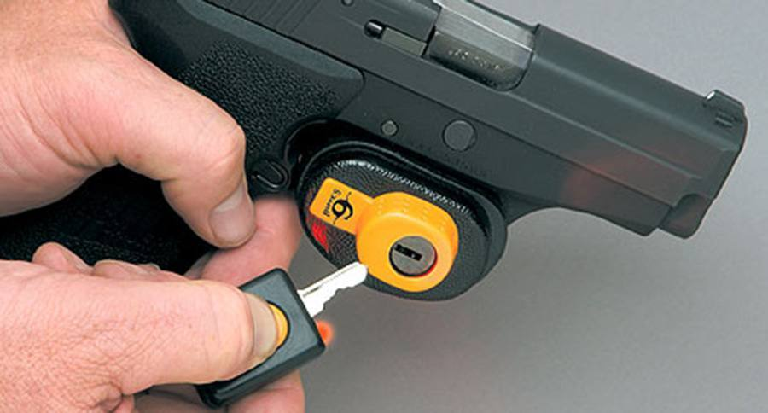
Safe Firearm Storage: Locking mechanisms
Keyed Locks
Notes:
Using TPI, discuss the pros & cons of each of the Locking Mechanisms.
Discuss the Pros & Cons of a keyed lock. Emphasize that they’re are more difficult to open under stress.

Slide 17
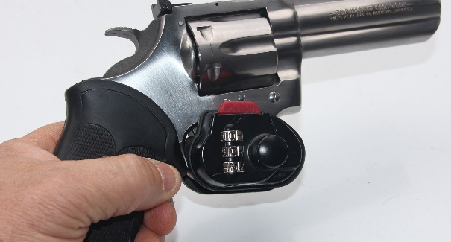
Safe Firearm Storage: Locking mechanisms
Combination Locks
Notes:
Using TPI, discuss the pros & cons of each of the Locking Mechanisms.
Discuss the Pros & Cons of a barrel combination lock. Emphasize that they’re are more difficult to open under stress.

Slide 18
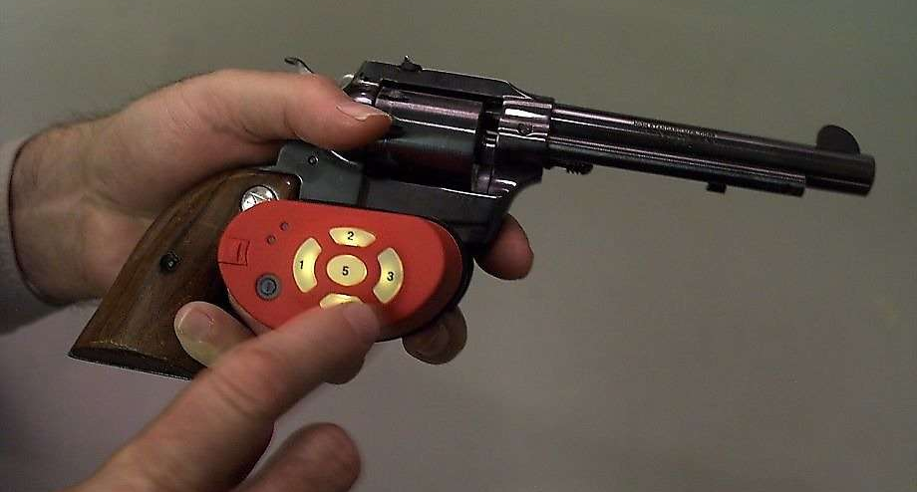
Safe Firearm Storage: Locking mechanisms
Simplex-type Locks
Notes:
Using TPI, discuss the pros & cons of each of the Locking Mechanisms.
Discuss the Pros & Cons of a combination key lock. Emphasize that they’re are less difficult to open under stress vs. a keyed lock.

Slide 19
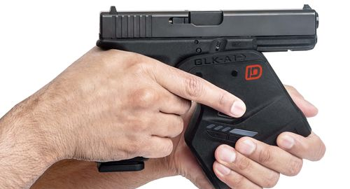
Safe Firearm Storage: Locking mechanisms
Finger pad Locks
Notes:
Using TPI, discuss the pros & cons of each of the Locking Mechanisms.
Discuss the Pros & Cons of a battery operated biometric lock.

Slide 20
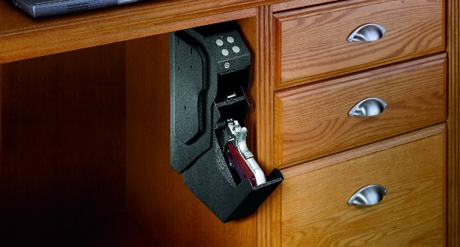
Safe Firearm Storage: Storage devices
Quick Access Devices
Notes:
Using TPI, discuss the pros & cons of each of the Storage Devices

Slide 21
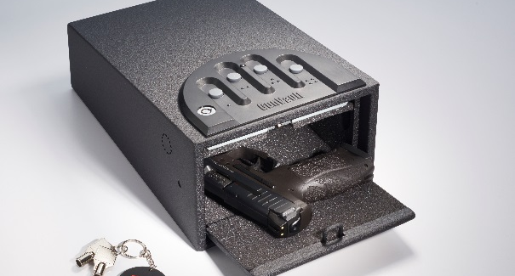
Safe Firearm Storage: Storage devices
Pistol Lockbox
Notes:
Using TPI, discuss the pros & cons of each of the Storage Devices

Slide 22
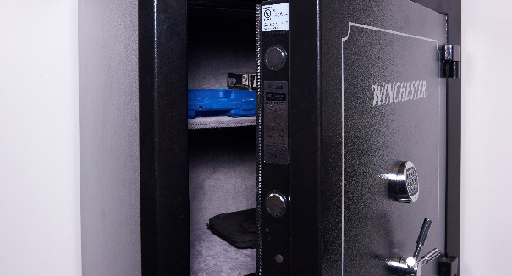
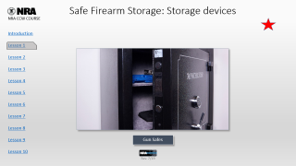

Safe Firearm Storage: Storage devices
Gun Safes
Notes:
Using TPI, discuss the pros & cons of each of the Storage Devices
NOTE: Emphasize that a gun safe is not viewed as a storage device for quick, quiet access.

Slide 23
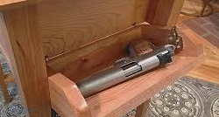
Safe Firearm Storage: Storage devices
Locking Drawers
Notes:
Using TPI, discuss the pros & cons of each of the Storage Devices
INSTRUCTOR NOTE: Discuss this picture from the perspective that it is a Locking Hidden Compartment built-into a piece of furniture. Explain the differences between this and a why a nightstand IS NOT a safe way to store a firearm.

Slide 24
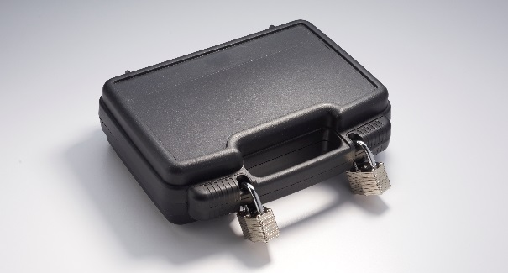
Safe Firearm Storage: Storage devices
Gun Cases
Notes:
Using TPI, discuss the pros & cons of each of the Storage Devices
NOTE: Gun cases should not be used for long-term storage/transportation unless they can be secured to a Hard Mounting Point.

Slide 25
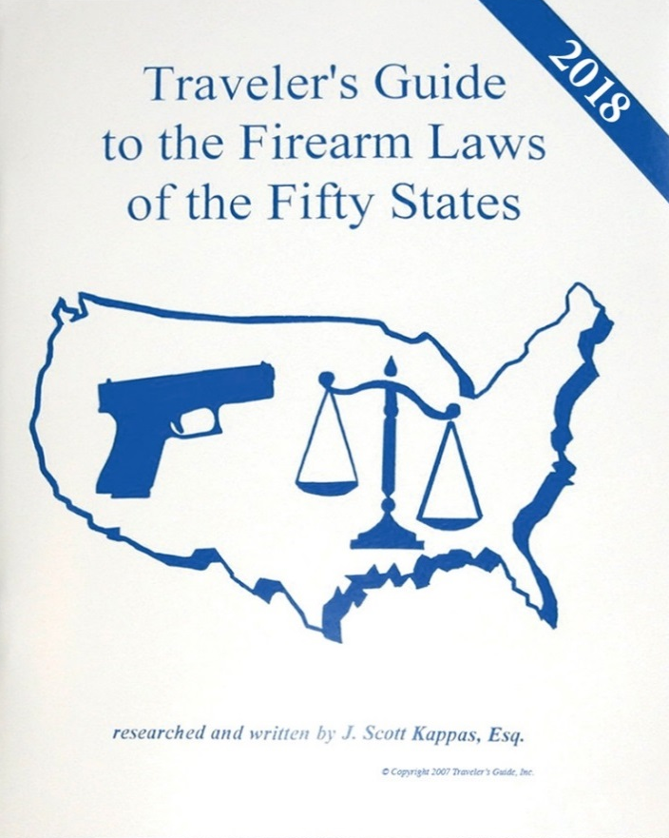
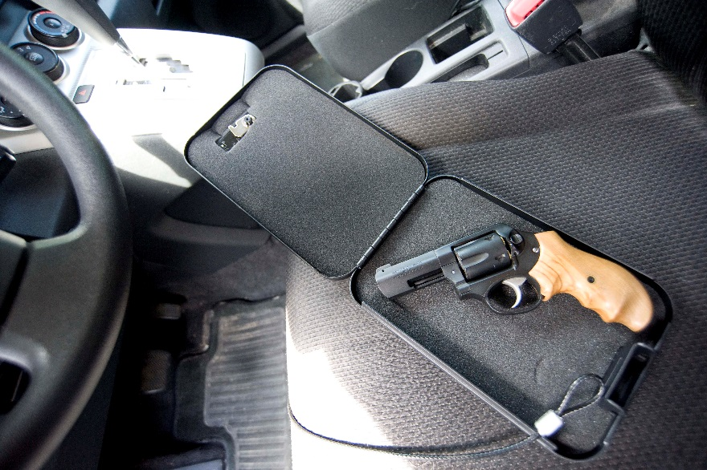
Safe Firearm Storage: Storage devices
Storing a gun outside the home
Under what conditions would this be necessary?
Vehicle storage
Travel planning
Notes:
Discuss with students alternatives for firearm storage & security outside of the home
Camping
Someone else's home
Hotel
Restaurant
School Grounds

Slide 26
Summary
Identify the main causes of firearm accidents.
How the three fundamental NRA rules for safe gun handling apply when carrying or using a concealed pistol.
How the NRA rules for using or storing a gun apply when carrying or using a concealed firearm.
The importance of carrying and using a pistol responsibly and ethically.
Special safety considerations that must be observed when carrying or using a concealed pistol.
Techniques for storing a pistol safely.

Slide 27
What Are Your Questions?

Slide 28
NRA CCW
Lesson 2:
Pistol Nomenclature and Selecting a Pistol for Self-Defense
No Live Ammunition in the Classroom

Slide 29
Lesson 2 – Pistol Nomenclature and Selecting a Pistol for Self-Defense
Learning Objectives:
Identify the two main types of pistols.
Identify the main components of a pistol.
Identify the criteria for selecting a pistol suited to their individual self-defense needs.
Notes:
Using Total Participant Involvement (TPI) have the students describe the learning objectives.

Slide 30
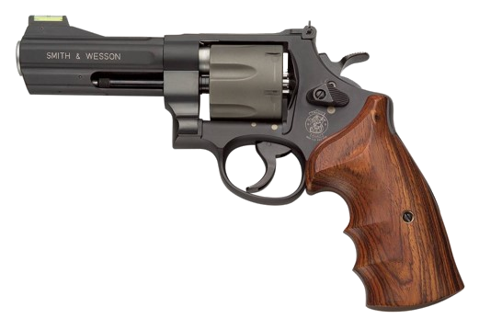
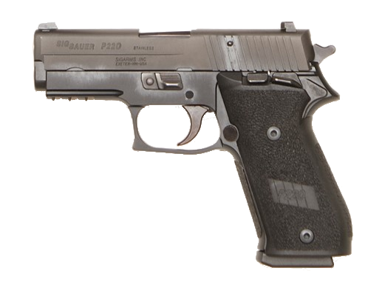
Main Pistol Action Types
Double-Action Revolver
Semi-Automatic Pistol
Notes:
Explain that the two most common pistol types that will be discussed in this course are:
Semi-automatic pistol
Double-action revolver

Slide 31
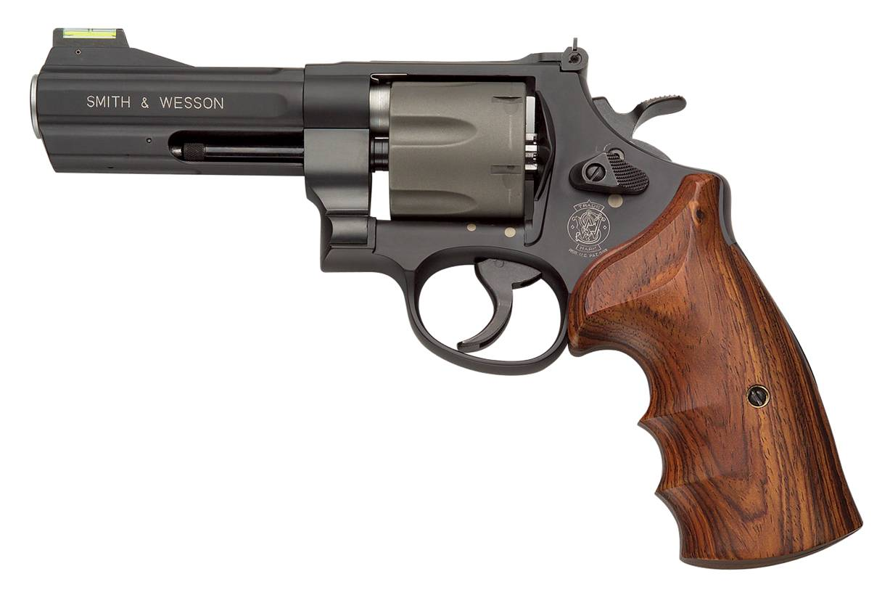
Double Action Revolver
Action
(Contained within frame)
Barrel
Frame
29
Notes:
NOTE: When using an actual gun in a demonstration, verify that it is unloaded, have a student perform a secondary verification that it is unloaded, and ensure that it is pointed in a safe direction at all times.
Point out and describe the functions of the revolver & the frame components:
Barrel
Frame
Action (Contained within the frame)
The frame is the backbone to which all other parts are attached.

Slide 32
Double Action Revolver
Front Sight
Rear Site
Hammer & Hammer Spur
Cylinder
Cylinder Release Latch
Ejector Rod
Backstrap
Trigger
Grip panels
Trigger guard
Front strap
Notes:
NOTE: When using an actual gun in a demonstration, verify that it is unloaded, have a student perform a secondary verification that it is unloaded, and ensure that it is pointed in a safe direction at all times.
Define a Double Action revolver for the students:
In a double-action revolver, the trigger performs two tasks: it both cocks and releases the hammer. Most double-action revolvers can also be fired in the single-action mode by manually cocking the hammer with the thumb. The revolver is a pistol that has a rotating cylinder containing a number of firing chambers.
Explain that a revolver consists of three main parts: the frame, the barrel, and the action.
The action of the trigger or hammer will line up a chamber with the barrel and firing pin.
The frame is the backbone to which all other parts are attached.
Point out and describe the functions of the revolver & the frame components:
Barrel
Ejector Rod
Cylinder
Rear Sight & Front Sight
Hammer Spur
Cylinder Release Catch
Trigger Guard
Back Strap & Front Strap
Grip Panels

Slide 33
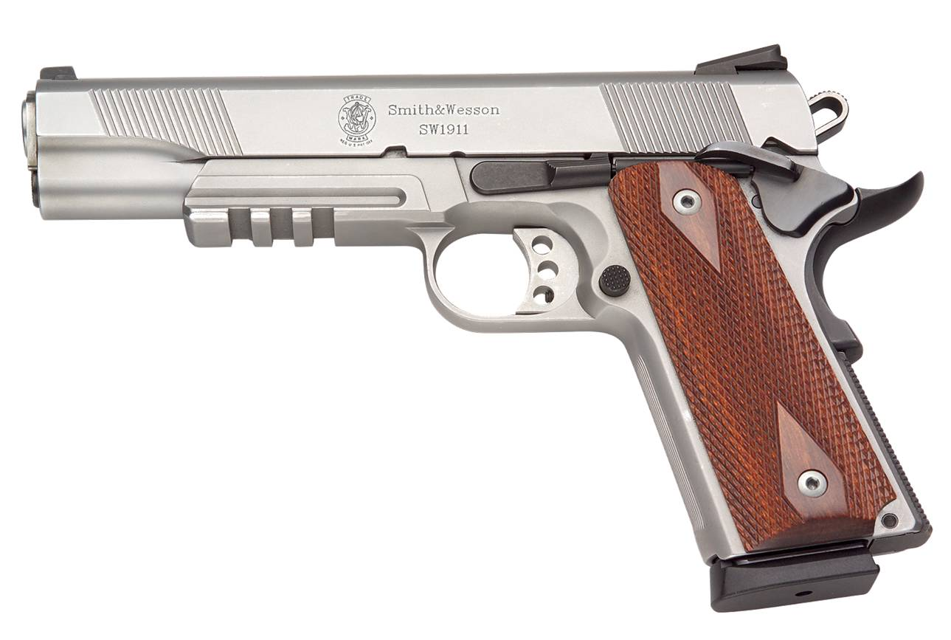
Semi-Automatic Pistol
Action
(Slide and parts within frame)
Rear Sight
Barrel
Safety
Frame
Backstrap
Trigger guard
Front strap
Grip panels
31
Notes:
NOTE: When using an actual gun in a demonstration, verify that it is unloaded, have a student perform a secondary verification that it is unloaded, and ensure that it is pointed in a safe direction at all times.
There are a number of types of semi-automatic pistol actions:
Single-action (each press of the trigger only performs one function—releasing the cocked hammer; the hammer must be manually cocked for the first shot)
Traditional Double-action (the initial long, heavy trigger press both cocks and releases the hammer; each subsequent shot is fired in the single-action mode)
Double-action-only (each trigger press both cocks and releases the hammer, as with a double-action revolver)
Define a semi-automatic pistol for the students & its Action:
A semi-automatic pistol is a firearm that, each time the trigger is pressed, fires a single cartridge, automatically extracts and ejects the empty case, and inserts a new cartridge into the chamber.
A semi-automatic pistol, like a revolver, consists of three main parts: the Frame, the Barrel, and the Action.
The Action is a group of moving parts used to load, fire and unload a pistol.
Point out and describe the functions of the semi-automatic & the components:
Frame
Barrel
Rear Sight & Front Sight
Trigger Guard
Back Strap & Front Strap
Grip Panels
*INSTRUCTOR NOTE: Stress that “Safeties are mechanical devices and can fail. Always follow the Fundamental Rules for Safe Gun Handling.”
TPI the 3 Fundamentals with the students.

Slide 34
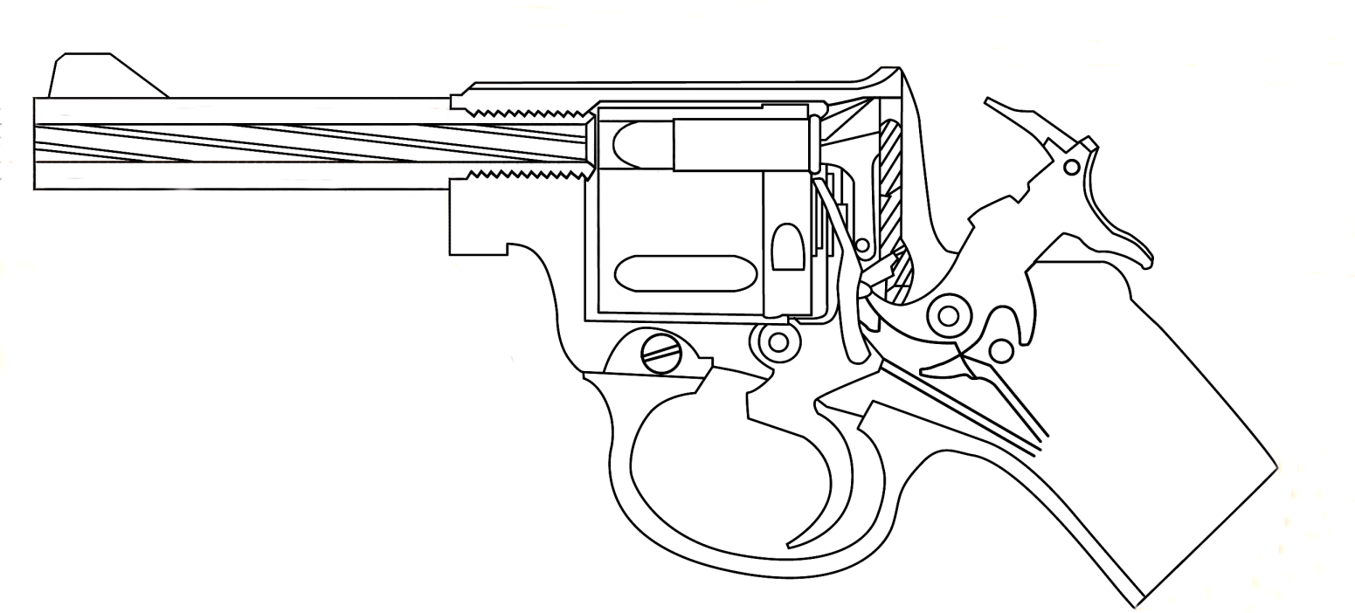
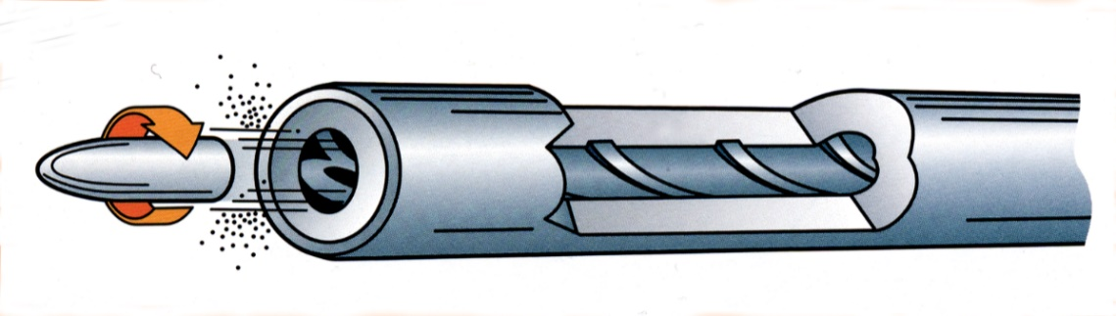
Parts of a Barrel
Chamber
(in cylinder, with cartridge)
Rifling (lands & grooves)
Rifling
Spiraling lands and grooves that engrave the bullet and give it spin as it travels through the bore.
Muzzle
Land
Groove
Groove
Land
31
Notes:
NOTE: When using an actual gun in a demonstration, verify that it is unloaded, have a student perform a secondary verification that it is unloaded, and ensure that it is pointed in a safe direction at all times.
The barrel is the metal tube through which the bullet passes.
Point out and describe the functions of the following pistol barrel parts or characteristics:
Bore (the hole inside the barrel)
Chamber (unlike the revolver, the semi-automatic pistol has a single chamber, located at the rear of the barrel. The chamber holds the cartridge at the instant of firing)
Rifling (the spiral lands and groves cut into the bore. Rifling imparts a spin to the bullet, which stabilizes its flight)
Know to Unknown here; Like throwing a football
Muzzle (the front end of the barrel where the bullet exits)
Front sight (used with the rear sight in aiming; mounted on the end of the barrel or slide)
Locking lugs/locking surfaces (in locked-breech actions, areas of the barrel that lock it to the slide)
Caliber (the diameter of the bore, measured across the lands or, sometimes, across the grooves, in decimal fractions of an in or in millimeters)

Slide 35
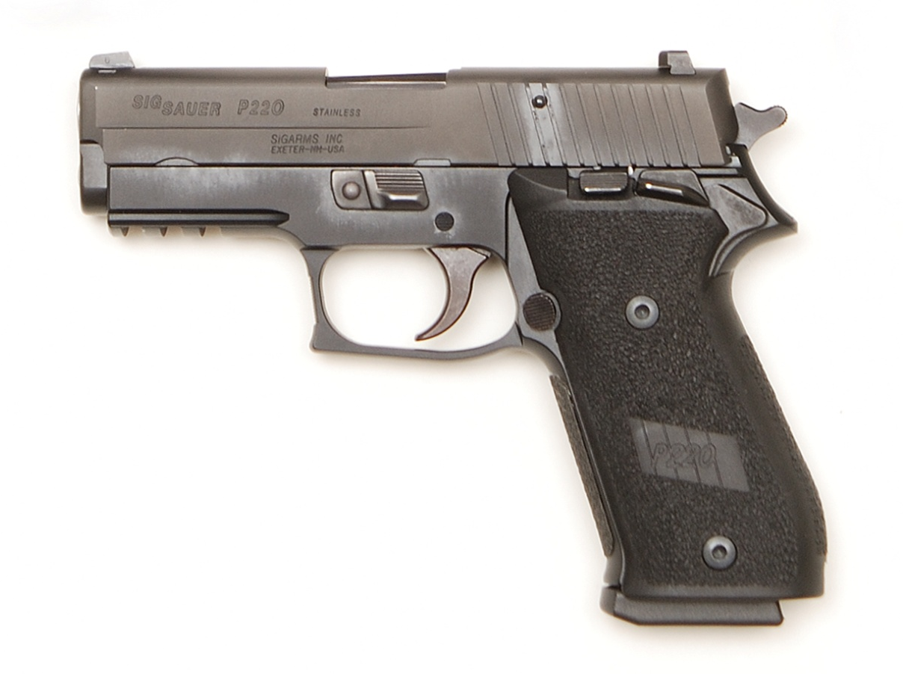
Semi-Automatic Pistol Action Parts
Slide
Takedown lever
Slide stop
Hammer
Hammer spur
Safety
Trigger
Magazine release
Magazine
31,34
Notes:
NOTE: When using an actual gun in a demonstration, verify that it is unloaded, have a student perform a secondary verification that it is unloaded, and ensure that it is pointed in a safe direction at all times.
The action is a group of moving parts used to load, fire and unload a pistol.
Point out and describe the functions of the following semi-automatic pistol action parts:
Slide: (a component that slides on rails in the frame. Upon firing, the slide moves to the rear, and is returned forward to close the breech by pressure from the recoil spring. Some slides enclose the barrel, while others are located at the rear of the barrel.)
The slide has three primary functions:
It extracts the cartridge case from the chamber and ejects it from the pistol
It cocks the hammer or firing pin (in most models)
It moves the top cartridge from the magazine into the chamber
Takedown Lever: a lever or other device on the frame that, when activated, allows the slide and barrel to be separated from the frame
Slide Stop: A lever on the frame that, when engaged, holds the slide rearward, and when disengaged, allows the slide to move forward
Hammer: Causes the firing pin to strike and fire the cartridge
Hammer Spur: The projection on the hammer that may be gripped by the thumb
Trigger: When pressed it activates the hammer
Safety: A mechanical device designed to prevent firing of the handgun, and thus helps reduce the chance of an unintentional discharge—sometimes mounted on the frame Remember—Mechanical devices can fail!
Magazine release: Aa button, lever or catch that releases the magazine so that it can be removed from the pistol
Magazine: A detachable storage device designed to hold cartridges ready for insertion into the chamber
Slide: (a component that slides on rails in the frame. Upon firing, the slide moves to the rear, and is returned forward to close the breech by pressure from the recoil spring. Some slides enclose the barrel, while others are located at the rear of the barrel.)

Slide 36
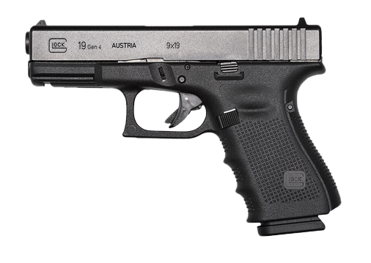
Semi-Automatic Pistol Action Parts
Front Sight
Slide
Rear Sight
Slide Lock
Slide Stop
Trigger
Trigger Safety
Magazine release
Magazine
Notes:
NOTE: When using an actual gun in a demonstration, verify that it is unloaded, have a student perform a secondary verification that it is unloaded, and ensure that it is pointed in a safe direction at all times.
Some semi-automatic pistols do not have a visible or external hammer, and are often referred to as hammerless, even though there may be an internal hammer or striker.
Using Total Participant Involvement (TPI) have the students identify the parts on this pistol.
Explain that the Slide Lock & The Takedown Level are the same, just perform and are utilized differently

Slide 37
Factors for Selecting a Pistol
Revolver or Semi-automatic
Fit
Size
Weight
Caliber
largest you can shoot confidently & effectively
Functional Reliability
Notes:
Size of the pistol is not limited to just how big it is, relative to the hand holding it.
Firearm Controls placement should also be taken into account.

Slide 38
Factors for Selecting a Pistol
Other Factors to Consider
Sights
Action type – Double Action Revolver vs. Semi-Auto
Ammunition Capacity
Finish/materials
Manufacturer’s reputation
Availability of parts, service and aftermarket accessories
New vs. Used
Modifications and enhancements

Slide 39
Summary
Identify the two main types of pistols.
Identify the main components of a pistol.
Identify the criteria for selecting a pistol suited to their individual self-defense needs.

Slide 40
What Are Your Questions?

Slide 41
NRA CCW
Lesson 3:
Ammunition Knowledge and Defensive Ammunition Selection
No Live Ammunition in the Classroom

Slide 42
Lesson 3 – Ammunition Knowledge and Defensive Ammunition Selection
Learning Objectives:
Identify the main components of a pistol cartridge.
Identify how to properly store ammunition.
Identify the major types of pistol ammunition.
Identify the difference between practice ammunition and defensive ammunition.
Identify additional accessories for concealed carry.

Slide 43
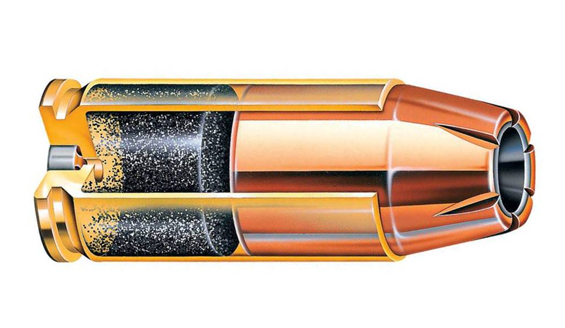
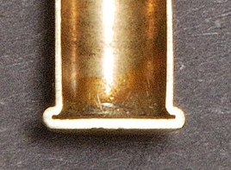
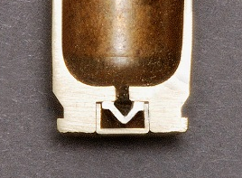
Components of a Pistol Cartridge
Powder charge
Bullet
Rimfire cartridge
Priming compound is contained in the inside of the rim of the case head
Primer (Contains
Priming compound)
Case
Centerfire cartridge
Priming compound is contained in a metal cup, called a primer, in the center of the case head
71
Notes:
p.59 BoPS
A cartridge has four components:
Case – A metal cylinder usually made of brass, closed at one end, which contains the other three components.
Priming compound – An impact-sensitive chemical compound used for ignition.
Powder charge – A fast-burning chemical compound used as a propellant.
Bullet – The projectile.
Explain the difference between a rim-fire and a center-fire cartridge.
In a rim-fire cartridge, the priming compound is contained in the inside rim of the case head.
In a center-fire cartridge, the priming compound is contained in a metal cup, called a primer, located in the center of the case head.

Slide 44
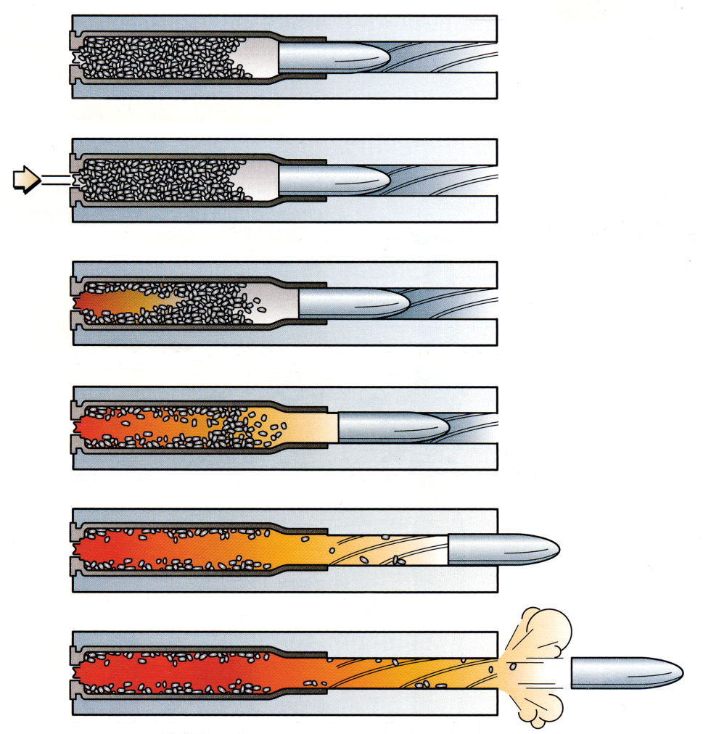
Firing Sequence of a Cartridge
Cartridge in chamber
Firing pin strikes primer or case rim and ignites the priming compound
Flame generated by priming compound ignites powder charge
Powder burns rapidly, generating a volume of hot, high-pressure gas
Gas pushes bullet through bore at high speed
Bullet exits muzzle, hot gas makes “bang”
Notes:
Explain the firing sequence of a cartridge:
Cartridge in chamber
The firing pin strikes the primer or case rim and ignites the priming compound.
The flame generated by the priming compound ignites the powder charge.
The powder burns rapidly and generates a large volume of hot, high-pressure gas.
The high-pressure gas propels the bullet out of the barrel at a high velocity.
Bullet exits muzzle, hot gas makes “bang”

Slide 45
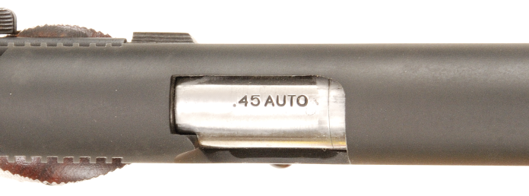
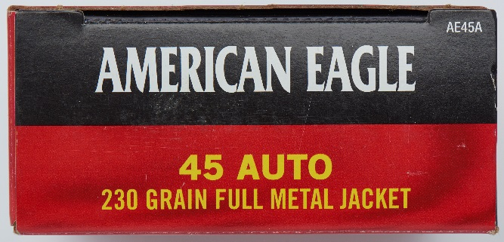
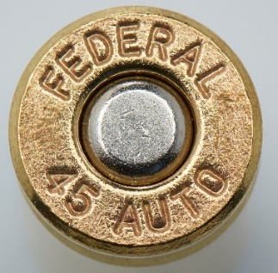
Cartridge Designation and Identification
Proper cartridge identification is necessary to ensure the correct ammunition is loaded into the pistol.
The cartridge designation is:
Marked on the Pistol
Printed on the factory ammunition box
Stamped on the head of the cartridge
Some cartridges have more than one designation, such as 9 mm para/9 mm luger/9x19 mm, and 45 auto/45 ACP.
+P or +P+ ammunition, can you use it?
Notes:
The shooter must know how to identify a cartridge to load the proper cartridge in the pistol.
The shooter should match the cartridge designations:
Marked on the pistol
Stamped on the head of the case of a center-fire cartridge (called the headstamp)
Printed on the factory ammunition box.
ASK STUDENTS: Where else would you find the caliber the pistol is chambered in? (Answer: Owner’s Manual)
Show the students the cartridge designation on a pistol, on the head of a fired case, and printed on an empty ammunition box.
Some cartridges may have more than one name (e.g. 9 mm Para, 9 mm Luger, and 9 x 19 are all the same cartridge.) Sometimes one name may be found on the gun and another on the cartridge headstamp.
*SAFETY NOTE: Discuss the safety issues with ensuring the students know whether or not +P or +P+ ammunition can be used in their pistol.

Slide 46
Storing Ammunition
Ammunition should be stored in a cool, dry place.
Avoid storage in a high-temperature location, such an attic or trunk of a car.
Always use the original factory packaging.
Keep ammunition away from children or other unauthorized persons.
Do not expose to water, solvents, petroleum products, bore cleaner, ammonia or other chemicals.
Wipe fingerprints off cartridges.
Notes:
Explain the following regarding the proper storage of ammunition:
Ammunition should be stored in a cool, dry place.
Avoid storage in a high-temperature location such as an attic or trunk of a car.
Always keep the ammunition in the original factory box carton.
Ask: Why is this important?
Store ammunition in a location where children or other unauthorized persons will not have access to it.
Do not expose ammunition to water, solvents, petroleum products, bore cleaner, ammonia or other chemicals. These materials can cause deterioration of the powder and priming compound, resulting in a cartridge malfunction.
Wipe fingerprints off cartridges. The salty residue may cause corrosion.

Slide 47
Ammunition for Self Defense
What is the minimum adequate caliber for personal protection?
Know the difference between “+P” or “+P+”
Due to the increased recoil, muzzle blast, and penetration, magnums are not generally recommended for defensive use, by those sensitive to recoil, or in densely populated areas.
What are reasons for testing self defense ammunition in your firearm?
Notes:
ASK: What do you think is the minimum adequate caliber to use for personal protection?
Briefly discuss responses.
Again, the minimum recommendation for a self-defense caliber is .38 Special for revolvers and 9mm Parabellum for semi-automatics.
People who opt, for one reason or another, to use a .22, .25, .32 or .380 should not feel that these handguns are not useful for defense, however. Many people have successfully defended themselves with small-caliber firearms.
Briefly define and discuss the use of +P, +P+, and magnum ammunition and the importance of not putting this ammunition in a pistol not rated for it.
Ask the students what are some reasons they should test Self Defense ammunition. A: To ensure the firearm operates with the ammunition selected. (Maybe there will be Light Strikes on the primer? Failure to feed issues?)

Slide 48
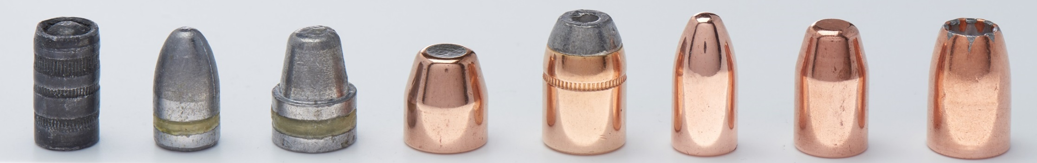
Bullet Types
Wadcutter
Lead round nose
Semi-wadcutter
Jacketed soft-point
Jacketed hollow-point
Full metal jacket
Frangible projectile
Hollow-point
Premium defensive ammunition
Notes:
Review each of the bullet types

Slide 49
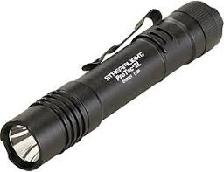
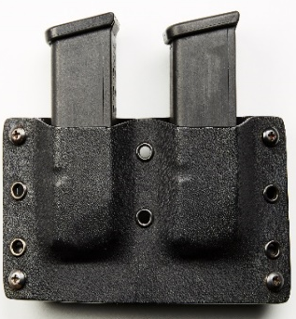
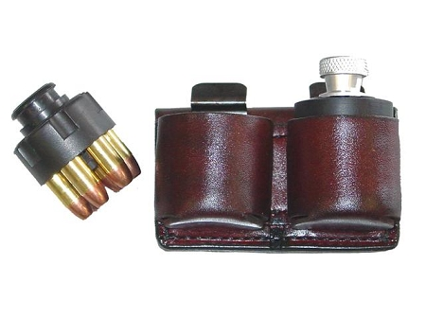

Accessories
Flashlight
Spare batteries and bulbs
Extra Loading Devices
Magazines for Semi-automatic Pistols
Speed Loaders for Revolvers
Cell Phone
Notes:
A bright flashlight. A high-intensity light (such as a Sure Fire® or Streamlight®) is desirable.
Regularly check batteries and bulbs, and keep spares on hand.
Keep spare batteries on hand in the home and vehicle(s)
Ask: what are the advantages of having a flashlight?
You may want to have one or more extra magazines/Speed Loaders.
*NOTE: Most malfunctions of semi-automatic pistols are linked to a problem with the magazine.
Rotate spare magazines / Speed Loaders and ensure proper functionality.
Mark the magazines to better determine which may be having a recurring malfunction. Be sure the speed loader is designed specifically for your model revolver.
Practice using spare magazine and speed loaders on a regular basis.
Cellular phones are a necessity for anyone carrying a gun. A phone gives you the option of summoning the police while avoiding a confrontation and being a good witness.
If a self-defense encounter does occur, it is highly desirable that you be the one to call the police.
ASK: Why do you think that is the case to be the one to call first?

Slide 50
Summary
Identify the main components of a pistol cartridge.
Identify how to properly store ammunition.
Identify the major types of pistol ammunition.
Identify the difference between practice ammunition and defensive ammunition.
Identify additional accessories for concealed carry.

Slide 51
What Are Your Questions?
Notes:
**GIVE STUDENTS A SHORT BREAK**

Slide 52
NRA CCW
Lesson 4:
Basic Defensive Pistol Skills
No Live Ammunition in the Classroom

Slide 53
Lesson 4 – Basic Defensive Pistol Skills
Learning Objectives:
Identify the Fundamentals of Marksmanship.
Identify Elements of a Good Shooting Position and explain how they can change in a defensive encounter.
Explain and demonstrate the fundamentals of defensive marksmanship.
Explain defensive accuracy.
Explain the differences between cover and concealment, and identify examples of each.

Slide 54
Fundamentals of Marksmanship
Aiming
Sight Alignment
Sight Picture
Breath Control
Hold Control
Trigger Control
Follow Through
Notes:
Discuss proper sight alignment.
Sight alignment refers to the proper relationship of the shooting eye, the rear sight and the front sight.
Discuss sight picture.
Sight picture is simply placing the aligned sights on the target. For defensive shooting, place the sights on the assailant where you want the bullet to hit. You should aim for the center of exposed mass of the exposed target.
Because of the stress induced by a defensive encounter and the speed at which it occurs, conscious control over refined breathing techniques is not possible.
The objective of hold control is to hold your body as still as possible while firing the shot. The first step in minimizing movement is to assume a well—balanced, stable shooting position naturally aligned with the target.
Briefly review trigger control.
Finger Placement
Trigger Movement
Briefly review follow-through.
ASK: What do you think Follow-Through is ?
Proper follow-through means maintaining the actions of aiming, breath control, hold control, and trigger control until the pistol settles back on the target, which will set you up for the next shot.
Developing proper follow-through is important since it is likely that multiple shots will be fired in a defensive encounter.

Slide 55
Elements of a Good Shooting Position
Consistency:
stance, grip, and muscle tension
Balance:
Keep your head level
Feet comfortable distance apart
Support:
Natural
Artificial
Natural Aiming Area (NAA)
Comfort
Notes:
Consistency is the most important element in shooting. To be consistent in your shooting, you need to be consistent in everything you do related to your position, including stance, grip, and muscle tension.
With Balance, you must keep your head level to reduce body movement. The brain controls balance by signals that are sent from the inner ear. Therefore, the movement of your head and body or the position of your head or body will probably affect your balance
Support can be natural or artificial.
Natural support is made up of your bones and muscles.
Artificial support includes such items as a bed, wall, or chair.
Bone support provides a great deal of steadiness when used properly. When used in conjunction with artificial support, such as a rest, movement is virtually eliminated.
Muscle support is extremely important. When properly prepared through training, muscles become steadier and do not fatigue quickly.
The more support you have, and the better your support is, the steadier you will be when you are shooting.
Natura Aiming Area is the element that makes hitting your target easier. When NAA is achieved, there is no conscious effort to aim or point to the center of the target.
Being comfortable allows you to focus on the fundamentals of shooting. Some shooting positions may be unfamiliar and uncomfortable when you first try them. With time, your muscles will stretch and strengthen as you practice the positions. If you experience abnormal pain in any position, stop shooting and raise your non-shooting hand for assistance in assuming and shooting from that position.

Slide 56
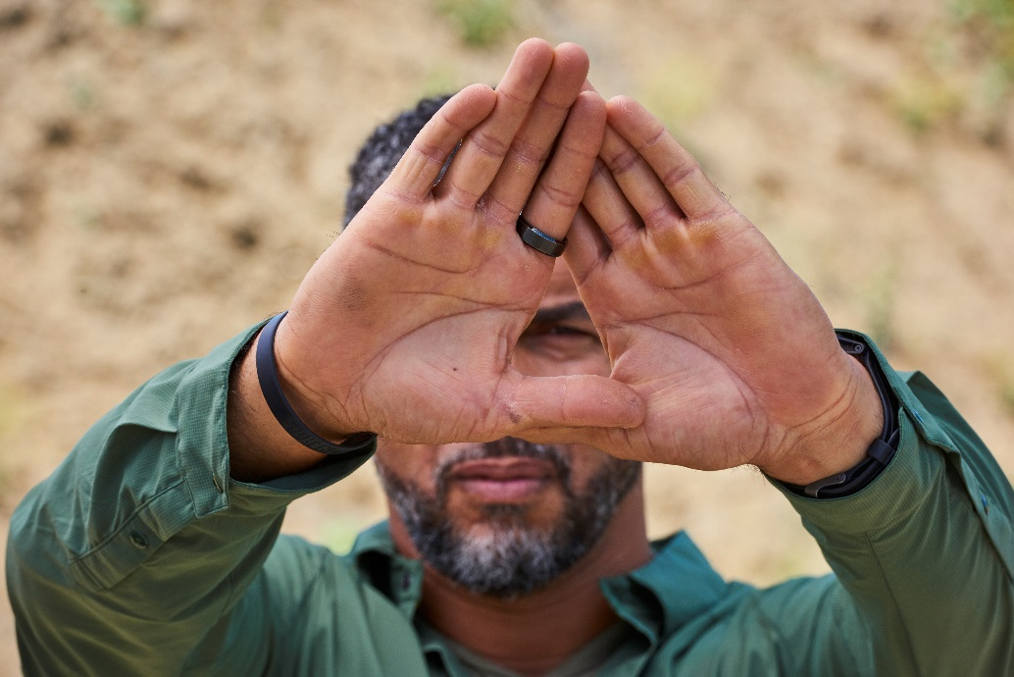
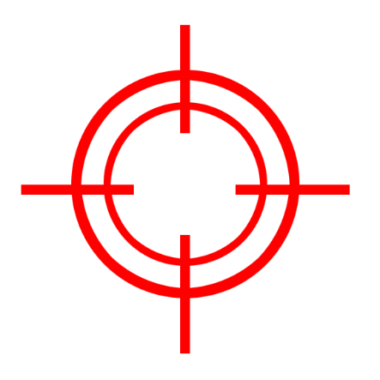
Fundamentals of Defensive Marksmanship
Eye Dominance – Practical Exercise
Notes:
Ask students Why it’s important to know which eye is dominant? A: So you know which eye to bring the sights to.
*** Demonstrate the steps of determining eye dominance before the exercise ***
Ask students to determine their dominant by following the process below. (Students may use the Targets on the slide to focus on)
First, focus on a distant object with both eyes open.
Then extend the arms forward with the hands brought together to form a hole between the thumbs, and look at the object through this hole.
Bring the hands close to the face, still observing the object.
When the hands are just a few inches from the face, the hole between the hands will be directly in front of the dominant eye.

Slide 57
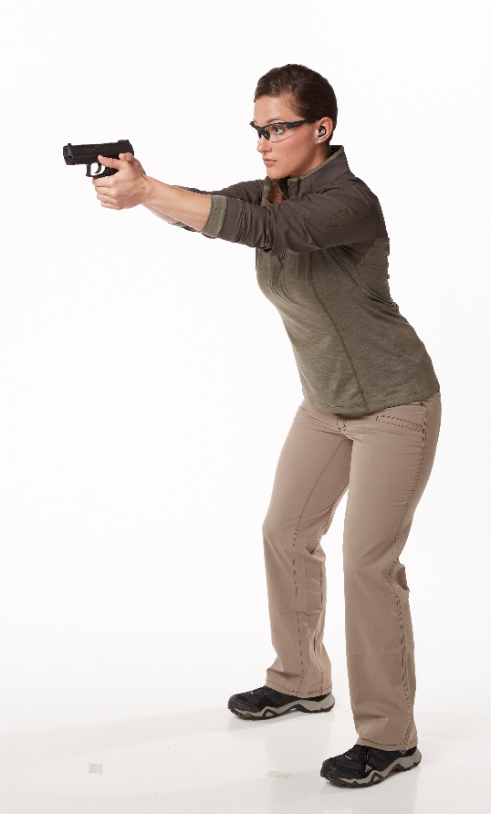
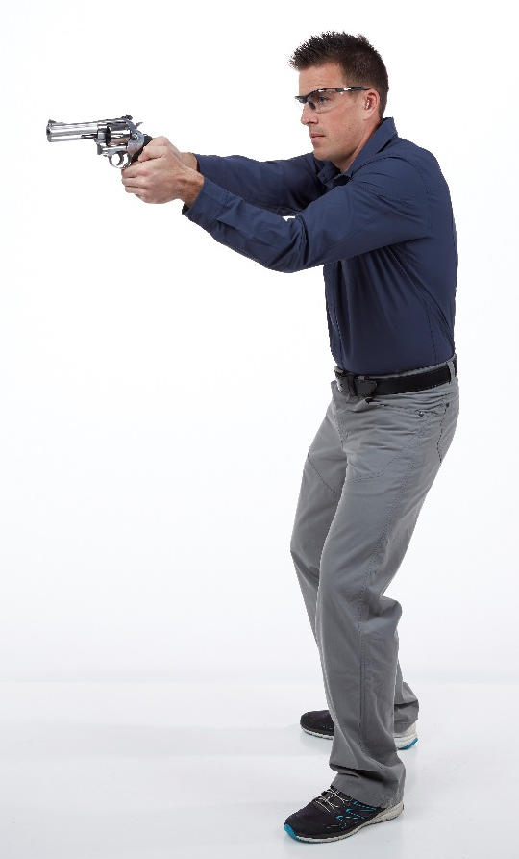
Fundamentals of Defensive Marksmanship
Two Handed Standing Position – Practical Exercise
Grip
Stance
Notes:
The two-handed standing shooting position is one of the positions taught in this course. Explain and demonstrate this position. Point out that the two-handed shooting position is assumed by simply standing with both arms extended fully forward and the feet evenly spaced.
Explain that this shooting position is commonly referred to as the isosceles position, because the arms, if viewed from above, would form an isosceles triangle. However there are other two-handed standing shooting positions such as the Weaver. Demonstrate each of these positions.
Grip refers to the manner in which the pistol is held in the hand. A proper and consistent grip is essential to accurate shooting. Together, grip and position are the foundations that allow proper execution of the shooting fundamentals. A two-handed grip is taught in this course.

Slide 58
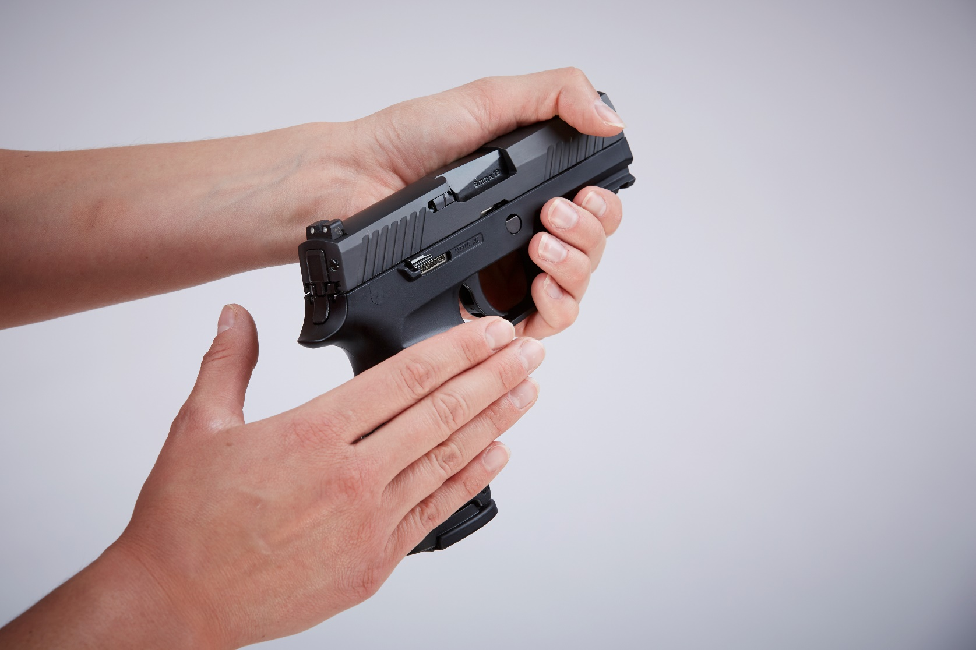
Fundamentals of Defensive Marksmanship
Notes:
While keeping the gun pointed in a safe direction, and with the finger off the trigger, use the non-shooting or support hand to place the pistol in the shooting hand.

Slide 59
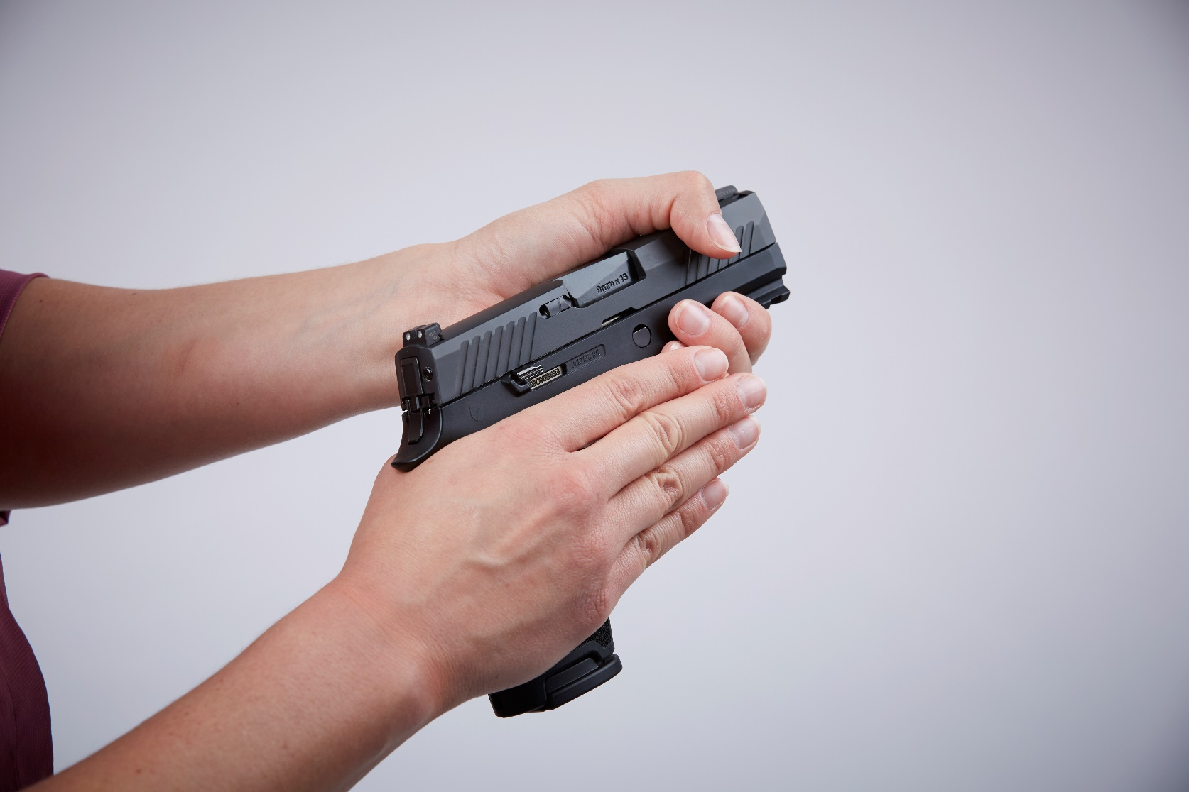
Fundamentals of Defensive Marksmanship
Notes:
Fit the “V” formed by the thumb and index finger of the shooting hand as high as possible on the pistol back strap.
**NOTE**
Point out that there should be little to no gap.

Slide 60
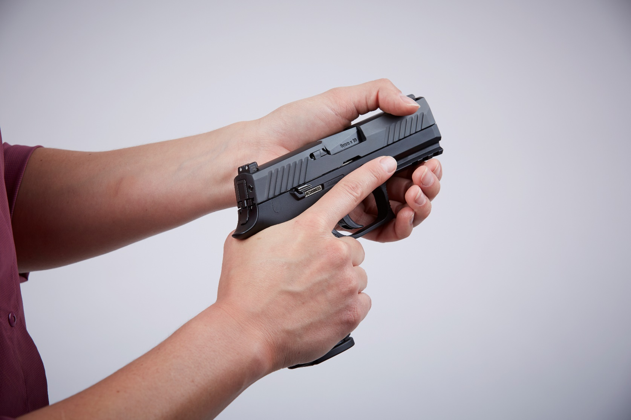
Fundamentals of Defensive Marksmanship
Notes:
Keep your finger off the trigger. It should rest along the side of the frame, outside of the trigger guard.

Slide 61
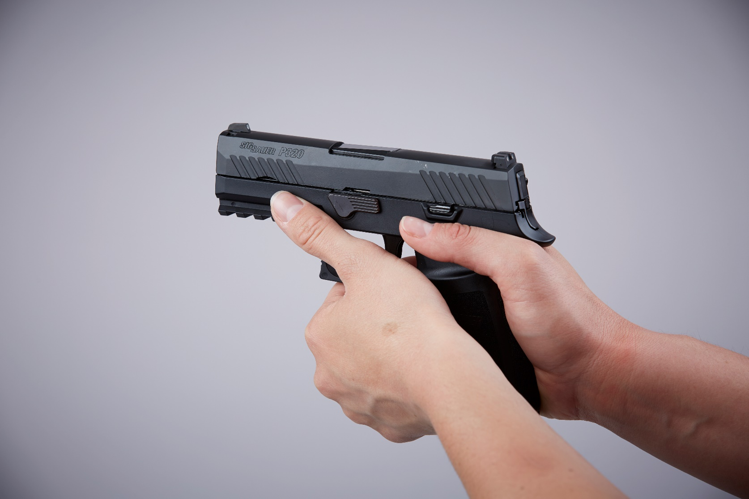
Fundamentals of Defensive Marksmanship
Notes:
The thumb should lie relaxed on the other side of the frame.

Slide 62
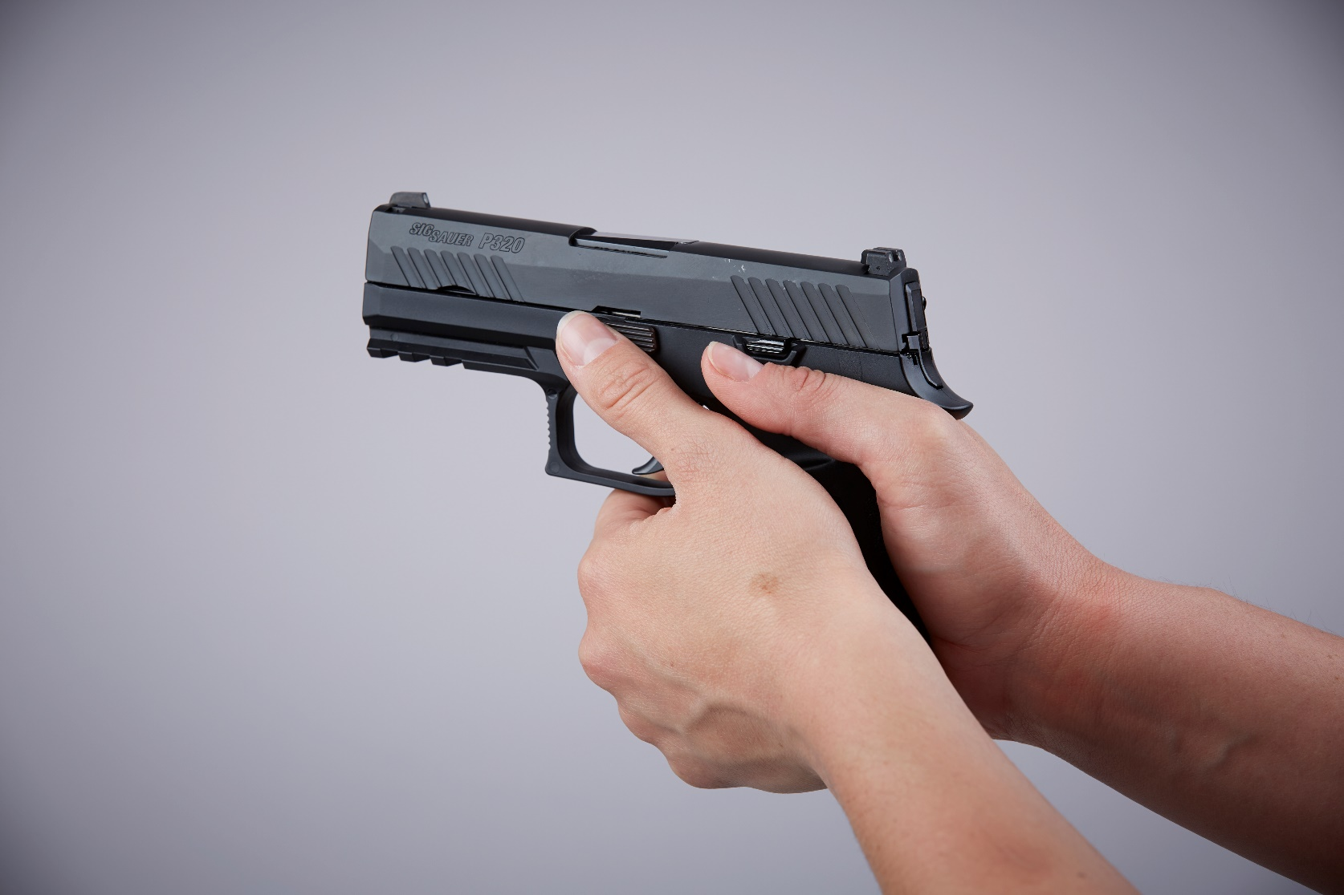
Fundamentals of Defensive Marksmanship
Notes:
Wrap the fingers of the support hand around the fingers of the shooting hand such that the corresponding knuckles of both hands meet.
Place the heel of the support hand against the heel of the shooting hand.
With a revolver, place the thumb of the support hand on the thumb of the shooting hand.

Slide 63
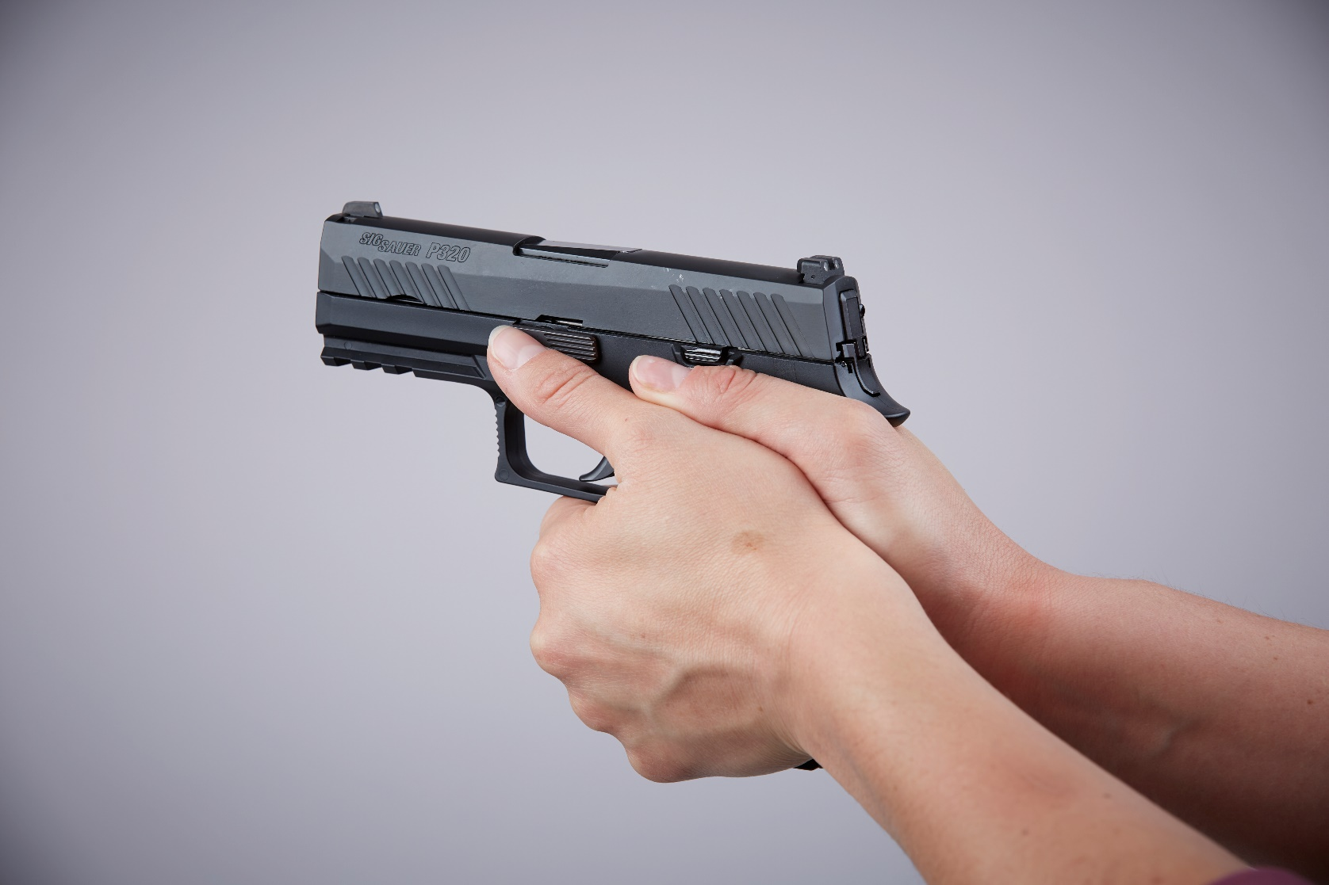
Fundamentals of Defensive Marksmanship
Notes:
With a semi-automatic pistol, place the support-hand thumb forward of and below the shooting-hand thumb.

Slide 64
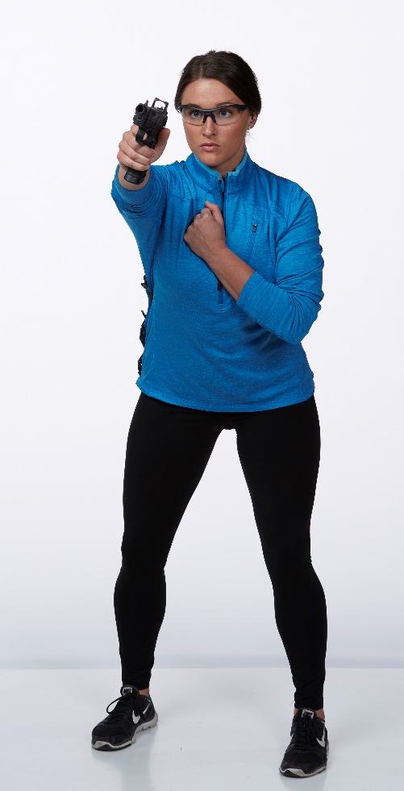
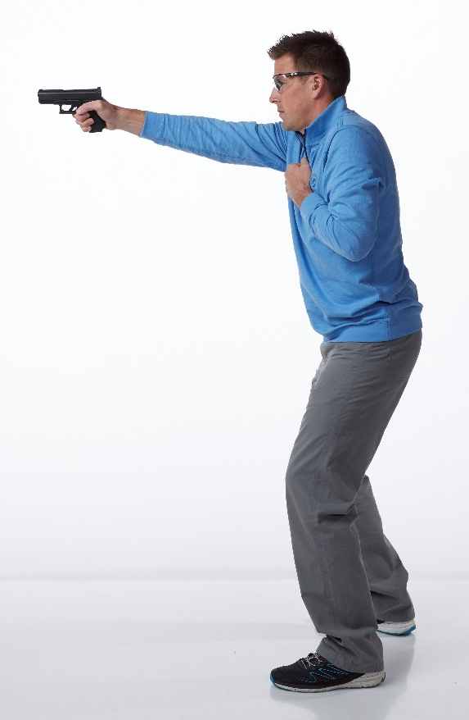
Fundamentals of Defensive Marksmanship
One Handed Shooting – Practical Exercise
Grip
Stance
Notes:
INSTRUCTOR: Demonstrate the proper one-handed grip and the one-handed standing position.
Ensure that the support hand is placed flat against the chest.
Demonstrate that the gun can be rotated (canted) slightly
Show that the stance has not changed from the two-handed position.
Have students focus on attaining a proper body position before adding the pistol.
Check for the following:
Feet shoulder-width apart with body weight evenly distributed
Body and head comfortably erect
Proper one-handed grip
Shooting arm fully extended
Non-shooting hand flat against chest
Pistol raised to eye level
Shooter relaxed and comfortable

Slide 65
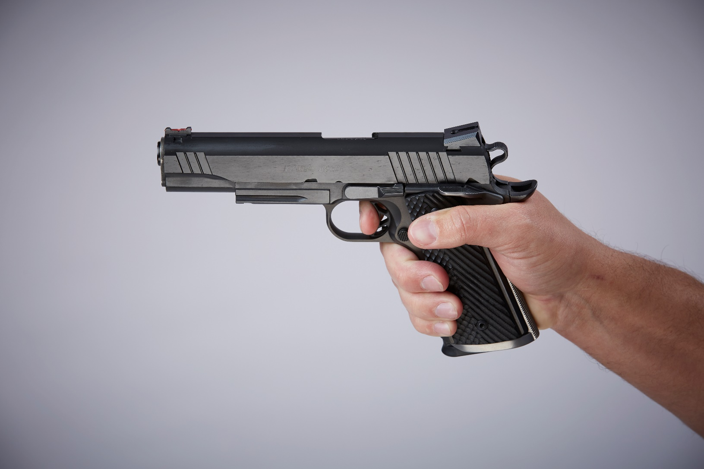
Fundamentals of Defensive Marksmanship

Slide 66
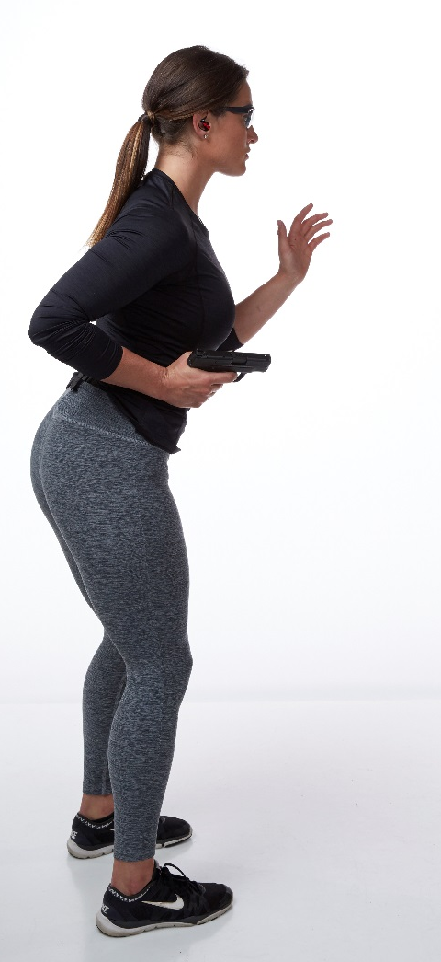
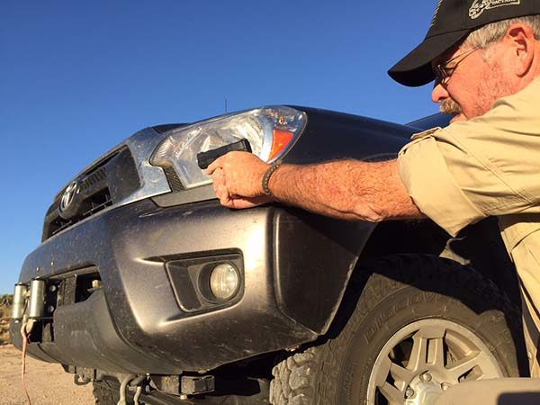
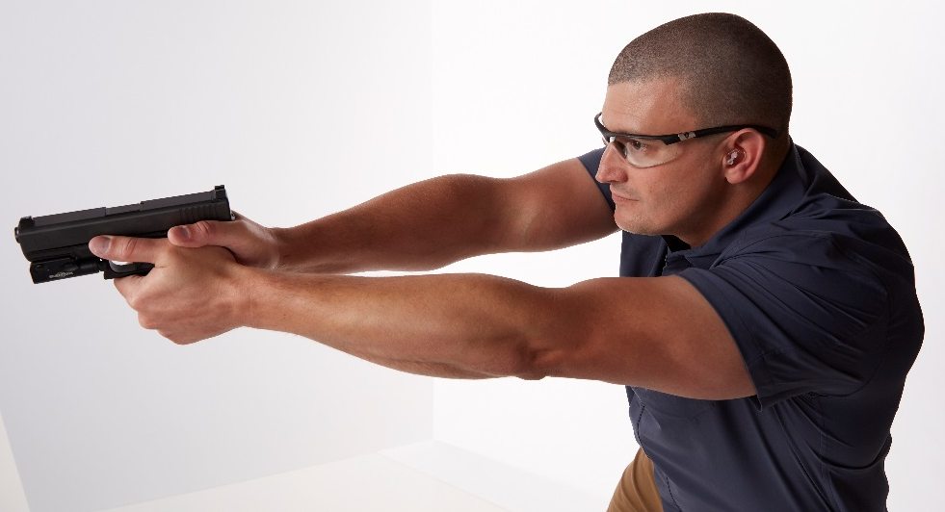
Fundamentals of Defensive Marksmanship
Changes during a defensive encounter
Grip
Stance
Safety
Notes:
ASK:
How would grip change during a defensive encounter? A: Carrying item(s) in your arms; Carrying a child…
How would stance change during a defensive encounter? A: Shooting from behind cover, like a parking garage pillar; Kneeling to get lower behind cover
NOTE: Additional safety risks/concerns are introduced when shooting other than from standing. (Bad knees, children in tow)

Slide 67
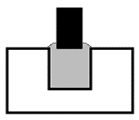
Defensive Accuracy
Larger groups
Balance speed with accuracy
Aim at the center of mass
Flash sight picture
Imperfect alignment
Quick acquisition
Rapid engagement
Distance equals time
Sequence & Cadence
Fig. 1
Fig. 3
Fig. 2
Fig. 4
Notes:
Larger Groups:
For self-defense purposes, a nine-inch group (which is the diameter of a standard paper plate) covering the center of mass is just as good as, or better than, a tight group in the center of the target.
Balance Speed & Accuracy:
You need to fire as fast as you accurately can. Proper trigger control is crucial to achieving this accuracy.
Aiming at the Center of Mass:
Aim at the center of mass. Note that when you fire quickly, your hits will be spread out from this aiming point because speedy shooting usually results in an imperfect alignment of the sights.
Flash Sight Picture:
In a close-range defensive encounter, you usually do not have the time to acquire perfect sight alignment. While accuracy is important, it is also important to deliver effective shots onto the target as rapidly as your ability allows.
Imperfect Sight Alignment:
As soon as the front sight is lined up somewhere within the rear sight, you should fire. The front sight blade may be slightly off to the right, left, high, or low, but as long as it is somewhere in the rear sight notch, you can fire. This is referred to as a flash sight picture.
Quick Acquisition:
You should be able to acquire this flash sight picture within a fraction of a second of bringing the sights onto the target at close range (i.e., 21 feet or less).
Rapid Engagement:
A flash sight picture is used for the shot fired when that shot must be taken quickly and at close range. It is also used as a technique to deliver rapid follow-up shots.
Distance Equals Time:
The farther away a target is, the more time you have to acquire a proper sight picture. Also, the farther away a target is, the more critical proper sight alignment and trigger control become in hitting the objective. Conversely, the closer the target, the less time you have to acquire a proper sight picture.
Sequence and Cadence:
The sequence of steps used in firing accelerated shots is as follows:
Flash sight picture
Trigger control
(BANG)
Follow-through
Release trigger (only release the trigger enough to reset for the next shot).
Flash sight picture
Trigger control
(BANG)
Follow-through

Slide 68
Cover or Concealment
What is Cover?
Anything that will protect all or part of the body from incoming fire.
What is Concealment?
Anything that hides all or part of the body from observation.
Will not stop incoming fire.
What are the characteristics of each?
Cover
Reduces the risk of injury.
Can be defeated with repeated hits on the same spot.
Care must be taken not to expose more of your body than necessary.
Remember to stay back far enough to prevent your gun from protruding beyond the cover.
Concealment
Prevents an adversary from locating you or being able to deliver accurate fire toward you.
Notes:
Ask students what is cover?
Cover is anything that will protect all or part of the body from incoming fire.
Ask students what is concealment?
Concealment is anything that hides all or part of the body from observation. It differs from cover in that it will not stop incoming fire.

Slide 69
Summary
Identify the Fundamentals of Marksmanship.
Identify Elements of a Good Shooting Position and explain how they can change in a defensive encounter.
Explain and demonstrate the fundamentals of defensive marksmanship.
Explain defensive accuracy.
Explain the differences between cover and concealment, and identify examples of each.

Slide 70
What Are Your Questions?

Slide 71
NRA CCW
Lesson 5:
Drawing From Concealment
No Live Ammunition in the Classroom
Notes:
Students should not handling ammunition or loaded pistols in this exercise.
No live ammunition in the classroom!

Slide 72
Lesson 5 – Drawing From Concealment
Learning Objective:
Explain and demonstrate the technique for safely presenting and holstering a concealed pistol.
Notes:
Personal & Public safety is always the First concern when carrying a concealed handgun. A safe technique must be ingrained from the very first practice session.

Slide 73
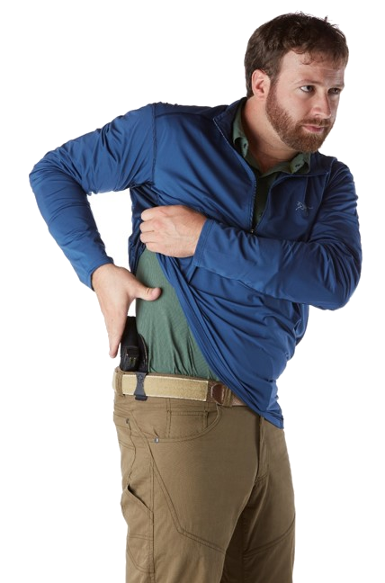

Drawing From Concealment
Clearing Cover Garments
Closed Front
Open Front
Notes:
Describe to students examples of an open front garment (unbuttoned jacket) vs. closed front
Demonstrate clearing and drawing from an open front garment. (Knife Edge vs. Rigid Thumb)
Knife Blade: During the access step the firing hand acts as a knife blade to forcibly move the garment and immediately proceeds to the grip-chest step.
Rigid Thumb: During the access step the firing hand uses a Rigid Thumb to forcibly move the garment and immediately proceeds to the grip-chest step.
Describe to students examples of a closed front garment (ie. sweatshirt)
During the access step the support hand reaches as far across as possible, then lifts the garment up so that the shooting hand can establish a good firing grip on the pistol. The garment should be forcibly lifted as high as possible to not interfere with the draw.

Slide 74
Drawing From a Holster
Access
Grip-Chest
Pull
Rotate
Join
Extend
Fire if necessary
Scan and Assess
Safety
Reluctantly Holster
Notes:
INSTRUCTOR NOTE: Stress to the students that when learning these steps for the first time or practicing at home, they should be done Slow & Controlled to ensure the proper steps and technique is being followed. Slow is smooth, smooth is fast.
Access the pistol by first clearing the cover garment.
Grip Chest is grasping the grip of the pistol with the shooting hand while placing the support hand on the chest.
Pull the pistol from the carry device.
Rotate the gun toward the target.
Join the non-shooting hand to the gun (if a two-hand hold is to be used).
Extend the gun forward to sight alignment (if sighted shooting technique is to be used).
Fire the gun (if necessary to stop an attack).
ASK: When wouldn’t you need to fire?
The attacker stops at the sight of the weapon.
Scan and Assess the area for continued or additional threats.
Safety – The pistol’s safety is engaged or the pistol de-cocked, if equipped.
Holster the gun, support hand goes to chest.

Slide 75

Access
Notes:
Demonstrate each step in pistol presentation as it is introduced
The first step in presenting the pistol is to gain access by either sweeping the cover garment aside if using an open front garment (such as a sport coat or jacket) or by lifting the hem of a closed front garment such as a sweater or t-shirt to expose the grip of the firearm.

Slide 76

Grip-Chest
Notes:
The next step is to acquire a firm grip on the pistol.
The pistol should fit firmly into the “Y” of the firing hand, with the trigger finger straight alongside the frame or along the side of the holster.
Obtaining the proper firm grip on the pistol is critical for two reasons. First, the initial grip you obtain is usually difficult to adjust during the draw. Second, obtaining a firm grip is essential to prevent dropping the gun or otherwise losing control of it during the draw.
During this phase, the support hand will be positioned in the middle of the chest, no lower than the solar plexus. This serves to keep that hand from crossing the muzzle. The support hand will remain in this position until the join step!

Slide 77

Pull
Notes:
In most cases, this step simply involves pulling the gun’s muzzle clear of the top of a holster. The simplest removal is from a fitted holster with no safety strap. Other types of holsters may require you first release a safety strap, switch or lever with your thumb.

Slide 78

Rotate
Notes:
Once the muzzle is clear of the holster, rotate the wrist up and the elbow down which will place the gun forward of the chest and pointed toward the target. The forearm will be parallel to the ground; this will help keep the muzzle pointed at the target during the “EXTEND” step.
When the gun is rotated fully forward and is pointed in the direction of the target, the trigger finger may be placed on the trigger. At this time also, the safety (if any) can be disengaged.
One advantage of rotating the gun toward the target as soon as it is removed from the carry device is that, in an emergency, it can be quickly fired at an assailant.
While the gun is being rotated toward the target, the support hand is in position in the middle of the chest.

Slide 79

Join
Notes:
The support hand is moved from its position on the chest to join with the firing hand to form the two-hand grip (unless a one-handed firing technique is being used). It is critical that the support hand approaches the gun from the rear to avoid crossing in front of the muzzle. This also helps to retain the gun in the event an arm’s-length assailant attempts to take it from you.

Slide 80



Extend
Notes:
You should be able to pick up the sights as the gun is moving forward into the correct firing position. With practice, you will be able to achieve defensive sight alignment simultaneously with full extension of your arms.
Note for purposes of defensive shooting, perfect sight alignment is not required. All that is usually necessary is for the front sight blade to be visible somewhere in the rear sight notch.
**NOTE**
ON ANIMATION CLICK Have the students pay close attention to the muzzle being Level and not Bowling or Fishing.

Slide 81

Fire (if necessary)
Notes:
If necessary, the trigger is pressed (dry pressed for the purposes of this classroom exercise).
Emphasize that firing the gun is an optional step after completing presentation, not an automatic step. The gun is fired only if there is still an imminent threat to life or severe bodily injury.

Slide 82
Continued Steps
Scan and Assess for additional threats
Check the status of your firearm
Perform at eye level
Reload if necessary
Engage the safety and/or de-cock only if there are no additional threats
Reluctantly holster
Notes:
Scan and Assess the area for continued or additional threats.
In an actual defensive encounter, once firing is completed and the attacker is down or has fled, you must scan the area and assess the situation to determine if the threat has actually ceased of if there are other threats that may present themselves from other directions (such as accomplices of the original attacker).
Safety: The pistol’s safety is engaged or the pistol de-cocked, if equipped.
Once you are certain that all threats to your safety or the safety of other innocent persons have ceased, your pistol should be de-cocked or the safety engaged prior to holstering. This is accomplished in the following manner:
Keep your eyes toward the target and your trigger finger straight along the frame of the pistol.
Pull the gun back into the middle of the chest keeping the muzzle pointed down range (ready position).
Engage the safety or de-cock (if applicable) the firearm.
Stress that the presentation of the firearm always begins and ends with the pistol’s safety engaged or the pistol de-cocked, if so equipped.
Holster the gun, support hand goes to chest.
Once you are satisfied with the status of your pistol, return it to the holster. This is accomplished in the following manner:
Remove your support hand from the gun and place it in the center of the chest.
If necessary, momentarily glance down at the holster to locate it visually. (With practice, you should be able to locate the holster by feel, without looking.)
Guide the muzzle of the gun into the holster. One should not be in a rush to holster. holster reluctantly!
Continue scanning and assessing the area.
Some holsters require the use of two hands to fully holster. With such devices, be careful not to point the muzzle of your gun at your support hand during the holstering process. It is recommended that you acquire a holster that does not need two hands to holster the firearm.
Emphasize that care must be taken not to entangle the gun in the fabric of a shirt, blouse or jacket lining while it is being holstered. Such entanglement could interfere with the fit of the gun in the holster and prevent a proper draw. Additionally, fabric that wraps around the trigger as the gun is being holstered could cause an unintentional discharge.

Slide 83
Dry Practice Presentation Exercise
Students should retrieve holsters and other gear.
Students are NOT to touch their firearm until instructed to do so.
Instructors should perform a gear and safety check.
Starting position for students will be: gun in the holster, both hands hanging relaxed at the sides.
Notes:
Explain and demonstrate the following dry-practice exercise to the students before conducting the exercise. Students should first run this drill without a cover garment. Once the drill has been repeated several times and students are comfortable with the draw, add the cover garment. Allow for several repetitions with the cover garment. Instructors should be monitoring students closely to ensure that the fundamentals of the draw are learned correctly before progressing to live fire.

Slide 84
Dry Practice Presentation Exercise
ACCESS!
RELAX!
Notes:
Access: Clear any cover garment away from the gun. (This will be demonstrated in a future slide/exercise)

Slide 85
Dry Practice Presentation Exercise
ACCESS!
GRIP-CHEST!
RELAX!
Notes:
Access: Clear any cover garment away from the gun. (This will be demonstrated in a future slide/exercise)
Grip Chest: The first word is for the shooting hand. Establish a firm grip on the pistol in the holster. The second word is for the non-firing hand. This hand goes flat against the chest to avoid being swept during the draw.

Slide 86
Dry Practice Presentation Exercise
ACCESS!
GRIP-CHEST!
PULL!
HOLSTER
Notes:
Access: Clear any cover garment away from the gun. (This will be demonstrated in a future slide/exercise)
Grip Chest: The first word is for the shooting hand. Establish a firm grip on the pistol in the holster. The second word is for the non-firing hand. This hand goes flat against the chest to avoid being swept during the draw.
Pull: The pistol clears the holster.

Slide 87
Dry Practice Presentation Exercise
ACCESS!
GRIP-CHEST!
PULL!
ROTATE!
HOLSTER
Notes:
Access: Clear any cover garment away from the gun. (This will be demonstrated in a future slide/exercise)
Grip Chest: The first word is for the shooting hand. Establish a firm grip on the pistol in the holster. The second word is for the non-firing hand. This hand goes flat against the chest to avoid being swept during the draw.
Pull: The pistol clears the holster.
Rotate: The muzzle of the pistol levels with the target. Once fully rotated any safety may be disengaged to fire immediately if necessary.

Slide 88
Dry Practice Presentation Exercise
ACCESS!
GRIP-CHEST!
PULL!
ROTATE!
JOIN!
HOLSTER
Notes:
Access: Clear any cover garment away from the gun. (This will be demonstrated in a future slide/exercise)
Grip Chest: The first word is for the shooting hand. Establish a firm grip on the pistol in the holster. The second word is for the non-firing hand. This hand goes flat against the chest to avoid being swept during the draw.
Pull: The pistol clears the holster.
Rotate: The muzzle of the pistol levels with the target. Once fully rotated any safety may be disengaged to fire immediately if necessary.
Join: The hands come together as early as possible. Establishing a two handed grip further away from the body results in less available grip strength.

Slide 89
Dry Practice Presentation Exercise
ACCESS!
GRIP-CHEST!
PULL!
ROTATE!
JOIN!
EXTEND!
HOLSTER
Notes:
Access: Clear any cover garment away from the gun. (This will be demonstrated in a future slide/exercise)
Grip Chest: The first word is for the shooting hand. Establish a firm grip on the pistol in the holster. The second word is for the non-firing hand. This hand goes flat against the chest to avoid being swept during the draw.
Pull: The pistol clears the holster.
Rotate: The muzzle of the pistol levels with the target. Once fully rotated any safety may be disengaged to fire immediately if necessary.
Join: The hands come together as early as possible. Establishing a two handed grip further away from the body results in less available grip strength.
Extend: Drive the front sight/muzzle of the pistol to the target. There should be a straight line between the eyes, the muzzle, the target. Muzzle should be level with ground during this sequence.

Slide 90
Dry Practice Presentation Exercise
ACCESS!
GRIP-CHEST!
PULL!
ROTATE!
JOIN!
EXTEND!
Press!
RESET Action
HOLSTER
Notes:
Access: Clear any cover garment away from the gun. (This will be demonstrated in a future slide/exercise)
Grip Chest: The first word is for the shooting hand. Establish a firm grip on the pistol in the holster. The second word is for the non-firing hand. This hand goes flat against the chest to avoid being swept during the draw.
Pull: The pistol clears the holster.
Rotate: The muzzle of the pistol levels with the target. Once fully rotated any safety may be disengaged to fire immediately if necessary.
Join: The hands come together as early as possible. Establishing a two handed grip further away from the body results in less available grip strength.
Extend: Drive the front sight/muzzle of the pistol to the target. There should be a straight line between the eyes, the muzzle, the target. Muzzle should be level with ground during this sequence.
Press: Only when completely necessary. Sometimes presenting the pistol may deescalate an attack at the last moment.

Slide 91
Dry Practice Presentation Exercise
ACCESS!
GRIP-CHEST!
PULL!
ROTATE!
JOIN!
EXTEND!
Press! (Optional)
SCAN AND ACCESS!
RESET Action, if necessary
HOLSTER
Notes:
Access: Clear any cover garment away from the gun. (This will be demonstrated in a future slide/exercise)
Grip Chest: The first word is for the shooting hand. Establish a firm grip on the pistol in the holster. The second word is for the non-firing hand. This hand goes flat against the chest to avoid being swept during the draw.
Pull: The pistol clears the holster.
Rotate: The muzzle of the pistol levels with the target. Once fully rotated any safety may be disengaged to fire immediately if necessary.
Join: The hands come together as early as possible. Establishing a two handed grip further away from the body results in less available grip strength.
Extend: Drive the front sight/muzzle of the pistol to the target. There should be a straight line between the eyes, the muzzle, the target. Muzzle should be level with ground during this sequence.
Press: Only when completely necessary. Sometimes presenting the pistol may deescalate an attack at the last moment.
Scan and Assess: Muzzle comes down to a 45 degree angle to allow for better visibility. Turn the head to look for additional threats.
Advise candidates that you should never scan with an empty gun. Always reload first then scan. If completely out of ammunition, they should be scanning for further options.
Holster: Safety on/de-cock before the muzzle leaves the horizontal plane. Holster reluctantly and deliberately. Look the pistol in to the holster as best as possible. This will set a good example for the Instructor Candidates to follow.
INSTRUCTOR NOTE: Once the students are able to safely draw from concealment with an Open Front Garment, have them do it, By-The-Numbers, with a Closed Front garment several times to learn the proper technique.

Slide 92
Summary
Explain and demonstrate the technique for safely presenting and holstering a concealed pistol.

Slide 93
What Are Your Questions?

Slide 94
NRA CCW
Lesson 6:
Loading and Stoppage Remediation
No Live Ammunition in the Classroom

Slide 95
Lesson 6 – Loading and Stoppage Remediation
Learning Objectives:
Explain and Demonstrate emergency reloads
Identify and Explain types of stoppages
Explain and Demonstrate immediate action drills

Slide 96
Reloads
Emergency
Reloading an empty gun as quickly as possible
Requires extra loading devices (speed loaders or magazines)
Notes:
Note the term emergency reload refers to reloading an empty gun as quickly as possible. A tactical reload refers to reloading a gun, which is not completely empty, when there is break in the attack. For the purpose of this course the emergency reload will be the method utilized.
To execute an emergency reload with a revolver, you need to use a speed loader, which is a cartridge-holding device that aligns the cartridges with the chambers, allowing all of the chambers to be loaded simultaneously. Speed loaders may be carried in pouches or in the pocket. In either case, carry speed loaders on the shooting hand side.
If you are using a semi-automatic pistol, carry any spare magazines on your non-shooting side. If you are right-handed, place the magazine in a pocket or pouch on the left side of your body; if you are left-handed, place it in a pocket or pouch on the right side of your body. Always make sure that the magazine is oriented with the bullets facing forward.

Slide 97




Emergency Reload Drill
Reloading an empty revolver as quickly as possible
Notes:
Rotate frame: Rotate the frame clockwise 90 degrees by twisting the wrist of your firing hand. Pass the two middle fingers of the left hand through the frame while maintaining the grip on the cylinder with the two middle fingers and thumb of your left hand. Rotate the frame away from the cylinder rather than pushing the cylinder out of the frame. Hold the cylinder in place with your left hand while your right hand rotates the frame away from the cylinder.
Point the muzzle up: As your right hand rotates the frame 90 degrees, roll your left wrist slightly toward your body to point the muzzle up, keeping it angled slightly away from your body.
***NOTE: Some ranges will Only allow muzzle level to the ground reloads. Utilize the range rule, but you Must teach the “Workspace” method.
Right hand off gun: Your right hand lets go of the revolver. The fingers and thumb of your left hand hold onto the cylinder, still in the 3 o’clock and 9 o’clock positions.
Arm/gun position: Your left elbow should now be touching your abdomen, and the revolver should be slightly off to the right side of your body (about 8 to 10 inches below the armpit).
Operate ejector: With the palm of your right hand strike the ejector rod with a straight sharp blow. Caution: Strike the ejector rod hard enough to throw the empty cases well clear of the cylinder with the first blow, but not so hard as to injure your hand or bend the ejector rod.
Let cases fall: Allow cartridges and cases to fall to the ground.
Reposition the gun: As your right hand reaches for a speed loader, bring the revolver in front of your body (about chest high) and rotate the muzzle toward the ground and away from your body.
Retrieve ammunition: Retrieve a speed loader with your right hand, and bring your right hand to the revolver.
Glance at cylinder: Briefly look down at the cylinder as the cartridges are lined up with the chambers. A momentary glance to ensure the nose of each cartridge has entered the chambers properly is sufficient. Release the cartridges into the chambers and drop the speed loader to the ground.
Close cylinder: As you raise the revolver (the muzzle should still be pointed down to keep the cartridges from falling out of the chambers), rotate the frame counter-clockwise with your right wrist while simultaneously pushing the cylinder home with the left thumb.
Once the cylinder latches, rotate the muzzle up, in line with the target.
Index cylinder: As the cylinder clicks positively shut, rotate the cylinder with your thumb and middle fingers to ensure it locks in place with a chamber directly under the firing pin.
Caution: Failure to properly index the cylinder with a chamber under the firing pin could result in the gun not firing when the trigger is pressed.
Most left handed revolver shooters simply use the right handed reload method described above.

Slide 98






Emergency Reload Drill
Reload an empty semi-automatic pistol as quickly as possible
Notes:
Gun position: Bring the pistol close to your body such that your right elbow is close to or in contact with your torso. Flex the elbow to orient the muzzle upward at an approximate 45-degree angle. This assists with magazine removal and assures the muzzle is angled away from you. Rotate your wrist 90 degrees so that the left side of the frame faces you. Keep your eyes on the target area throughout the procedure except when actually inserting the magazine into the gun.
Activate the magazine release. Regardless of hand size, it may be necessary to shift your grip to reach the magazine release. Let the empty magazine fall to the ground. Do not attempt to catch or retrieve it.
Reach for a fresh magazine. As you bring your right arm back close to your body, reach for a loaded magazine with your left hand.
Proper magazine grip: Grasp the magazine between the thumb and middle finger of your left hand, with the floorplate (base) of the magazine in the palm of your left hand and your index finger running up the front of the magazine, resting on or just below the tip of the bullet of the top cartridge.
Glance at pistol: Glance down at the magazine well (the opening in the frame for the magazine).
Insert magazine: Using the right index finger on the magazine to “point” toward the opening in the grip, insert the top of the magazine into the frame and seat it by pushing it all the way in with the palm of your right hand. (Once the magazine has been lined up with the magazine well and is being seated, return visual focus to the target area.)
Release slide: Release the slide by pulling it to the rear and releasing it from the rear-most position. Allow the slide to move forward under its own power. Maintaining contact with the slide as it moves forward may cause a stoppage.
Establish support grip: As you continue to return to a firing position, slide your support hand back into its supporting position.
INSTRUCTOR NOTE: Be sure to Explain & Demonstrate that some ranges may not allow the 45 degree method and the muzzle May have to be pointed in a safe direction towards a backstop with the barrel level to the ground.
OPTIONAL: ONLY IF YOU HAVE LEFT HANDED STUDENTS
Begin with the pistol held in a firing grip, finger indexed alongside the frame, muzzle pointed in a safe direction.
Gun position: Bring the pistol close to your body such that your left elbow is close to or in contact with your torso. Flex the elbow to orient the muzzle upward at an approximate 45-degree angle. This assists with magazine removal and assures the muzzle is angled away from you. Rotate your wrist 90 degrees so that the right side of the frame faces you. The trigger is at eye level, look at the target while reloading.. Keep your eyes on the target area throughout the procedure except when actually inserting the magazine into the gun.
Release magazine: Place the trigger finger on the magazine release. Press the magazine release straight into the frame and release the empty magazine. (You may find it necessary to use the middle finger instead.)
Reach for a fresh magazine: As you bring your left arm back close to your body, reach for a loaded magazine with your right hand.
Proper magazine grip: Grasp the magazine between the thumb and middle finger of your right hand, with the floorplate (base) of the magazine in the palm of your right hand and your index finger running up the front of the magazine, resting on or just below the tip of the bullet of the top cartridge.
Glance at pistol: Glance down at the magazine well.
Insert magazine: Using the right index finger on the magazine to “point” toward the opening in the grip, insert the top of the magazine into the frame and seat it by pushing it all the way in with the palm of your right hand. (Once the magazine has been lined up with the magazine well and is being seated, return visual focus to the target area.)
Release slide: Release the slide by pulling it to the rear and releasing it from the rear-most position. Allow the slide to move forward under its own power. Maintaining contact with the slide as it moves forward may cause a stoppage.
Establish support grip: As you continue to return to a firing position, slide your support hand back into its supporting position.
Keep your eyes on the target or the area of expected threat throughout the reloading operation except for the brief moment you are lining up the magazine with the frame.

Slide 99



Stoppages – Semi-Automatic Pistol
Failure to fire – Practical Exercise
TAP
RACK
ASSESS
Notes:
Have students say together TAP, RACK, ASSESS several times before revealing pictures.
What types of stoppages might occur while shooting a semi-automatic pistol?
Briefly discuss responses, making sure they include the following:
Failure to go into battery: This is when the slide does not return all the way forward and the cartridge is not fully seated in the chamber.
Failure to fire: This is when the trigger has been activated but there is no discharge (click with no bang). It is caused either by a defective cartridge in the chamber or an empty chamber. A cartridge may not be chambered due to the magazine not being fully seated in the frame preventing the slide from stripping the top cartridge from the magazine.
Failure to eject: The fired case is extracted from the chamber but not fully ejected from the pistol. The fired case may be inside the slide or partially sticking out of the ejection port. This latter position is often referred to as a stovepipe.
The three types of stoppages listed above are the most common and all may be corrected—and the pistol returned to action—in one or two seconds by conducting an immediate action drill.
More serious stoppages require more complex remedial action to return the pistol to a firing state.
In semi-automatic pistols there is one response that will correct all of these stoppages. The three steps of the drill are referred to as tap, rack, assess.
TAP – Tap the base of the magazine with the palm of the support hand to ensure it is fully seated.
RACK – rack the slide vigorously by pulling it all the way to the rear.
ASSESS – Resume the shooting position, ASSESS the situation, and resume firing, if appropriate.
Emphasize that the time saved by immediately responding with one drill may save the time of having to analyze the problem, identify the cause, and then deciding which drill to use to remedy the malfunction.

Slide 100
Stoppages – Semi-Automatic Pistol
Double-feed – Practical Exercise
Lock
Rip
Tuck
Work
Insert
Rack
Notes:
Using dummy ammunition to simulate a double feed
Instructor: Lock the slide of the pistol to the rear. Insert a dummy cartridge in the chamber of the pistol. Next, insert a magazine with the top cartridge being a dummy cartridge. Finally, let the slide go forward pinching one cartridge against the other.
Demonstrate a tap, rack, assess to demonstrate the lack of effectiveness on clearing this type of stoppage.
Demonstrate the six steps to clearing a double feed.
LOCK - First lock the slide to the rear. This takes the pressure off of the cartridges causing the double feed.
RIP - Next, rip out the magazine. Quite often the magazine will not drop free on its own and you must physically remove it.
TUCK - If the shooter is carrying only one magazine, tuck it under the shooting side arm.
WORK - Rack the slide several times to clear the cartridges from the chamber. (Rack, Rack, Rack)
INSERT - Reinsert your magazine or preferably replace the magazine with a new one. (Many stoppages are the result of a faulty magazine)
RACK - Rack the slide and assess whether or not you need to shoot again.

Slide 101

Stoppages – Revolver
Failure to fire
Advance cylinder by pulling the trigger again
Notes:
What should you do with a double-action revolver if it fails to fire?
Briefly discuss responses, making sure they include simply pulling the trigger again to advance to the next cartridge.
Why is it important to keep a revolver clean?
Briefly discuss responses, making sure they include:
Preventing debris from obstructing cylinder advance
Allowing for smooth ejection of spent cartridges

Slide 102
Practical Exercise: Loading and Stoppage Remediation
Equipment Check
Evaluate gear and equipment for safety hazards
Ensure all equipment is properly mounted, secured, and operational.
This includes: holster, magazines, pouches, clothing, belt, etc.
Notes:
Once all students have holstered: Instructors must walk the line checking each student for the safety of their equipment.
Ensure that holsters are conducive to the safe administration of the course of fire. As part of that evaluation ensure that the holster covers the trigger.
Check direction of magazines.
Make sure that equipment is in the correct location on the waist.
When transitioning to cover garments look for tassels or strings that might get inside a trigger guard

Slide 103
Summary
Perform tactical reloads
Identify types of stoppages
Perform Immediate action drills

Slide 104
What Are Your Questions?

Slide 105
NRA CCW
Lesson 7:
Mindset, Responding to an Attack and the Aftermath
No Live Ammunition in the Classroom

Slide 106
Lesson 7 – Mindset, Responding to an Attack and the Aftermath
Learning Objectives:
Explain the levels of mental awareness.
Explain the importance of mental preparation and developing the proper mindset for carrying and using a pistol for personal protection.
Explain the techniques for avoiding life-threatening confrontations.
Explain the psychological and physiological changes that may occur during an attack.
Explain the differences between armed self defense in the home and outside the home.
Explain & Demonstrate techniques for controlling and responding to a violent encounter.
Explain the emotional, legal and social aftermath of a defensive shooting.

Slide 107

Levels of Mental Awareness
The most important key to staying safe is to remain alert in your environment.
Levels of Awareness
Unaware
Notes:
Ask the students what is awareness? Discuss their answers briefly.
Ask the students what the lowest level of awareness is in the NRA’s Awareness Levels?
Unaware
In the unaware, you are not aware of what is going on in your environment. Ask the students for examples of an unaware condition.
Briefly discuss their answers, which should include examples such as:
When you are asleep.
When you are daydreaming.
When you are concentrating fully on work, a book, a movie, etc.

Slide 108

Levels of Mental Awareness
The most important key to staying safe is to remain alert in your environment.
Levels of Awareness
Unaware
Aware
Notes:
Aware
You are in an aware condition when you:
Are conscious of your surroundings.
Are cognizant of those around you.
Have mentally identified where potential threats may emanate.
Ask the students when they should be in an aware condition.
Briefly discuss their answers, which should include:
When walking on the street.
When driving a car.
When in any public building.
When in a parking lot.
When jogging or hiking.
As often as possible.
*NOTE: It is best to avoid, if possible, a potentially violent situation once we become AWARE.

Slide 109

Levels of Mental Awareness
The most important key to staying safe is to remain alert in your environment.
Levels of Awareness
Unaware
Aware
Alert
Notes:
Alert
In the alert level, a specific potential threat or threats have been identified. This is a heightened state of awareness.
Ask the students for examples of situations that may justify an alert condition.
Briefly discuss their answers, which should include examples such as:
When a stranger approaches on a deserted street.
When a stranger asks for the time, a cigarette, spare change, etc.
When a stranger stares at you for no discernible reason.
When you are around a person or persons who are under the influence of alcohol or drugs, or who are behaving aggressively, erratically or unpredictably.
Ask the students what steps should be taken once a potential threat has been identified.
Briefly discuss their responses. Emphasize that at the alert level, it is crucial to take two steps immediately after identifying a potential threat:
Set a limit that will initiate action. Once the threat crosses this limit, action must be taken.
Formulate a plan ahead of time that you will implement if the threat crosses that limit. This plan may be to evade or defend. Evasion routes should be identified as part of this action.
*NOTE: It is best to avoid, if possible, a potentially violent situation once we become ALERTED.

Slide 110

Levels of Mental Awareness
The most important key to staying safe is to remain alert in your environment.
Levels of Awareness
Unaware
Aware
Alert
Alarm
Notes:
Alarm
Ask the students what the difference is between an alert condition and an alarm condition.
Their answers should stress that in an alarm condition, the potential threat is now a real threat to the intended victim’s physical safety. Whatever action was planned in the alert level is now implemented.
*NOTE: It is best to avoid, if possible, a potentially violent situation once we become ALERTED.

Slide 111
Mindset - Training
Never give up!
Training
Develop a plan
Practice visualization
Practice the plan
Train for real life
Train to control the encounter
Train for stress
Notes:
Emphasize that the single most crucial aspect to surviving a life-threatening encounter is the determination to Never Give Up, and to persevere and prevail in a life-threatening encounter.
Training
Take your training seriously. Training goes beyond merely learning how to shoot.
Ask the students what they believe are some of the aspects of effective training. Briefly discuss their answers, which should include the following:
Develop an individual personal protection plan to suit your particular needs, including a plan of what to do to avoid a confrontation.
Visualize scenarios you may encounter outside your home, as well as your response to them.
Just like fire drills, practice your contingency plans for an attack.
After this course, students must continue to train, both mentally and physically. Monthly practice of skills is a goal everyone should strive to attain. The way one trains is the way a person will react under stress. This is why we train to develop proper habits, such as immediately seeking cover.
Through mental preparation, physical training, and developing your gun-handling and marksmanship skills, you will gain the self-confidence to control a life-threatening encounter.
Note the importance of incorporating stress into training. Learning to perform under stress is crucial to prevailing in a defensive encounter. Assailants count on putting their victims under stress and expect them to fold under the pressure.
Inform students that, during the range exercises, they will be put under a moderate amount of stress in order to manifest some of these reactions and to acclimate themselves to those reactions.
Instructor Note: The students will put stress on themselves when on the range to practice defensive techniques. Remember that NRA training philosophy is one of positive reinforcement; instructors do not need to induce any stress in addition to that which the exercise produces.

Slide 112
Mindset – Avoiding Confrontations
Notes:
Ask the students what the preferred way is to deal with a potentially violent situation?
Briefly discuss their responses. Emphasize that avoiding a confrontation, if possible, is always the best way to deal with a potentially violent situation.

Slide 113
Mindset – Avoiding Confrontations
Awareness of potential threats in the environment.
Notes:
Ask the students for some of the ways in which a confrontation may be avoided.

Slide 114
Mindset – Avoiding Confrontations
Awareness of potential threats in the environment.
Plan ahead
Notes:
Planning ahead to maximize your safety and minimize the risk of having a violent encounter.

Slide 115
Mindset – Avoiding Confrontations
Awareness of potential threats in the environment.
Plan ahead
Avoid dangerous people
Notes:
Avoiding dangerous people who may constitute a threat, or who may get you into trouble.

Slide 116
Mindset – Avoiding Confrontations
Awareness of potential threats in the environment.
Plan ahead
Avoid dangerous people
Avoid dangerous places
Notes:
Avoiding dangerous places, such as high-crime neighborhoods, unfamiliar areas, etc.

Slide 117
Mindset – Avoiding Confrontations
Awareness of potential threats in the environment.
Plan ahead
Avoid dangerous people
Avoid dangerous places
Avoid making yourself a target through clothing or behavior
Notes:
Avoiding wearing clothing or visible accessories that may make you a target.
Avoiding having a behavior which may antagonize others.

Slide 118
Mindset – Avoiding Confrontations
Awareness of potential threats in the environment.
Plan ahead
Avoid dangerous people
Avoid dangerous places
Avoid making yourself a target through clothing or behavior
Avoid antagonizing others through clothing, appearance or behavior
Notes:
Avoiding antagonizing others through provocative T-shirts, bumper stickers, confrontational behavior, or unusual dress.

Slide 119
Mindset – Avoiding Confrontations
Awareness of potential threats in the environment.
Plan ahead
Avoid dangerous people
Avoid dangerous places
Avoid making yourself a target through clothing or behavior
Avoid antagonizing others through clothing, appearance or behavior
Avoid having a pattern or predictable routine
Notes:
Avoiding having a pattern or predictable routine that a criminal may take advantage of.

Slide 120
Mindset – Avoiding Confrontations
Awareness of potential threats in the environment.
Plan ahead
Avoid dangerous people
Avoid dangerous places
Avoid making yourself a target through clothing or behavior
Avoid antagonizing others through clothing, appearance or behavior
Avoid having a pattern or predictable routine
Don’t respond to antagonistic behavior or escalate a confrontation
Notes:
Not responding to antagonistic behavior by arguing aggressively, losing your temper, or otherwise responding to verbal attacks; don’t do anything to escalate a confrontation.

Slide 121
Mindset – Avoiding Confrontations
Awareness of potential threats in the environment.
Plan ahead
Avoid dangerous people
Avoid dangerous places
Avoid making yourself a target through clothing or behavior
Avoid antagonizing others through clothing, appearance or behavior
Avoid having a pattern or predictable routine
Don’t respond to antagonistic behavior or escalate a confrontation
Look for escape routes
Notes:
Looking for escape routes when you are walking on the street or driving in your car; these may allow you to escape a threat.

Slide 122
Psychological Responses
Notes:
In any threatening encounter, there are five possible responses: submit, freeze, flight, posture and fight.

Slide 123
Psychological Responses
Submit
Notes:
In any threatening encounter, there are five possible responses: submit, freeze, flight, posture and fight.
Submit: This is simply giving in to an adversary. Data from the FBI’s annual Uniform Crime Reports supports the contention that submitting to an assailant is more dangerous for the victim than fighting back.

Slide 124
Psychological Responses
Submit
Freeze
Notes:
Freeze: If the threat sufficiently overwhelms or surprises you, you may freeze and be incapable of any action. This freeze may last only a fraction of a second, or it may last throughout the encounter.

Slide 125
Psychological Responses
Submit
Freeze
Flight
Notes:
Flight: The flight response simply involves fleeing from the threat.

Slide 126
Psychological Responses
Submit
Freeze
Flight
Posture
Notes:
Posture: Posturing is combat without contact. Words, sounds, gestures and body language are the weapons used to dominate, intimidate and subdue another.

Slide 127
Psychological Responses
Submit
Freeze
Flight
Posture
Fight
Notes:
Fight: The fight response means using whatever force is available to prevent harm. Ethically and legally there are limits to your fight response.

Slide 128
Psychological Responses
Submit
Freeze
Flight
Posture
Fight
Can you see into the future?
Cannot predict assailant responses
Notes:
There is no way you can predict your response to a given situation, regardless of your prior experience.
Make a plan in your head.
Think about “What If” situations and how you might respond
These reactions apply to an assailant as well. An assailant may go through a progressive thought process, and it is almost certain threy will have made contingency plans before confronting you.

Slide 129
Physiological Reactions
Notes:
In a stressful, life-threatening encounter, you may experience any of several physiological reactions.
Ask the students to suggest what some of these reactions might be.
Briefly discuss their answers, which should include the following:

Slide 130
Physiological Reactions
General bodily responses to imminent danger
Notes:
General bodily responses may include:
Increase in heart rate and respiration.
Dilation of the pupils.

Slide 131
Physiological Reactions
General bodily responses to imminent danger
Adrenaline rush
Notes:
Adrenaline Rush
In addition to heightening senses and strength, an adrenaline rush may also cause muscles to tremble, making it difficult to hold the firearm steady or to stand still. Sometimes both the assailant and the victim perceive this shaking as fear. An adrenaline rush is also what causes the uncontrollable shaking sometimes experienced when the confrontation is over.

Slide 132
Physiological Reactions
General bodily responses to imminent danger
Adrenaline rush
Diminished use of fine motor skills
Notes:
Diminished Fine Motor Skills
Stress—regardless of the source—results in a diminishment of fine motor skills. Because of this, all gun-handling techniques should use only gross motor skills—movements that use major muscle groups.

Slide 133
Perceptual Changes
Tunnel vision
Notes:
Explain that the stress of a violent confrontation may also produce perceptual changes.
Tunnel Vision
Ask the students if they can define the term tunnel vision.
Discuss their answers briefly.
Stress that when you are threatened, your
Focus will be on the threat
all or most of the surrounding environment will disappear from conscious perception.
One of the reasons you learn to lower the firearm and assess the area after firing is to reduce tunnel vision.

Slide 134
Perceptual Changes
Tunnel vision
Auditory exclusion
Notes:
Auditory exclusion
Extraneous sounds may be inaudible. Sounds emanating from outside visual perception—and even those from within it—may go unheard. Your assailant may also suffer from auditory exclusion. It is important to shout commands when confronting an assailant, both to intimidate him and to break through the veil of his auditory exclusion.

Slide 135
Perceptual Changes
Tunnel vision
Auditory exclusion
Time dilation
Notes:
Time Dilation
Time may seem to slow down, and things will appear to move in slow motion. This is why people wait much longer than necessary before taking action, letting down their guard, or emerging from hiding.

Slide 136
Perceptual Changes
Tunnel vision
Auditory exclusion
Time dilation
Temporary loss of memory
Notes:
Temporary Memory Loss
Highly stressful events can sometimes cause a mental overload that leads to temporary memory loss. You may forget details of an encounter, or you may lose all remembrance of the event; statements you make immediately after an incident may be inaccurate. For this reason, you should avoid making detailed statements to police before consulting an attorney.

Slide 137
Controlling an Encounter
Keep your distance
Notes:
Explain to the students that your assailant will usually have the advantages of surprise and knowledge of the area. Nonetheless, there are things you can do to control the encounter.
Keep your Distance
Maintain a safe distance from strangers, especially those who seem to pose a potential threat. Avoid riding in an elevator alone with a suspicious-looking person; cross the street if you see a group of unruly people on the sidewalk ahead; pass up an empty subway car in favor of one having numerous riders. If a potential threat moves toward you, move away, maintaining your distance. If you are attacked, put obstacles, such as a car, mailbox, trash can, etc. between yourself and your assailant.

Slide 138
Controlling an Encounter
Keep your distance
Be wary of strangers
Notes:
Be Wary of Strangers
During the preliminary stage of an attack, your assailant may attempt to close the distance by pretending to panhandle, asking for the time, etc. Do not fall for such ploys; maintain your distance, walking away if necessary. Also, when dealing with any stranger, use your peripheral vision and head movement to stay aware of any accomplices approaching you from the side or the rear.

Slide 139
Controlling an Encounter
Keep your distance
Be wary of strangers
Yell your commands
Loud and confident voice
Able to be heard by attacker and witnesses
Notes:
Yell Your Commands
STOP!
GO AWAY!
DO NOT COME CLOSER!
I AM ARMED!
DROP YOUR WEAPON!
LIE DOWN!
These commands should be yelled with authority. If they are heard by others nearby, they can also substantiate your claim of legitimate self-defense should you be forced to fire.

Slide 140
Controlling an Encounter
Keep your distance
Be wary of strangers
Yell your commands
Loud and confident voice
Able to be heard by attacker and witnesses
If the attacker flees, let them go
Notes:
If your attacker ignores your commands and continues to approach, you should defend yourself appropriately.
If he flees, let them go.

Slide 141
Holding an Attacker at Gunpoint
Do not approach for any reason
Have attacker put any weapon on the ground some distance away
While standing have attacker keep hands high
Yell your commands
Instruct attacker to lie face-down, away from all weapons
Utilize cover to protect yourself from any additional attacks
Call the police!
Stay aware of other potential threats
Notes:
Briefly discuss each bullet point with the students.

Slide 142
Differences in Armed Self Defense
In the home
Known and controllable environment
Outside the home
Firearm must be concealed
Potential threats are more ambiguous
Generally unfamiliar ground
No safe room
Notes:
Ask the students for the differences between having a firearm for personal protection in the home and carrying a firearm for personal protection outside the home.
Responses should include:
The defensive firearm should be concealed outside the home.
Potential threats are more ambiguous outside the home.
You generally will be on unfamiliar ground when you are confronted by a threat outside your home and the attacker will most likely have the advantage of the surrounding area and surprise.
You will have no safe room to retreat to outside your home

Slide 143
If You Must Shoot
Number of shots
Notes:
Ask the students: how many shots should be required to stop an assailant?
Briefly discuss their responses. Emphasize that it can take multiple shots to stop a threat. You should fire until there is no longer any imminent deadly threat. As soon as the imminent deadly threat ceases, the defender must stop shooting.

Slide 144
If You Must Shoot
Number of shots
No immediate effect or apparent injury
Notes:
No Immediate Effect
Instant incapacitation as a result of being shot with a bullet from a pistol is extremely rare. It is possible for assailants to receive a mortal injury yet continue to fight for some time. Reactions to being shot vary greatly with circumstances, physical conditioning, and mindset. Thus, you may need to fire multiple shots.

Slide 145
If You Must Shoot
Number of shots
No immediate effect or apparent injury
Spotting hits
Notes:
Spotting Hits
Emphasize that, unlike in Hollywood movies, or when shooting paper targets, you probably will not be able to see where your shots have struck. Ask the students why this is so. Their answers should include the following:
Many shootings take place in low light.
Clothing can obscure bleeding or other signs of bullet impact.
People simply may not bleed visibly immediately when they are shot.

Slide 146
If You Must Shoot
Number of shots
No immediate effect or apparent injury
Spotting hits
Possibility of injury
Notes:
Possibility of Injury
Realize the possibility that you will be injured in an encounter, regardless of the outcome. Even if you are injured, you must continue to defend yourself.

Slide 147
If You Must Shoot
Number of shots
No immediate effect or apparent injury
Spotting hits
Possibility of injury
If you are injured
Notes:
Ask the students how they might lessen the likelihood of being injured during an attack.
Their answers should include:
Use cover.
Create as much distance as possible from the assailant (at least 21 feet).
Don’t wait to fire on an attacker until the last possible moment—fire whenever there is a clear, unavoidable and immediate threat to your life.
If You’re Injured
Stress that many persons who have survived an attack have reported not being aware of their injuries during the attack. This was especially true among those who were completely focused mentally on the struggle to survive and win.

Slide 148
If You Must Shoot
Number of shots
No immediate effect or apparent injury
Spotting hits
Possibility of injury
If you are injured
Once attacker is down
Do not approach
Notes:
Do Not Approach
Explain that once your attacker is down, you must not approach him for any reason—not to disarm him, render medical care, or check on his condition. A seemingly incapacitated attacker may revive and resume his attack, or may be shamming and will take advantage of your proximity to try to injure or kill you.
Explain that once you have fired shots that stop an assailant’s attack, you should:
Lower the pistol slightly to allow you to see over your gun.
Observe the effect of your shots on the assailant.
Shift your eyes from side to side to scan for additional threats, without losing sight of the attacker.

Slide 149
If You Must Shoot
Number of shots
No immediate effect or apparent injury
Spotting hits
Possibility of injury
If you are injured
Once attacker is down
Do not approach
Scan for threats
Notes:
Scan For Threats
Explain that once you are confident that you have stopped an assailant’s attack, perform a wider scan from side to side, taking your eyes off the attacker only for a split second at a time.
Explain that you should scan for threats even when you are holding an attacker at bay, or after your shots have apparently caused your attacker to run off. Unseen assailants can take advantage of your distraction to attack from the rear.

Slide 150
If You Must Shoot
Number of shots
No immediate effect or apparent injury
Spotting hits
Possibility of injury
If you are injured
Once attacker is down
Do not approach
Scan for threats
Move to cover
Notes:
Move to Cover
Ask the students why it is necessary to move to cover after downing, incapacitating or scaring off an attacker.
Their responses should include:
A downed attacker may be shamming, and resume his attack.
An injured attacker may still be able to continue his attack.
You may still be vulnerable to attack from unseen additional assailants

Slide 151
If You Must Shoot
Number of shots
No immediate effect or apparent injury
Spotting hits
Possibility of injury
If you are injured
Once attacker is down
Do not approach
Scan for threats
Move to cover
Contact the Police…
Notes:
Contacting the Police
Explain that, after any defensive shooting, you must contact the police to report the incident, as well as to request medical help for any persons who are injured.
SEGUE TO NEXT SLIDE…

Slide 152
Contacting the Police
Contacting the Police
Notes:
Contacting the Police
Stress the following regarding contacting the police:
Contact the police only after you have moved to cover.
Contact the police even if a bystander has already done so—this may help minimize confusion and demonstrate your responsibility.
Use your cell phone if possible.
Without a cell phone, borrow a bystander’s phone, or ask a bystander to call the police.
In a deserted area, you may need to flag a motorist and ask to borrow their cell phone, or ask him or her to call police.
Be careful not to lose sight of your attacker, or to expose yourself to any more danger than is absolutely necessary.
When talking to a police dispatcher:
Be calm and succinct.
Inform the dispatcher that you are armed.
Describe yourself, your attacker and other aspects of the scene as necessary to help the responding officers know who is who.
Stress that you had to shoot in self-defense.
Stay on the phone with the dispatcher, if possible. Don’t volunteer any more information than is necessary to answer the dispatcher’s questions.

Slide 153
Contacting the Police
Contacting the Police
Wait for the Police
Notes:
Wait for the Police
Ask the students what actions an armed citizen should take while waiting for police to arrive. Their answers should include:
Remain behind cover with the gun in a ready position.
Observe any downed assailant.
Scan for additional threats.
Don’t talk to the assailant except to yell short commands as necessary to maintain control over the situation.
Don’t leave cover unless it is to maintain your safety or to contact police.
If others are with you behind cover, keep them there with you.
Keep your distance from any downed assailant.
Don’t abandon cover or flee the scene unless you can do so in safety.
Stress that there may be secondary assailants who may attack you if you leave cover.

Slide 154
Contacting the Police
Contacting the Police
Wait for the Police
Guard Against a Resumption of the Attack
Notes:
Guard Against Another Attack
Explain that just because an attacker has been downed, it cannot be assumed that the attack is over. He may revive, or he may be shamming, hoping that you will let down your guard. If a downed attacker revives and resumes his attack, you may have no choice but to again use your defensive firearm.
Stress that you should not, however, fire upon a downed attacker who revives and then flees the scene. You are not empowered to act as a law enforcement officer, and you may have no legal right to use lethal force once the attack has ceased.

Slide 155
Contacting the Police
Contacting the Police
Wait for the Police
Guard Against a Resumption of the Attack
Maintain the Integrity of the Scene
Notes:
Maintain Integrity of Scene
Explain that an intensive forensic investigation will follow any shooting incident, and thus all physical evidence at the scene must remain undisturbed. Moving, touching or removing evidence may:
Destroy proof relating to your claim of self-defense.
Create the appearance of guilt.
Stress that if your attacker had a weapon it is crucial to prevent that weapon from being moved or taken by a bystander or member of a crowd that may form.

Slide 156
Contacting the Police
Contacting the Police
Wait for the Police
Guard Against a Resumption of the Attack
Maintain the Integrity of the Scene
Greeting the Police
Notes:
Greeting the Police
Ask the students how they should greet the police when they arrive at the shooting scene.
Their answers should include:
Do not have your gun in your hand.
Comply with all their commands.
Do not behave in an aggressive manner.
Move slowly and keep your hands visible.
Be cooperative.
Don’t argue with witnesses at the scene.
Stress that an armed citizen may not always have the opportunity to call the police dispatcher before officers arrive at the scene and that these officers won’t know who the aggressor is and who the defender is; they’ll just see a person with a gun. In such a situation, it is critical to appear non-aggressive and to immediately obey all the officers’ commands.

Slide 157
Contacting the Police
Contacting the Police
Wait for the Police
Guard Against a Resumption of the Attack
Maintain the Integrity of the Scene
Greeting the Police
Leaving the Shooting Scene
Notes:
Leaving the Scene
Explain that you are obligated to stay at the scene of a shooting until police arrive unless remaining at the scene would compromise your safety. Examples of when this might occur would include:
A multiple-assailant attack in which some of the assailants were not disabled and still pose a threat.
A situation in which a hostile crowd gathers at the shooting scene.
Explain that if you must leave a shooting scene before the police arrive, you should:
Immediately go to a police station or, if you contact the police by phone, follow the instructions of the dispatcher.
Do not go home, change clothes or wash up, as this may destroy evidence.
Stress that a report should be made to the police even if shots are fired and the assailant seemed not to have been hit.

Slide 158
Aftermath of a Defensive Shooting
Emotional aftermath
Notes:
Emotional Aftermath
Ask the students what emotions they might expect to feel after being involved in a defensive shooting.
Their responses should include:
Elation
Revulsion
Remorse
Self-doubt
Acceptance

Slide 159
Aftermath of a Defensive Shooting
Emotional aftermath
Elation
Revulsion
Remorse
Self-doubt
Acceptance
Notes:
Emotional Aftermath
Their responses should include:
Elation
Revulsion
Remorse
Self-doubt
Acceptance
Discuss each of these emotions briefly with the students.
Stress that not all persons will experience all the above emotions, and that they may be experienced in a different order.

Slide 160
Aftermath of a Defensive Shooting
Emotional aftermath
Elation
Revulsion
Remorse
Self-doubt
Acceptance
Post-Traumatic Stress Disorder (PTSD)
Notes:
Post traumatic Stress Disorder (PTSD)
Some persons involved in traumatic events, such as life-threatening attacks, develop Post-Traumatic Stress Disorder (PTSD). This disorder is characterized by:
Flashbacks
Recurring nightmares
Inability to function normally
Note that not everyone experiencing such events will develop PTSD. Also, those who do show symptoms of PTSD have a medical disorder; they are not weak or cowardly.

Slide 161
Aftermath of a Defensive Shooting
Emotional aftermath
Elation
Revulsion
Remorse
Self-doubt
Acceptance
Post-Traumatic Stress Disorder (PTSD)
Reducing emotional effects
Counseling
Self reinforcement
Notes:
Reducing the Aftermath Effects
Counseling
Self-reinforcement
Discuss these briefly with the students.
Stress that under any circumstances, being involved in a defensive shooting has dramatic emotional, legal and social consequences. Mental preparation for the aftermath of a defensive shooting is just as critical as mastering shooting and gun handling skills, or learning to adopt a defensive mindset.

Slide 162
Aftermath of a Defensive Shooting
Legal aftermath
Notes:
Legal Aftermath
Ask the students what might be some aspects of the legal aftermath of a defensive shooting.
Their responses should include:
Arrest
Criminal charge and trial
Civil lawsuit
Search of home, vehicle and/or workplace
Seizure of firearms
Revocation of carry permit
Legal fees

Slide 163
Aftermath of a Defensive Shooting
Legal aftermath
Arrest
Criminal charge and trial
Civil lawsuit
Search of home, vehicle and/or workplace
Seizure of firearms
Revocation of carry permit
Legal fees
Notes:
Legal Aftermath
Their responses should include:
Arrest
Criminal charge and trial
Civil lawsuit
Search of home, vehicle and/or workplace
Seizure of firearms
Revocation of carry permit
Legal fees
Stress that in clear cut cases of self-defense, many prosecutors will not even file charges. Also point out that shootings outside the home
May often be ambiguous, and that even in the absence of criminal charges, a civil lawsuit is likely.

Slide 164
Aftermath of a Defensive Shooting
Legal aftermath
Arrest
Criminal charge and trial
Civil lawsuit
Search of home, vehicle and/or workplace
Seizure of firearms
Revocation of carry permit
Legal fees
Be careful what you say
Notes:
Be Careful What you say
Emphasize that every word you utter and every gesture you make immediately after a defensive shooting will be scrutinized by police, prosecutors and others. Even if you feel elation, anger, sadness and so forth, do not express these emotions in any way. Don’t hoot or cheer, make derogatory remarks about your attacker, or state how sorry you feel. Act as though everything you say and do will later be put on display in court or in the media.
Don’t talk to family or friends about what happened. STAY OFF social media.

Slide 165
Aftermath of a Defensive Shooting
Legal aftermath
Arrest
Criminal charge and trial
Civil lawsuit
Search of home, vehicle and/or workplace
Seizure of firearms
Revocation of carry permit
Legal fees
Be careful what you say
Social aftermath
Notes:
Social Aftermath
Ask the students what might be some aspects of the social aftermath of a defensive shooting. Their responses should include:
Ostracism at the workplace or in your neighborhood.
Anonymous notes or phone calls.
Changes in the way friends and family interact with you.
Harassment of your family members at school, in the neighborhood, etc.
Being branded as a “vigilante” or worse.

Slide 166
Summary
The levels of mental awareness.
The importance of mental preparation and developing the proper mindset for carrying and using a pistol for personal protection and facing a life-threatening encounter.
Techniques for avoiding life-threatening confrontations.
The psychological and physiological changes that may occur during an attack.
The differences between having a firearm for personal protection in the home and carrying a pistol for personal protection outside the home.
Techniques for controlling and responding to a violent encounter.
The emotional, legal and social aftermath of a defensive shooting.

Slide 167
What Are Your Questions?

Slide 168
NRA CCW
Lesson 8:
Carry Modes and Pistol Concealment
No Live Ammunition in the Classroom

Slide 169
Lesson 8 – Carry Modes and Pistol Concealment
Learning Objectives:
Identify benefits and limitations of various concealment modes.
Explain the basic principles of pistol concealment
Notes:
Ask the students what factors should be considered when choosing a pistol carry device (holster, holster purse, etc.). Their answers should focus on:
Concealment
Access
Retention
Comfort

Slide 170
Concealed Carry Requirements
Concealment
The degree to which the device hides the gun from observation
Notes:
Concealed means to be hidden from view. It is not difficult to successfully conceal a handgun from the casual observer with reasonable attire, a sturdy belt and a well designed holster.
Note that the single most important aspect of concealed carry is actually having a gun on your person. The best pistol and holster in the world do you no good in a violent confrontation if they are locked up at home.
While other elements of holster design are discussed at length later in this lesson, to ensure safety all pistol carry devices should cover the pistol’s trigger while it is in the holster. This helps prevent the shooter from inadvertently pulling the trigger during presentation or any other object (such as the fabric of the shirt or blouse) from contacting and pulling the trigger.

Slide 171
Concealed Carry Requirements
Access
You must be able to get to your gun immediately if needed
Correctly grasping the firearm
Removing the firearm from the device
Often a compromise between concealment and access
Notes:
Equally important as concealment is access. You must be able to get to your gun immediately when needed. A delay of only a few seconds in accessing your firearm could be disastrous in a real-world attack.
Access involves two components:
Correctly grasping the firearm.
Removing the firearm from the holster, holster purse, etc.
Your choice of pistol carry mode must allow both to be done as quickly as possible.
Emphasize that the ability to physically grasp the firearm quickly usually depends upon the pistol’s location on the body, while the ability to quickly remove the firearm from the carry device is a function of the design of that device.
Point out that there is usually a tradeoff between concealability and accessibility. Holsters and other carry devices offering great concealment often do not afford optimum access, and vice versa.
Ask the students for examples of both high concealment/low access and high access/low concealment carry modes.
The selection of a particular carry device usually involves a compromise between concealment and access, depending upon the relative importance of each to the gun owner.
Note to Instructors: To maintain the highest level of safety and assure compliance with the rules of most shooting ranges, shooting side hip holsters are to be used to conduct the live fire portions of the NRA CCW course. Shoulder holsters, crossdraw holsters, fanny packs, ankle holsters, and small-of-back holsters are not permitted for use in the course.

Slide 172
Concealed Carry Requirements
Retention
Aspects of design that prevent the loss of the gun in an attack or during normal to vigorous activity
Notes:
Ask the students under what conditions would they want a holster or other carry device to retain its grip on the pistol? Their answers should include:
While running, jumping or otherwise engaging in strenuous activity.
If you fall to the ground.
If you must grapple with an assailant.
If an attacker attempts to get your gun out of the holster or other carry device.
If you sit, bend over or put yourself in some other body position in which the gun can simply fall out of the holster or other carry device.
Retention is afforded by:
Snug-fitting holsters molded to the specific gun (friction fit).
Safety or retention straps.
Steel springs or elastic bands (in some shoulder holsters and belly bands).
Point out that safety straps that must be disengaged before the gun can be drawn represent another step that must be performed under stress, and can slow your presentation. Some holsters or other devices using springs or elastic bands to retain the gun can allow it to be extracted from several different angles. This can permit an assailant to more easily grab your gun and jerk it out of a holster.
Emphasize that a properly made holster that is snugly fitted to the pistol usually allows a draw in one direction only, making removal by an assailant more difficult. Hip holsters with a forward tilt (“FBI cant”) make it harder for an assailant to remove the gun from behind.
Fitted holsters often combine good retention with a fast presentation unimpeded by straps that must be unfastened.
Note that some carry devices, such as holster purses and fanny packs, almost always employ some sort of retaining straps (usually with Velcro fastenings) to properly secure and position the gun inside the device.

Slide 173
Concealed Carry Requirements
Comfort
Should provide comfortable carry for extended periods
Properly fit your body
Requires experimentation
Notes:
An often-overlooked factor in choosing a carry device is comfort. Ask the students why comfort is important. Discuss their answers briefly.
Their answers should include:
You are more likely to leave your gun at home if it is uncomfortable to wear.
You may reveal the fact that you are carrying a gun if you are frequently adjusting its position, scratching where it irritates, etc.
An uncomfortable holster, holster purse, etc. often indicates that something is not quite right (e.g., the gun is too heavy.)
Your pistol carry device should be able to provide comfortable carry for extended periods. Among the factors contributing to comfort are:
A wide gun belt.
Wide, smooth cross straps (shoulder holster).
Rounded edges where they contact the body.
Construction of soft or padded materials.
You are much more likely to draw smoothly and quickly from a pistol carry device that properly fits your body.
Experimentation with different types and brands of pistol carry devices may be the only way to find the one that is right for you.
Note that some combinations—a heavy, large-frame pistol worn in a belt holster by a small person—may simply never afford complete comfort.

Slide 174




Concealed Carry Devices
Materials
Holsters
Shoulder
Holsters
Shooting Side
Hip Holsters
Appendix
Holsters
Ankle
Holsters
Notes:
Ask students of what materials are pistol carry devices usually constructed? Their answers should include:
Leather
Nylon fabric
Plastic/polymer
Leather holsters can be made to precisely fit a pistol, making a safety strap unnecessary on some designs. Fitted leather holsters can expand with use, making some sort of tension adjustment desirable. Holster purses are also usually made of leather to make them resemble normal purses. Leather can be reasonably tough and durable, but can deteriorate upon exposure to moisture, oils, solvents and extreme temperature conditions.
Nylon fabric is used for many types of pistol carry devices, including holsters, holster purses and the like. This material is soft and flexible, and is often used in several layers with a layer of padding sandwiched in between. Holsters made of nylon fabric generally cannot be made to fit a pistol as well as fitted leather holsters do, so nylon fabric holsters usually require safety or retaining straps.
Plastic or polymer materials come in many forms and are used in various designs. These include hard, stiff plastic holsters that offer retention equal to fitted leather holsters as well as “hybrid” designs incorporating laminated layers of both stiff plastic and soft nylon fabric. Plastic or polymer designs often have excellent “memory” (ability to retain their shape over time) and are more resistant than leather to moisture, solvents and oil. Note that pistols can sometimes move slightly inside hard polymer holsters, producing noise and wear on the gun’s finish.
Holsters
A holster is a pistol carry device that positions the gun on the body, leaving both hands free (unlike a holster purse). Holsters are the most common pistol carry devices, and probably the best for most people under most conditions. Additionally, properly-designed holsters position the gun in a consistent manner, providing a snug-fitting holster molded to the specific gun, and help conceal the gun under appropriate clothing.
Ask the students for different types of holsters and briefly discuss when they might be used and the Pros & Cons of each. Their answers should include:
Shoulder holsters
Shooting-side hip holsters
Appendix holsters
Ankle holsters

Slide 175




Concealed Carry Devices
Holsters
Small-of-the-back Holsters
Pocket
Holsters
Other Holster Types
Holster
Accessories
Notes:
…Continued
Small-of-the-back holsters
Pocket holster
Purse Holsters

Slide 176
Principles of Concealed Carry
Aspects of gun selection
Thickness
Low profile for concealability
Size
Caliber vs. Concealability
Style
Safety requirements of some action types
Features
Grips
Sights
Notes:
Emphasize the following about selecting a pistol for concealed carry:
Thickness is the single most important gun characteristic affecting concealment. For this reason, semi-automatics are generally easier to conceal than revolvers.
As a general rule, the thinnest, shortest pistol you can carry will be the most concealable. You may have to make a compromise between caliber and concealability.
If a single-action semi-automatic is carried with the hammer back and the safety on, it should be carried in a holster or a device having a safety strap preventing inadvertent discharge. Carrying such a gun loosely in a pocket, handbag or briefcase is unsafe.
A gun that may be carried and drawn from under clothing should have all sharp edges smoothed and projections (such as hammer spurs) removed.
Pistol grips made of soft rubber should be avoided, as they tend to stick to fabric/clothing and impair both concealment and access.

Slide 177
Principles of Concealed Carry
Aspects of Holster Selection
Hold tight against the body for maximum concealment
Silent when carrying and drawing
Retention considerations
Cover the trigger
Notes:
Emphasize the following about selecting a holster for concealed carry:
The holster should hold the gun tight against the body for maximum concealment. The holster should be silent when the gun is carried or drawn. Squeaking leather or clicking plastic can alert others to the presence of a carried pistol.
A fitted holster that allows gun retention without the need for a safety strap often provides a faster and simpler draw.
Some holster designs are flatter than others. Holster designs that minimize the bulge of the gun allow the most concealment. All holsters considered for concealed carry should cover the trigger portion of the gun when the gun is in the holster.

Slide 178
Principles of Concealed Carry
Aspects of Holster Purse Selection
Designed expressly for that purpose
Metal reinforced straps
Separate dedicated gun compartment
Internal holster or retention straps
Easy-access closures
Support side shoulder carry instead of handles
Notes:
Ask students (Even if all male) why a standard purse is not recommended as a carry option
Ask students what things in a purse might cause a discharge
Emphasize the following about selecting a holster purse for concealed carry:
The best holster purses for pistol carry are those designed expressly for that purpose, with metal-reinforced straps that resist cutting, a separate, dedicated gun compartment with an internal holster or retention straps to hold the gun in position for a proper grip, and easy-access closures for that compartment.
Holster purses that can be hung off the support-side shoulder are more easily carried and retained (and are therefore preferable to) those which can be carried only by handles.

Slide 179
Principles of Concealed Carry
Aspects of Clothing Selection
Loose clothing provides better concealment
Fit the climate and circumstances
Thick fabric prevents printing
Dark colors and irregular patterns provide better concealment
Adding thick patches of heavy, stiff fabric can prevent printing and help ease access
Notes:
Emphasize the following about selecting clothing for concealed carry:
Loose clothing generally provides better concealment than tight.
Your clothing should fit the climate and the circumstances. If you wear a jacket to cover your gun when everyone else is clad in shorts and T-shirts, you will stick out to any reasonably observant person.
Thick fabric does not allow a gun to print through as readily as thin clothing.
Dark colored clothing and irregular patterns provide better concealment than light colors or regular patterns.
Concealment (and clothing life) can sometimes be improved by affixing patches of heavy, stiff fabric in the lining of clothing over the position of the gun. This prevents the gun’s outline from printing through the clothing, and can help ease access to the gun. Also, patches can prevent abrasion of the clothing lining by the gun.

Slide 180
Testing the Pistol Carry Device
Test with an unloaded pistol
Check to determine if it is revealed by movement (concealment)
Test retention
Test access
Test comfort
Notes:
Explain that the final step in selecting a pistol carry device is testing it for concealment, retention, access and comfort.
Emphasize that any tests of a pistol carry device must be performed with an unloaded pistol.
Use a full-length mirror—or two mirrors, if necessary—to evaluate concealement from different angles.
Turn, bend, stoop, squat, etc. while wearing your gun to see if it is revealed by movement. Have a second person observe you as you move. Note that raising the arms over head causes the jacket to ride up several inches, potentially revealing the bottom of a belt holster. Bending forward can also make the butt of a gun worn in a hip holster stick out toward the rear.
Test the retention of the pistol carry device by jumping, jogging, or engaging in other strenuous activities. Also, have a friend attempt to grab your unloaded firearm from the carry device. Retention problems may require adjustment or replacement of the device.
Test the device for rapid access by practicing presentation while wearing covering clothing. Have a friend time the presentation with a stopwatch. An elapsed time of more than two seconds is too slow.
Test comfort by wearing it around your home for extended periods.

Slide 181
Summary
Identify the various pistol concealed carry modes and the benefits and limitations of each.
Explain the basic principles of pistol concealment as they relate to the carrying of a pistol for self-defense.

Slide 182
What Are Your Questions?
Notes:
Give the students a short break

Slide 183
NRA CCW
Lesson 9:
Firearm Cleaning and Maintenance
No Live Ammunition in the Classroom

Slide 184
Lesson 9 – Firearm Cleaning and Maintenance
Learning Objectives:
Identify the basic equipment needed to clean/maintain a firearm.
Identify how to properly clean both semi-automatic pistols and revolvers.
Identify what services should be referred to a qualified gunsmith.

Slide 185

Cleaning Equipment
Cleaning kit components
Caliber specific components
No live ammunition
in the cleaning area!
GUN OIL
BORE CLEANER
EYE
PROTECTION
SOFT
CLOTH
PATCHES
SMALL BRUSH
PROTECTIVE GLOVES
BORE BRUSH & JAGS
CLEANING ROD
Notes:
Cleaning Kit
Typical cleaning kits contain the following components:
Cloth patches
A cleaning rod and cleaning rod attachments, including a bore brush and tips to hold patches
A small brush (for cleaning gun crevices)
Gun solvent (bore cleaner)
Gun oil
A soft cloth
Kits containing all or most of these items are commercially available at any gun shop and many hardware, sporting goods and large discount stores.
Make sure that any such kit, or any individual cleaning rod, patches, jag (a tip designed specifically to hold a cleaning patch) or bore brush is the proper size for pistol caliber to be cleaned.
Additional Considerations
Safety glasses can be worn to protect eyes from cleaning solvents and spring-loaded parts that may be inadvertently released during disassembly.
Also recommended are thin rubber gloves to protect skin from exposure to solvents, lubricants, firing residues and lead particles.
The gun-cleaning area needs good ventilation, and do not eat, drink or smoke while performing firearm cleaning or maintenance.
There should be no live ammunition in the cleaning area.
*NOTE: Consult the Owner’s Manual for detailed instructions on the proper method of cleaning & lubrication.

Slide 186

Cleaning a Pistol
Disassembly
Notes:
Firearm Disassembly
Disassemble & Clean the firearm according to the instructions in the owner’s manual for the specific make/model to be cleaned. If you do not have an owner’s manual, you can usually obtain one from your gun’s manufacturer. Also, a professional gunsmith may be able to show you how to disassemble your gun.
Attach the bore brush to the cleaning rod and moisten it with gun cleaning solvent. If possible, use a dropper or spray to put solvent onto the brush; avoid dipping the brush in the solvent, as this contaminates the clean solvent with dirt and grit that may be on the brush.
Starting at the chamber, push the brush all the way through the bore, then pull it back through. Do not try to reverse direction with the brush still in the bore. Run the brush through the bore about 10-15 times, adding solvent to it as necessary.
Attach the jag to the cleaning rod and push a patch moistened with solvent through the bore. This patch will come out quite dirty with the material that was loosened by the solvent and the bore brush. Run several dry patches through the bore. These should come out progressively cleaner, until virtually no fouling is visible. If the patches continue to come out somewhat dirty, repeat the cleaning process as outlined above. Visually check the bore for any remaining fouling, lead, or powder residue.

Slide 187

Cleaning a Pistol
Cleaning other gun surfaces
Notes:
Cleaning other gun surfaces
Once the bore is clean, residue must be removed from other gun surfaces. Use a solvent-soaked patch, cotton swab or toothbrush, as appropriate, to loosen and remove powder residue and other matter from working surfaces. On a semi-automatic pistol, such surfaces include the interior of the slide, the slide and frame rails, and the exterior barrel surface. On a revolver, such surfaces include the crane, frame, and any action parts that are accessed by the removal of the stocks.
In most cases, the owner’s manual will present only basic disassembly instructions for general cleaning and maintenance; further gun disassembly by the owner is usually discouraged. However, dirt and powder residue collects in interior action areas that can be accessed only by complete disassembly. A partial cleaning of these inaccessible areas may be achieved by flushing the action with gun cleaner or a solvent that leaves no residue, such as brake cleaner. The solvent is sprayed into the action in such a way as to allow the excess to drain freely (such as with the stocks removed), dissolving and flushing away loosened dirt and residue.

Slide 188

Cleaning a Pistol
Cleaning barrel/bore
Notes:
Cleaning the cylinders/barrel/bore
In cleaning a revolver, the cylinders are cleaned with the bore brush and patches using much the same technique as are employed in cleaning the bore in this slide.

Slide 189

Cleaning a Pistol
Cleaning semi-automatic magazines
Notes:
Cleaning semi-automatic magazines
Maintenance of semi-automatic pistol magazines is critical for proper pistol functioning. Most magazines are designed to be disassembled; instructions should be in your owner’s manual.
Once the magazine is disassembled, remove dirt and powder residue from the inside of the magazine body using a brush and patches.

Slide 190

Cleaning a Pistol
Inspection
Notes:
Firearm Inspection
The ideal time for giving your firearm a thorough visual inspection is when it is disassembled after cleaning. Defects are easiest to spot on parts that are free of dirt, residue and oil. Look for cracks, burred, pitted or indented areas, broken components and so forth.
Also be aware of screws or pins that have worked loose, sights that have drifted from recoil forces, or parts that seem to have shifted from their normal positions.
Additionally, every time you pick up your firearm, whether to practice at the range, dry practice in your basement, or clean it in your workroom, you should give it a cursory inspection (after, of course, making sure it is unloaded).
Look for the buildup of firing residues; grips screws or other parts that have become loose; excessive oil leaking out of the joints between parts; and any other condition that may affect the functioning of the gun. Getting in the habit of making this kind of inspection will help you determine when cleaning or lubrication is necessary, or if there are any conditions that may make your gun unsafe or unreliable.
Cleaning powder residues and other foreign material from the gun usually removes necessary lubrication from working surfaces. Thus, it is essential to re-lubricate the firearm after it has been cleaned.

Slide 191

Cleaning a Pistol
Lubrication
Notes:
Lubrication
The owner’s manual for your gun will likely contain detailed instructions on the proper method of lubrication. In general, lubricate revolvers in the areas of the crane, ejector rod, and cylinder latch, and around the sides of the hammer and trigger. With the stocks removed, you may also squirt oil into action areas to smooth the trigger pull.
Semi-automatic pistols should be lubricated on the slide and frame rails, at the muzzle (where the barrel engages the slide), and in the barrel locking area. Also apply a small amount of oil to the sides of the trigger and hammer where they enter the frame, and drip a little lubricant into action areas. If you desire, you may put a very light film of oil on the exterior surface of the magazines to prevent rust.
It is critical not to allow oil to be transferred to the cartridges carried within the magazine. Oil on cartridge cases can penetrate to the primer, making its ignition unreliable, and may have other harmful effects on gun functioning as well.
Use only those lubricants designed expressly for use in firearms. Over time, improper lubricants may become gummy, impairing proper gun functioning, or may be too thin or runny to provide lasting protection. Also, firearms that are used in extremely hot, cold, wet or dusty climates often have very special lubrication needs, as do firearms that will be stored for extended periods. Consult with a gun shop or gunsmith to determine the proper lubricants to be used with your firearm.
It is also important to avoid over-lubricating your pistol, or leaving oil in certain areas. For example, while a thin film of oil should coat the bore of a firearm that is to be stored, all oil should be removed from the bore before the gun is fired. Excess lubricant can also penetrate wood stocks and cause them to deteriorate. Too much oil left on the exterior of a pistol that is carried in a leather holster can soak into the leather, softening it. This can be of particular concern with leather holsters that are molded to snugly fit a particular pistol model. As explained above, oil left inside the magazine of a semi-automatic pistol or the chambers of a revolver cylinder can contaminate cartridge primers and lead to misfires.

Slide 192

Cleaning a Pistol
Reassembly and function check
Notes:
Reassembly and function check
After cleaning, inspecting and lubricating the firearm, the final stage is reassembly and function checking. The inspection process referred to previously should continue during reassembly. Be aware of parts that do not go together as they should, a sudden increase in the play or looseness of pins and other components, and so forth. Finally, wipe the pistol with a soft, lightly oiled cloth.
When the firearm is reassembled, make sure that it is unloaded and then dry press the trigger a few times to see if there are any changes in the feel of the trigger or the functioning of the controls. With a revolver, swing the cylinder out and test the action of the extractor rod.
Rack the slide of a semiautomatic and ensure that its various safety controls are functioning. Don’t just look with your eyes; listen with your ears. Sometimes the sound of the gun as it is cycled or when the trigger is dry pressed can reveal a functional problem.
Similarly, when firing live ammunition at the range, be aware of any changes in the gun’s function or feel. Gradual changes in gun function such as sluggish cycling, frequent stoppages or larger groups can result from a buildup of dirt, powder residue, congealed lubricant and so forth. Thorough cleaning and lubrication often restores proper functioning in such cases. However, a sudden tendency of the gun to misfire, jam, or change the size or location of its groups may be a sign of a broken part or other serious mechanical problem that usually requires gunsmith attention.

Slide 193

Cleaning a Pistol
Other maintenance
Notes:
Other Maintenance
Firearm maintenance involves more than just cleaning, inspection, lubrication and function testing. Both semi-automatic pistols and revolvers are powered by springs, which can, over time, fatigue.
The springs that power revolver hammers generally last for many years, however, revolvers having a tendency to produce light hits on the primer may be suffering from weak springs.
Recoil springs on semi-automatic pistols should be regularly replaced, usually every several thousand rounds. Your owner’s manual should have specific recommendations regarding recoil spring replacement, as well as directions for installing new springs. Magazine springs, too, sometimes require replacement, as some will lose stiffness over time and produce feeding problems. A competent gunsmith can diagnose and remedy problems stemming from fatigued springs.

Slide 194

Cleaning a Pistol
Gunsmith Check-up
Notes:
Gunsmith Check-Up
In addition to the normal maintenance you can perform, it is important to periodically have a gunsmith completely disassemble, clean, inspect and lubricate your firearm. This is also an opportunity for an experienced eye to look for wear, breakage or other conditions that may affect your gun’s ability to function properly. The frequency of this kind of gunsmith examination depends upon your shooting habits. In general, if you practice regularly with your firearm, an annual check-up is recommended.

Slide 195
Summary
Identify the basic equipment needed to clean/maintain a firearm.
Identify how to properly clean both semi-automatic pistols and revolvers.
Identify what services should be referred to a qualified gunsmith.

Slide 196
What Are Your Questions?

Slide 197
NRA CCW
Lesson 10:
Sport Shooting and Training Activities
No Live Ammunition in the Classroom

Slide 198
Lesson 10 – Sport Shooting and Training Activities
Learning Objectives:
Identify organizations, associations, clubs, and businesses that may help hone, enhance, and expand personal protection skills.
Explain methods and precautions for dry practice, including drawing from the holster.
Notes:
Emphasize the importance of Safety during Dry Practice.
Dry Practicing should include malfunction drills with dummy rounds.
Unloading and Loading in a different room (Bathroom; Closet) than where performing Dry Practice
Always keep the firearm pointed in a safe direction, even when it is unloaded. Follow all practical Firearm Fundamental Rules for dry practice.
Literally talking to yourself when you are about to Begin dry practice & when you are Finished.
Speaking to one’s self, “The gun is now loaded” 3 times.
Ask the students: When is someone likely to have an unintentional discharge? A: Immediately after dry practice or Live Fire practice.

Slide 199
Shooting Activities
NRA Marksmanship Qualification Program
https://mqp.nra.org/
Recreational shooting
https://explore.nra.org/interests/recreational-shooting/
NRA-affiliated clubs
https://explore.nra.org/interests/affiliated-clubs-ranges-and-businesses/
Competitive shooting events
https://explore.nra.org/interests/competitive-shooting/
Notes:
NRA Marksmanship Qualification Program
Briefly review the program with them, noting that:
It is a self-paced program
It does not require you to enter any formal matches or competitive events.
Awards are available at each level.
It is an excellent way to progress and challenge your skills.
Recreational shooting
Practice your defensive shooting skills at least once a month.
The investment each month of an hour or two of time and a couple hundred rounds of ammunition is a small price to pay to ensure your firearm is functioning properly and your skills are up to par.
If available, distribute a list of local ranges and clubs, or note the location of facilities in the area.
NRA-affiliated clubs
NRA-affiliated clubs are an excellent resource for a wide variety of skill-enhancing opportunities. Many offer the opportunity to practice at your own pace, as well as myriad sport shooting and training activities.
Visit local clubs and become an active member of at least one club.
Competitive shooting events
The various types of defensive-style shooting competitions which can improve your defensive shooting ability are:
NRA Action Pistol Shooting
International Defensive Pistol Association (IDPA)
International Practical Shooting Confederation/United States Practical Shooting Association

Slide 200
Additional Training Activities
NRA training
https://explore.nra.org/interests/firearms-training/
Commercial training facilities
Books, periodicals, and videos
Dry-Practice
Conditions of the dry-practice area
Precautions
Notes:
NRA Training
Note the other NRA training courses available.
Continue with your skill development, and become an NRA Certified Instructor so you can help others learn firearm safety and exercise their Constitutional rights responsibly and safely.
Commercial training facilities
There are a number of commercial training centers throughout the United States. These facilities offer a variety of philosophies, techniques, and tactics for defensive shooters to study and practice.
Books, periodicals, and videos
A variety of information is available through books, periodicals, videos, the Internet, and other training media.
Be aware that while a wealth of good material is available, some of the materials on the market and in cyberspace are of questionable quality.
Reading and watching videos is no substitute for training and practice under the tutelage of a qualified individual.
Dry practice
One of the most beneficial training exercises is dry practice. This includes practicing the draw, practicing combat reloading, and other gun handling skills without any live ammunition in the handgun.
When conducting dry drills:
No live ammunition should be in the room.
Practice must be conducted in a suitable area and toward a ballistically safe backstop.
Precautions
Observe the following safety precautions regarding dry practice:
Designate an area as the dry practice area. Make it a habit, if possible, never to have a loaded firearm in this area of the home.
Do not conduct dry drills in the same room in which the firearm is normally stored.
Always wear eye protection while handling the gun.
Always keep the firearm pointed in a safe direction, even though it is unloaded. Adhering to this rule requires special care when drawing from a holster.
If possible, at the conclusion of dry practice, wait 15 minutes or more before reloading the firearm. The purpose of the waiting period after dry practice is to clear your mind of the immediate response training you have just completed.
Do not reload the firearm in the same area that the dry practice was conducted.
As the firearm is reloaded, say to yourself out loud three times: “This gun is now loaded.”
Secure the firearm so it is not accessible to unauthorized persons.
Ask the students why we take these precautions at the conclusion of our dry practice session?
Briefly discuss responses, making sure they include:
Many unintentional discharges of firearms are attributable to shooters loading the firearm immediately upon concluding a dry practice session and firing into the spot they had been aiming at during the practice session.
Shooters have just concluded a training session where they were conditioning themselves to pull the trigger when presented with certain stimuli. If shooters load in the same area where they were practicing, these stimuli are still present and may result in the same response.
Emphasize, Consciously verbalizing the fact that “This gun is now loaded” mixes the senses involved and reinforces to the shooters that the training session is now over and they are now holding a loaded gun.

Slide 201
Summary
Identify organizations, associations, clubs, and businesses that may help hone, enhance, and expand personal protection skills.
Explain methods and precautions for dry practice, including drawing from the holster.

Slide 202
What Are Your Questions?

Slide 203
The NRA
NRA MEMBERSHIP
Enroll You or Renew Your Membership for only
One-Year Membership
$45 $30
Five-Year Membership
$150 $100
Three-Year Membership
$100 $85
Life Membership
$1500 $600 today
Save Money, Join or Renew Now!
Help the NRA defend your 2nd Amendment Rights. Join now for a discounted price or extend your current membership: https://membership.nrahq.org/forms/signup.asp?campaignid=XI036520

Slide 204

U. S. LawShield A Pre-Paid Legal Service Membership Company
If you must act in self-defense, you shouldn’t have
to worry about paying for an attorney.

Slide 205
Questions
DISMISSAL

