Slide 1
PPITH Version Control Worksheet Rev. 9/21 (This slide is hidden and should not show in the presentation to students)
This slide deck does not have the Lesson Plan Built-In, please continue to use the old hard-copy Lesson Plan with this slide presentation. It is only meant to replace the older slide deck to bring this course more visually aligned with the rest of the updated course presentations already released (ie. Pistol, Rifle, Shotgun). The next version of this course that will be released will have all new pictures, verbiage aligned with all other curriculum and the Lesson Plan built-in.
Overall Design layout overhaul
New Color scheme
Some Newly updated pictures
Minimal Click-thru slides (Click-thru appropriately placed)
Hyperlinked Lesson Numbers

Slide 3
Introduction
Chief Instructor
Assistants/Staff
Students

Slide 4
Administrative Items
NO LIVE AMMUNITION IN THE CLASS
Security of firearms
Restroom drinking fountains
Phones and emergency exits
Refreshments/snack policy
Smoking policy
Breaks and lunch
Air conditioning and heating adjustments
Cell phones and pager

Slide 5
Course Goal
To develop in the students the basic knowledge, skills and attitude essential to the safe and efficient use of a firearm for protection of self and family, and to provide information on the law-abiding citizen’s right to self defense.

Slide 6
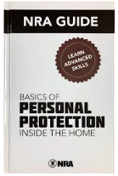
Gun Owners Responsibilities
Americans enjoy a right that citizens of many other countries do not—the right to own firearms. But with this right come responsibilities. It is the gun owner’s responsibility to store, operate and maintain his or her firearms safely. It is the owner’s responsibility to ensure that unauthorized or untrained individuals cannot gain access to his or her firearms.
It is the gun owner’s responsibility to learn and obey all applicable laws that pertain to the purchase, possession and use of firearms in his or her locale. Guns are neither safe nor unsafe by themselves. When gun owners learn and practice responsible gun ownership, guns are safe.

Slide 7
Lesson I
Introduction To
Defensive Shooting

Slide 8
Learning Objectives
Upon completion of this lesson you should be able to:
Explain the importance of using a firearm responsibly and ethically for personal protection.
Explain the importance of developing the proper mindset for using a firearm for personal protection and facing a life-threatening encounter.
Explain and evaluate your state of mental awareness using the four levels of awareness
Explain the importance of mental preparation and physical training for a potentially life-threatening confrontation.

Slide 9
Ethical Responsibility
Tool of last resort
“The best way to win a confrontation is to avoid a confrontation.”
Are you capable of using deadly force?
Preparation
Religion
Moral standards
Judgment
Mental preparation

Slide 10
Mindset
NEVER GIVE UP!!!!
Training
Develop a plan
Practice visualization
Practice the plan
Continue training
Visualize target
Control the encounter

Slide 11
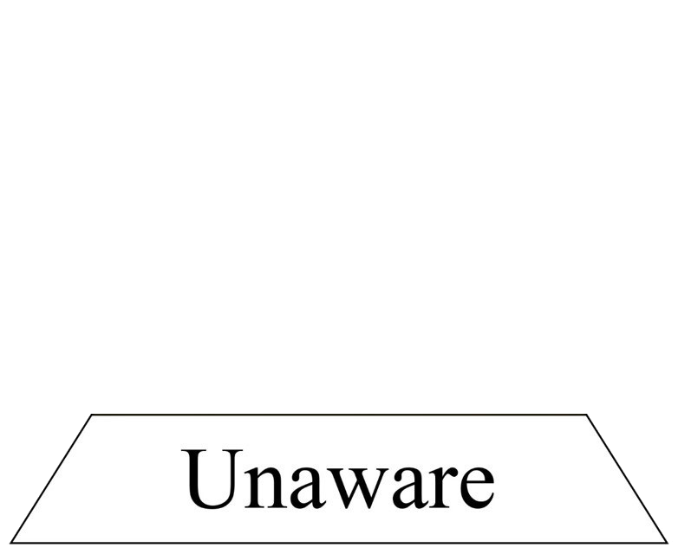
Mental Awareness
Levels of awareness
Maintaining awareness

Slide 12
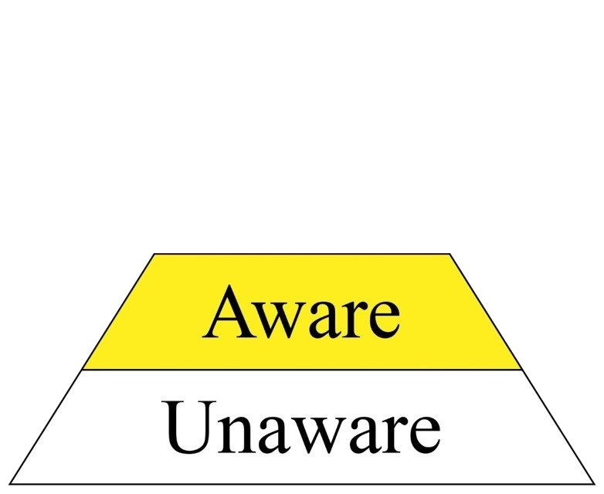
Mental Awareness
Levels of awareness
Maintaining awareness

Slide 13
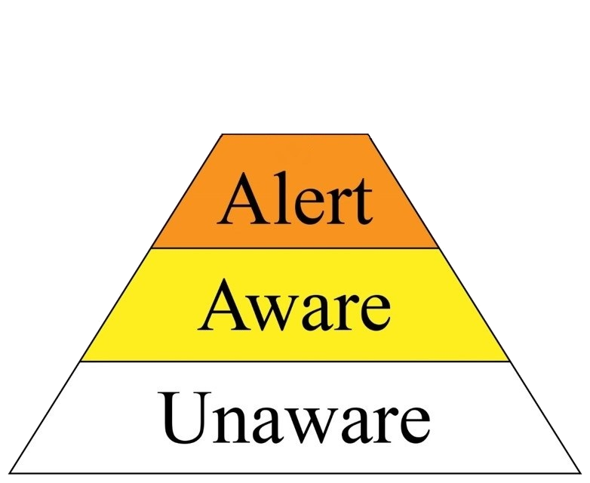
Mental Awareness
Levels of awareness
Maintaining awareness

Slide 14
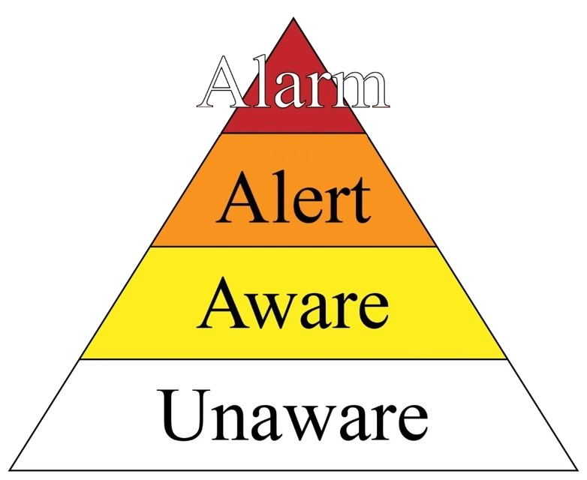
Mental Awareness
Levels of awareness
Maintaining awareness

Slide 15
Mental Awareness
Levels of awareness
Maintaining awareness

Slide 16
Confronting an Intruder or Assailant
Defensive confrontations
Controlling the encounter
Psychological reactions (five possible)
Fight
Flight
Freeze
Posture
Submit
Cannot predict response
Responses may escalate
Assailant responses

Slide 17
Confronting an Intruder or Assailant Cont…
Physiological reactions
Loss of fine motor skills
Tunnel vision
Auditory exclusion
Time dilation
Adrenaline rush
Training for stress
Visualization while training

Slide 18
If You Must Shoot
Number of shots
No immediate effect or apparent injury
Spotting hits
Incoming fire

Slide 19
Lesson Summary
As a result of your participation in this lesson, you can now:
Explain the importance of using a firearm responsibly and ethically for personal protection.
Explain the importance of developing the proper mindset for using a firearm for personal protection and facing a life-threatening encounter.
Explain and evaluate your state of mental awareness using the four levels of awareness.
Explain the importance of mental preparation and physical training for a potentially life-threatening confrontation.

Slide 20
What ARE Your Questions?

Slide 21
Lesson II
Basic Defensive Pistol Skills

Slide 22
Learning Objectives
Upon completion of this lesson you should be able to:
Explain and demonstrate the fundamentals of defensive marksmanship.
Explain defensive accuracy.
Shoot targets in the center of mass using aimed shots from a two-handed standing position.
Explain the differences between cover and concealment, and identify examples of each.
Shoot targets in the center of mass:
Using a flash sight picture.
Using Cover and Concealment.
From a Kneeling Position.
At Close Range Using Point Shooting.

Slide 23
Range Safety Briefing
Topics to be Covered
Purpose of the shooting event
Range layout and limits
Range safety rules
Range commands
Emergency procedures

Slide 24
Purpose of the Shooting Event
LIVE Fire Exercises for Personal Protection In The Home Course
Chief Range Safety Officer
Range Safety Officers
Any other range personnel

Slide 25
Range Layout and Limits
Entry and exit routes
Ready line
Firing line
Firing points
Left and right range limits
Safety berms
Target area
Target and firing line numbers

Slide 26
Range Layout and Limits (Continued)
Backstop and impact area
Downrange
Range flags or warning markers
Other physical safety features of the range
First-aid kit
Phone
Fire extinguishers
Any other applicable equipment

Slide 27
Range Safety Rules
NRA Gun Safety Rules
General range safety rules
Site specific rules
Administrative rules
ALWAYS Keep the gun pointed in a safe direction.
ALWAYS Keep your finger off the trigger until ready to shoot.
ALWAYS Keep the gun unloaded until ready to use.

Slide 28
Range Commands
“Load”
“Commence firing”
“Cease firing”

Slide 29
Emergency Procedures
What to do if there is an emergency?

Slide 30
Defensive Accuracy
Larger groups
Balanced speed with accuracy
Aim at the center of mass
Determining individual ability

Slide 31
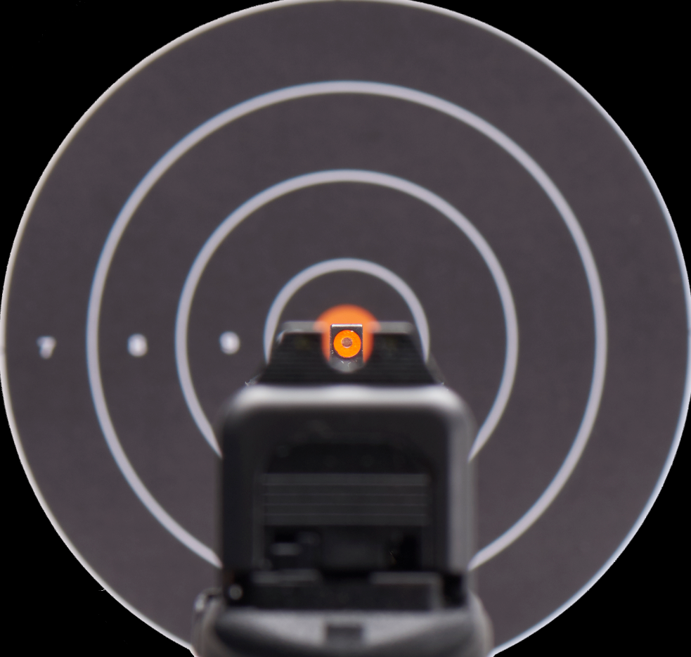
Fundamentals of Marksmanship
Aiming
Sight alignment
Sight picture
Breath control
Hold control (grip)
Trigger control
Finger placement
Trigger movement
Follow-through

Slide 32
Elements of a Good Shooting Position
Consistency
Balance
Support
Natural Aiming Area (NAA)
Comfort

Slide 33
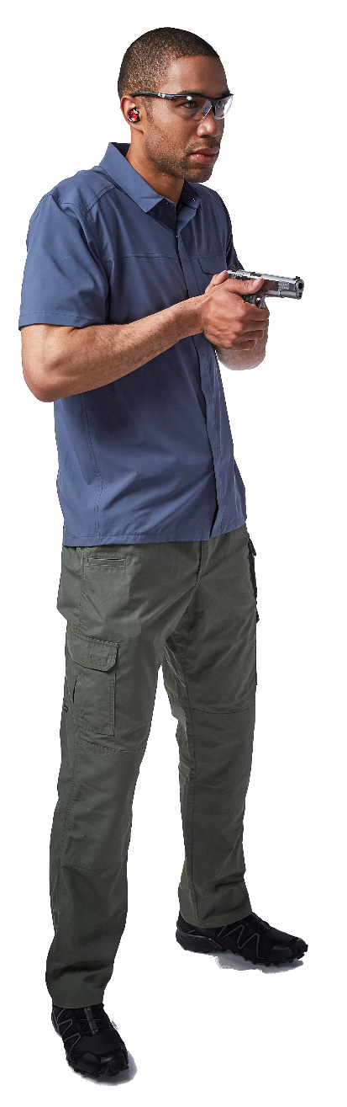
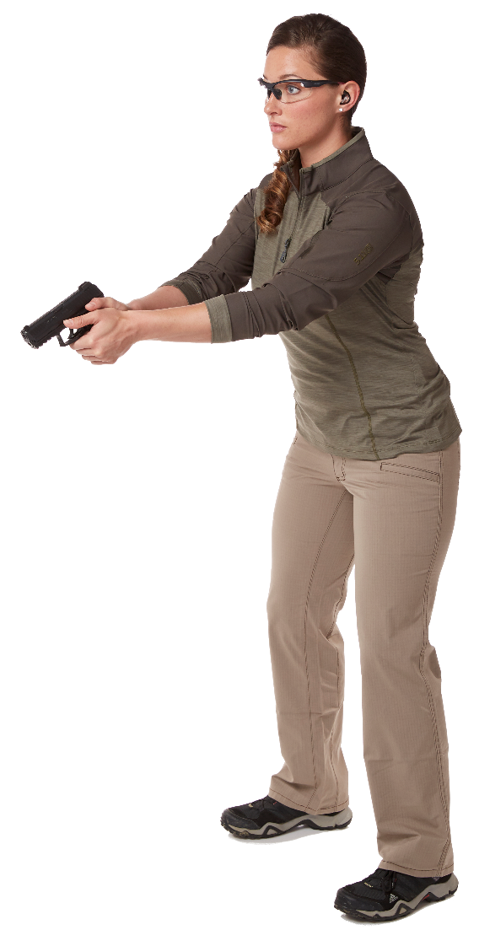
Two Handed Standing Ready Positions
Low ready
Retention ready/
High ready

Slide 34
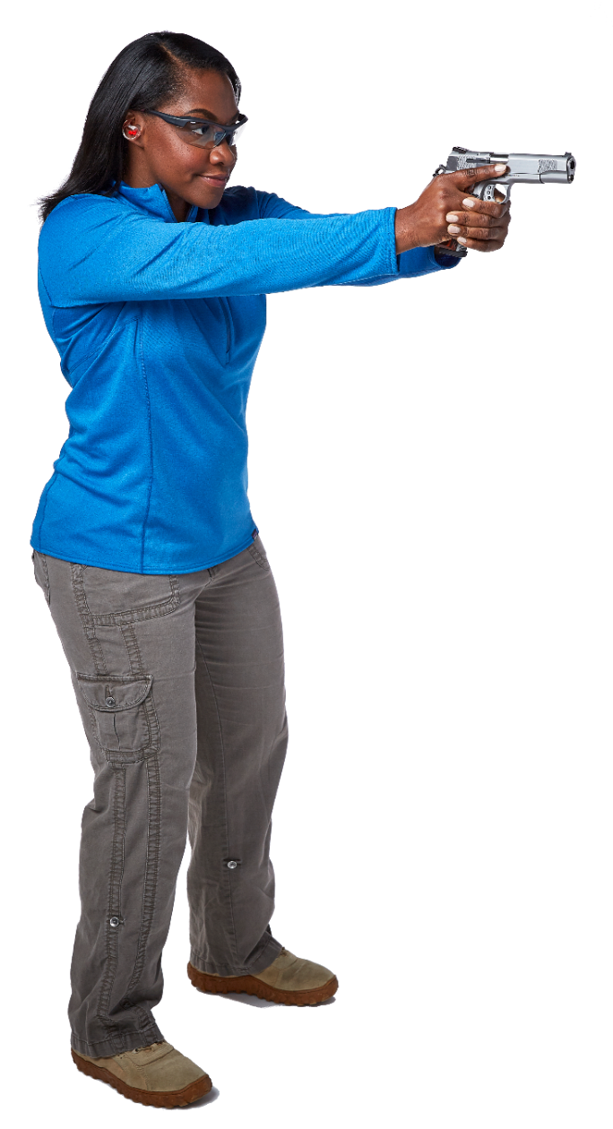
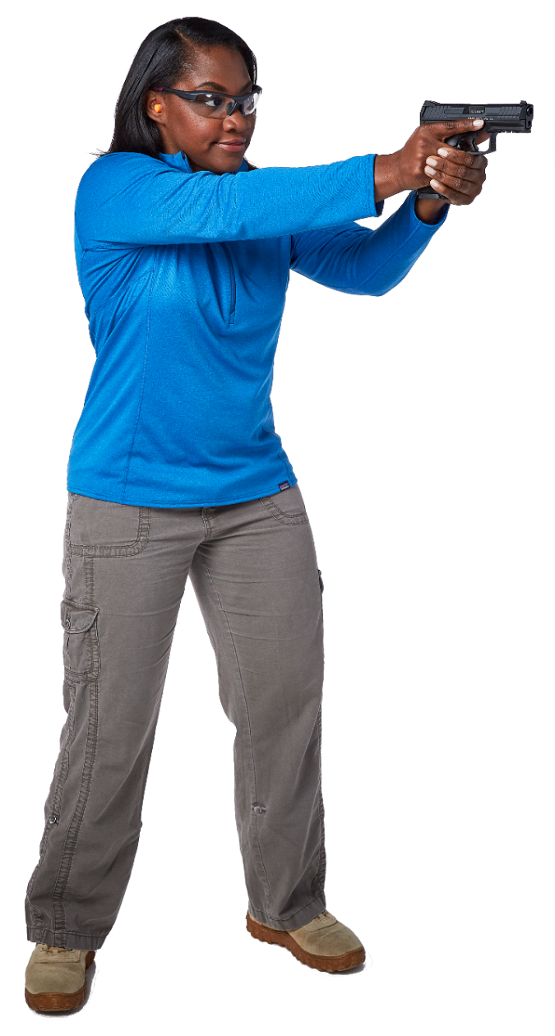
Two Handed Standing Shooting Positions
Isosceles position
Weaver position

Slide 35
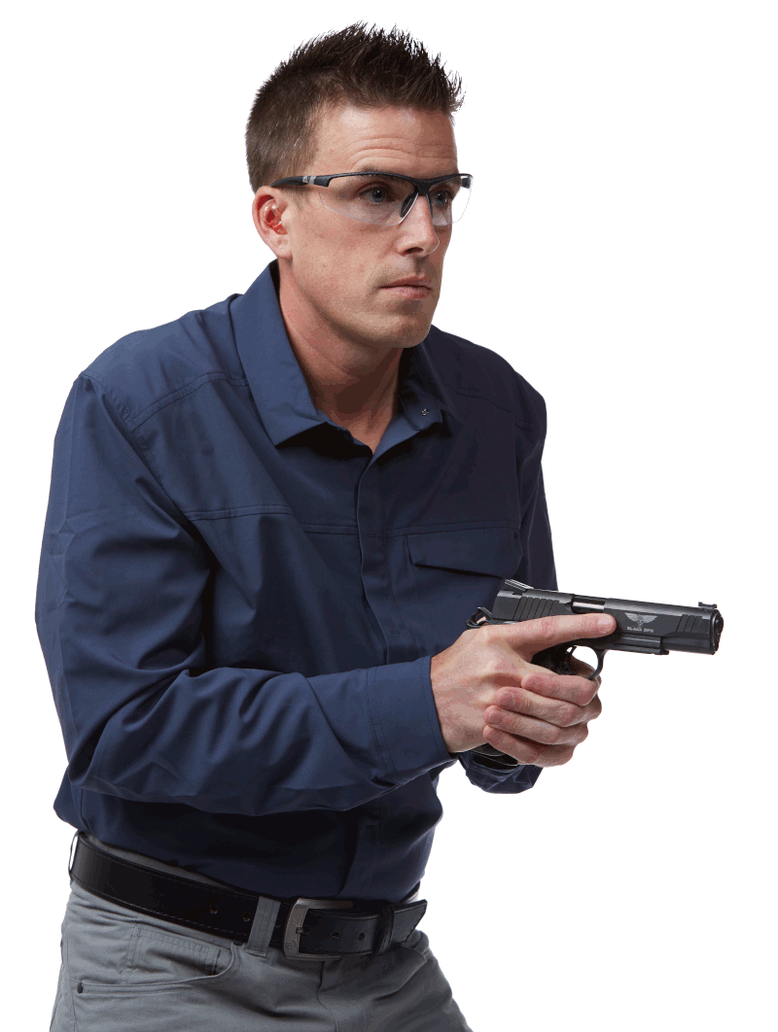
Defensive Shooting Skills
Scanning & Assessing the area for the additional threats
Range Safety
For safety purposes on the range, be careful not to allow your muzzle to turn with your head when assessing left and right.
Notes:
Animation repeats 2x

Slide 36
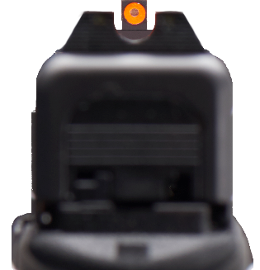
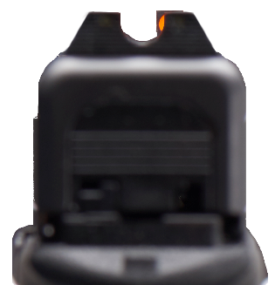
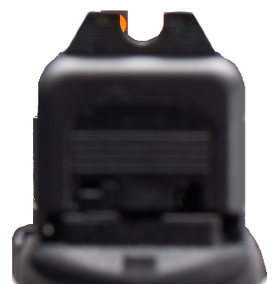
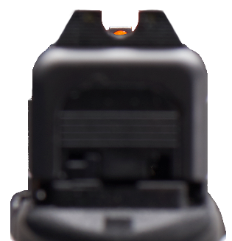
Defensive Shooting Skills
Flash sight picture (sight deviation)
Imperfect alignment
Quick acquisition
Rapid engagement
Distance equals time
Fig. 1
Fig. 3
Fig. 2
Fig. 4

Slide 37
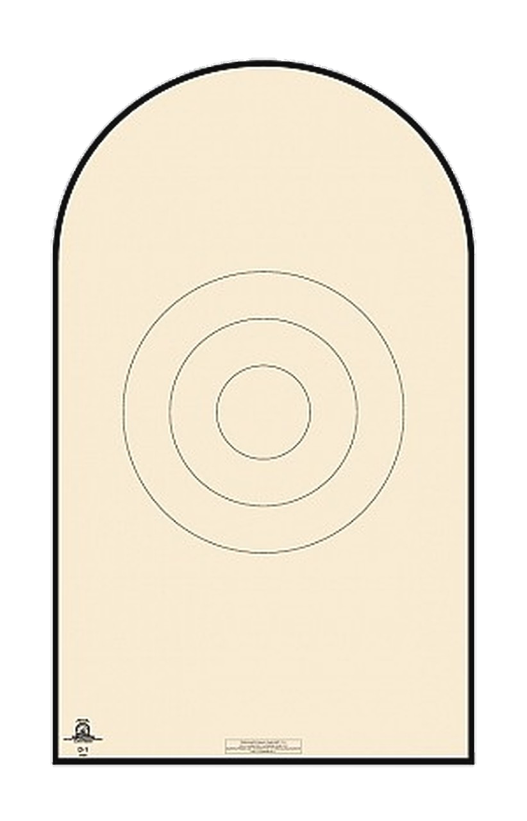
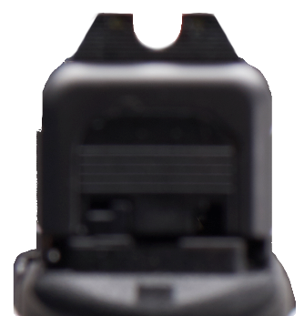
Defensive Shooting Skills
Flash sight picture (sight deviation continued)
Center of Mass
Fig. 1
Fig. 3
Fig. 2
Fig. 4

Slide 38

Defensive Shooting Skills
Flash sight picture (sight deviation continued)
Center of Mass
Fig. 1
Fig. 3
High Center
Center Right
Fig. 2
Fig. 4
Center Left
Low Center

Slide 39
Defensive Shooting Skills
Flash sight picture (sight deviation continued)
Center of Mass
Fig. 1
Fig. 3
Fig. 2
Fig. 4

Slide 40
Defensive Shooting Skills
Flash sight picture (sight deviation continued)
Center of Mass
Fig. 1
Fig. 3
Fig. 2
Fig. 4

Slide 41
Defensive Shooting Skills
Flash sight picture (sight deviation continued)
Center of Mass
Fig. 1
Fig. 3
Fig. 2
Fig. 4

Slide 42
Cover vs. Concealment
Cover
Concealment
Cover vs. concealment
Common household objects: cover or concealment?
Shooting from cover

Slide 43
Defensive Shooting Skills
Kneeling position
Point shooting
Verbal challenge
Tueller Drill

Slide 44
Shooting Exercises
Warm up exercise
Flash sight picture sight deviation
Accelerated shots
Cover and concealment
Kneeling position
Point shooting
Verbal challenge drill
Tueller drill

Slide 45
NRA Gun Safety Rules
ALWAYS Keep The Gun Pointed In A Safe Direction
ALWAYS Keep Your Finger Off The Trigger Until Ready To Shoot
ALWAYS Keep The Gun Unloaded Until Ready To Use

Slide 46
Lesson Summary
As a result of your participation in this lesson, you can now:
Explain and demonstrate the fundamentals of defensive marksmanship.
Explain defensive accuracy.
Shoot targets in the center of mass using aimed shots from a two-handed standing position.
Explain the differences between cover and concealment, and identify examples of each.
Shoot Targets in the Center of Mass:
Using a flash sight picture.
Using Cover and Concealment.
From a Kneeling Position.
At Close Range Using Point Shooting.

Slide 47
What ARE Your Questions?

Slide 48
Lesson III
Firearms and the Law:
Possession, Ownership,
and the Use of Deadly Force

Slide 49
Learning Objectives
Upon completion of this lesson you should be able to:
Explain key provisions of the law pertaining to the purchase, transfer and possession of pistols.
State key provisions and restrictions within the law pertaining to the use of deadly force.
Explain potential criminal and civil legal actions that may be taken against you subsequent to a defensive encounter.
Explain where you may find detailed legal information for their specific jurisdiction.

Slide 50
Obtaining a Pistol
Federal law
State and local law
Intrastate acquisition
Interstate acquisition

Slide 51
Laws
Transferring a gun
Possession
Home
Place of business
Curtilage
Temporary residences (hotel, camping etc..)
Automobile
Open carry
Concealed carry
Public places
Government offices

Slide 52
Laws
Transportation
In Vehicle
On board public mass transit vehicle
In airports and on aircraft
Going to or from a range or hunting
Interstate transportation
Other

Slide 53
Use Of Deadly Force
Use of reasonable force
Standard of “the reasonable man”
Use of deadly force
Ability of attacker
Presence of Imminent threat
Innocent victim of attack
Duty to retreat
Castle doctrine
Cessation of threat
Transferred intent
Brandishing

Slide 54
Laws
Potential legal aftermath of using justified deadly force
Criminal investigation
Fifth Amendment protections
Civil actions

Slide 55
Resources for Legal Information
Legal information
Obtaining legal representation

Slide 56
Lesson Summary
As a result of your participation in this lesson, you can now:
Explain key provisions of the law pertaining to the purchase, transfer and possession of pistols.
State key provisions and restrictions within the law pertaining to the use of deadly force.
Explain potential criminal and civil legal actions that may be taken against you subsequent to a defensive encounter.
Explain where you may find detailed legal information for their specific jurisdiction.

Slide 57
What ARE Your Questions?

Slide 58
Lesson IV
Strategies for Home Safety
and Responding
to a Violent Confrontation

Slide 59
Learning Objectives
Upon completion of this lesson you should be able to:
Explain strategies and methods to your personal safety at home and in public.
Describe strategies for responding to a potentially life-threatening encounter.
Explain the importance of mentally preparing for the aftermath of a violent confrontation.
Explain methods for safely storing a personal protection pistol.

Slide 60
Strategies For Home Safety
Making yourself and your home safer:
Self
Residence
Grounds and landscaping
Exterior
Interior
Safe room

Slide 61
Strategies For Home Safety
Emergency plan for responding to a possible break-in
Retreat to safety
Secure the room
Call police/911
Verbal warning
Secure/lock door
Retrieve and load firearm
Have phone ready
Have flashlight ready (if appropriate)
Listen

Slide 62
Strategies For Home Safety
When the police arrive:
Establishing contact with police on the scene
Police entry
Greeting the police

Slide 63
Emotional Aftermath
Stages of emotion
Elation
Revulsion
Remorse
Self doubt
Acceptance
Post-Traumatic Stress
Counseling
Self reinforcement

Slide 64
Legal Aftermath
Criminal Investigation
Civil actions
Self incrimination
Boasting/Bravado

Slide 65
Safe Storage
Safe storage rule
Considerations for safe storage
Methods of safe storage
Diligence- “Your gun is always somewhere.”
Trigger locks
Key locks and dial combinations

Slide 66
Lesson Summary
As a result of your participation in this lesson, you can now:
Explain strategies and methods to enhance your personal safety home and in public.
Describe strategies for responding to a potentially life-threatening encounter.
Explain the importance of mentally preparing for the aftermath of a violent confrontation.
Explain methods for safely storing a personal protection pistol.

Slide 67
What ARE Your Questions?

Slide 68
Lesson V
Selecting a Pistol for Self-Defense

Slide 69
Learning Objectives
Upon completion of this lesson you should be able to:
Identify the criteria for selecting a pistol and ammunition suited to your individual self-defense needs.
Identify major cartridge designs available for practice and personal protection and explain the use, advantages, and disadvantages of each type.

Slide 70
Selecting A Pistol
Fit
Power
Functional reliability
Revolvers vs. Semi-Auto
Size
Caliber
Other features
New vs. Used
Import vs. Domestic
Modifications

Slide 71
Ammunition Considerations
Power vs. Overpenetration
Minimum adequate caliber
+P, +P+, and Magnums

Slide 72
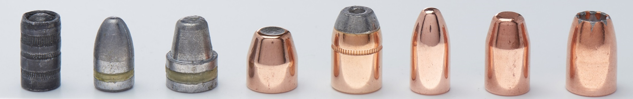
Bullet Types Continued
Wadcutter
Lead round nose
Semi-wadcutter
Jacketed soft-point
Jacketed hollow-point
Full metal jacket
Frangible projectile
Hollow-point
Premium defensive ammunition

Slide 73
Ammunition
Testing personal protection ammunition
Personal protection vs. Practice ammunition
Functioning
Changing ammunition

Slide 74
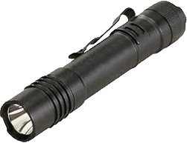
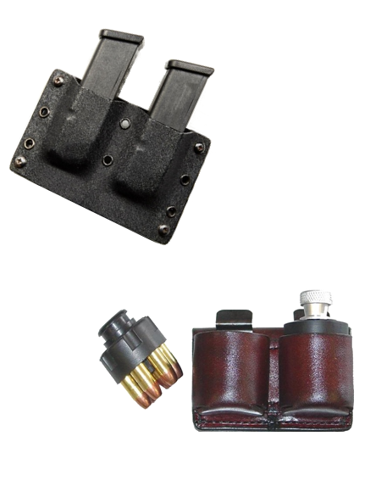

Accessories
Flashlight
Spare batteries and bulbs
Extra Loading Devices
Magazines for Semi-automatic Pistols
Speed Loaders for Revolvers
Cell Phone

Slide 75
Lesson Summary
As a result of your participation in this lesson, you can now:
Identify the criteria for selecting a pistol and ammunition suited to your individual self-defense needs.
Identify major cartridge designs available for practice and personal protection and explain the use, advantages, and disadvantages of each type.

Slide 76
What ARE Your Questions?

Slide 77
Lesson VI
Sport Shooting Activities
and Training Opportunities

Slide 78
Learning Objectives
Upon completion of this lesson you should be able to:
Identify organizations, associations, clubs and businesses that may help hone, enhance, and expand your personal protection skills.
Explain methods and precautions for dry-practice.

Slide 79

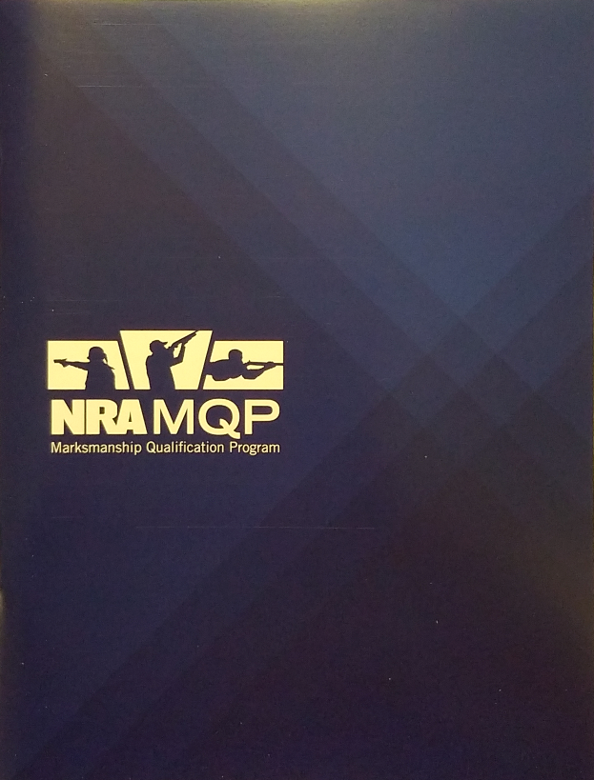
NRA Marksmanship Qualification Program
The NRA Marksmanship Qualification Program is a self-paced skill development program which allows shooters to earn awards while practicing by themselves or with others.

Slide 80
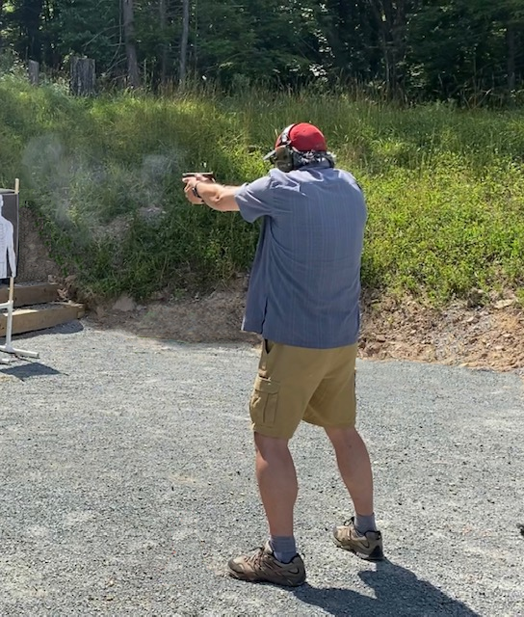
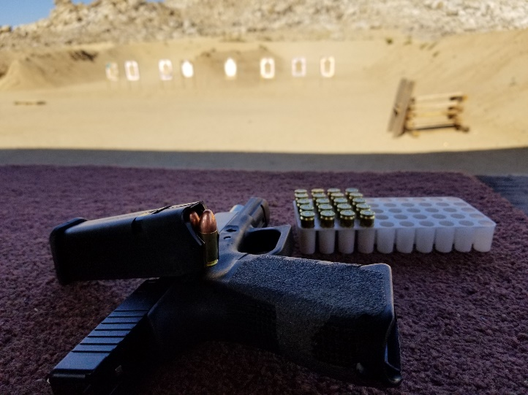
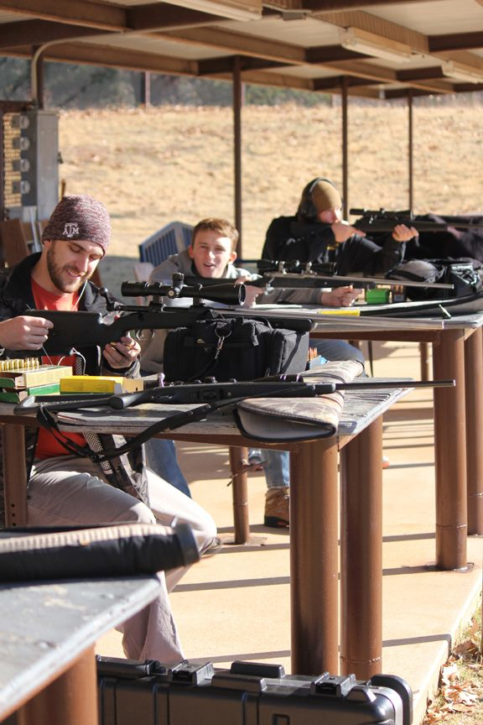
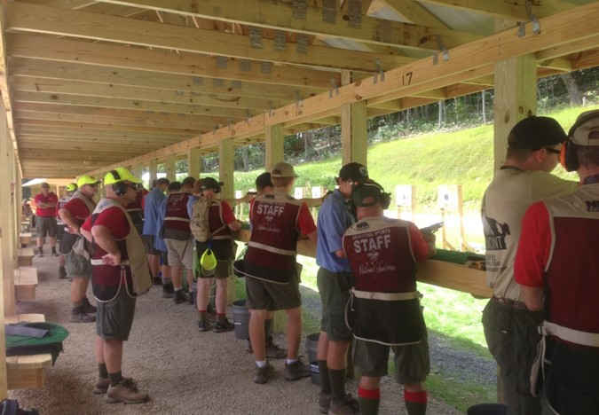
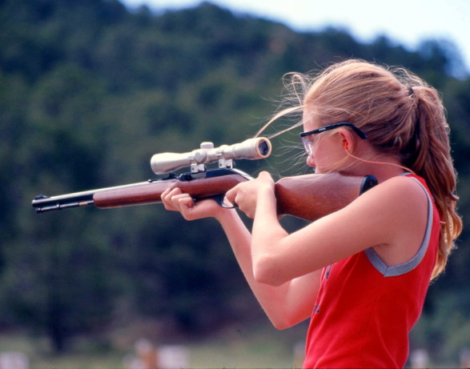
Recreational Shooting

Slide 81

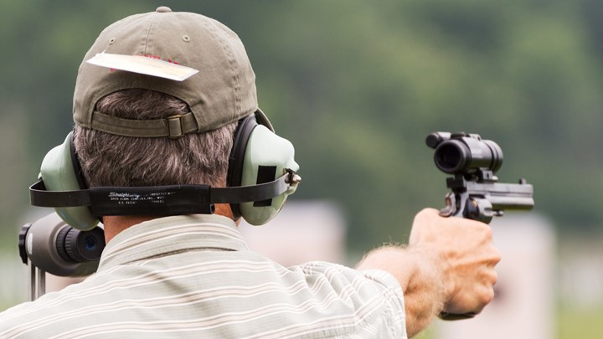
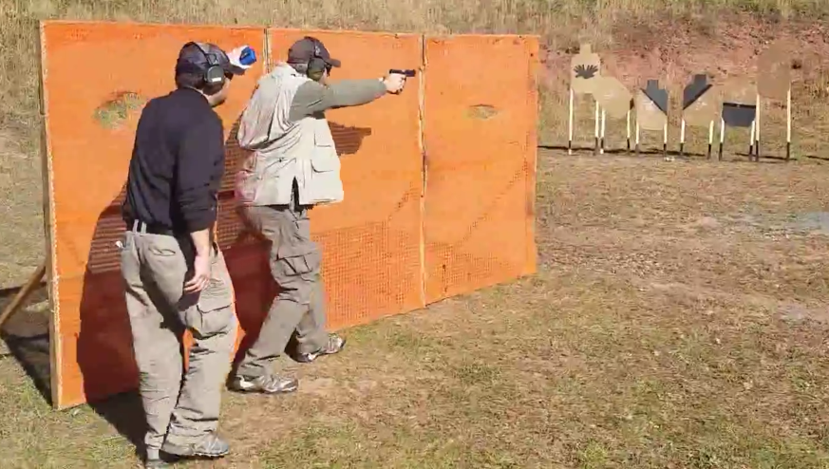
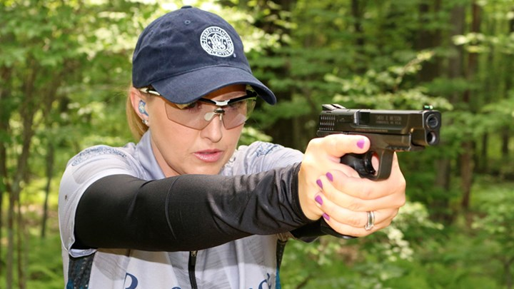
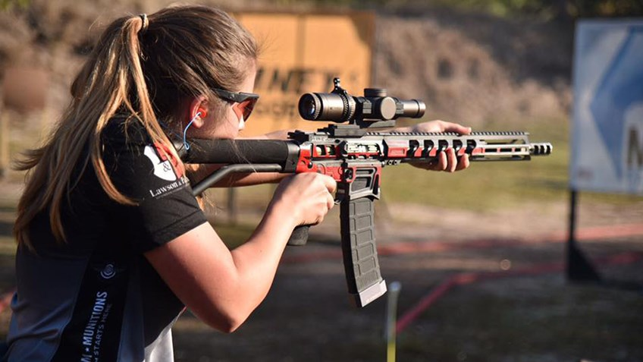
Shooting Activities
Competitive shooting events
Local Shooting Club Matches
State Matches
Regional Matches
National Matches

Slide 82
Competitive Shooting
NRA competitive shooting division sanctions pistol shooting tournaments and leagues nationwide.
Competitive disciplines include:
Bullseye
Action pistol
Pistol silhouette
Air pistol
NRA publishes Shooting Sports USA for competitive shooters.

Slide 83
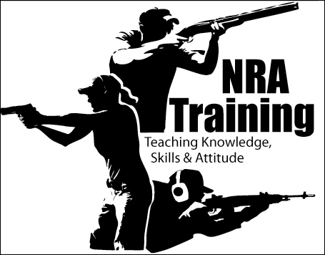
Additional NRA Training Opportunities
NRA Training
Other shooting organizations
Commercial training facilities
Books periodicals and videos
Dry Practice
www.nrainstructors.org

Slide 84
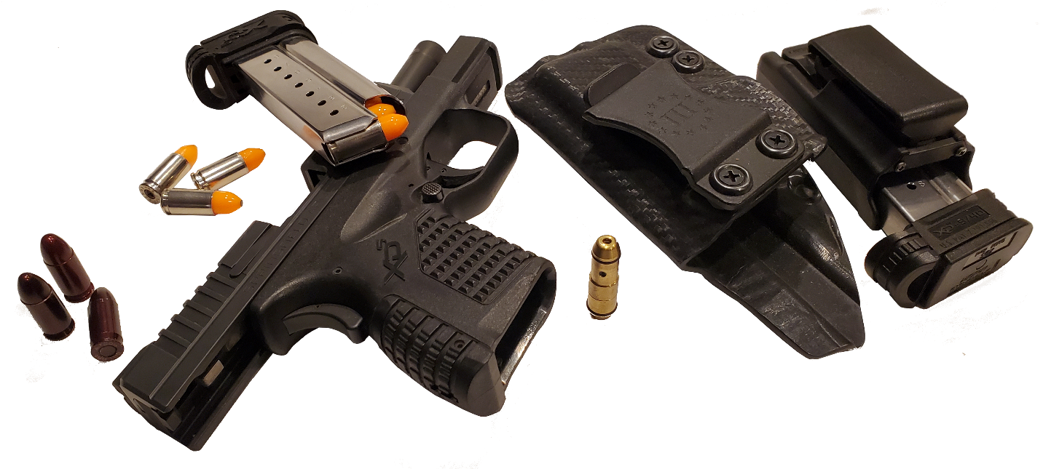
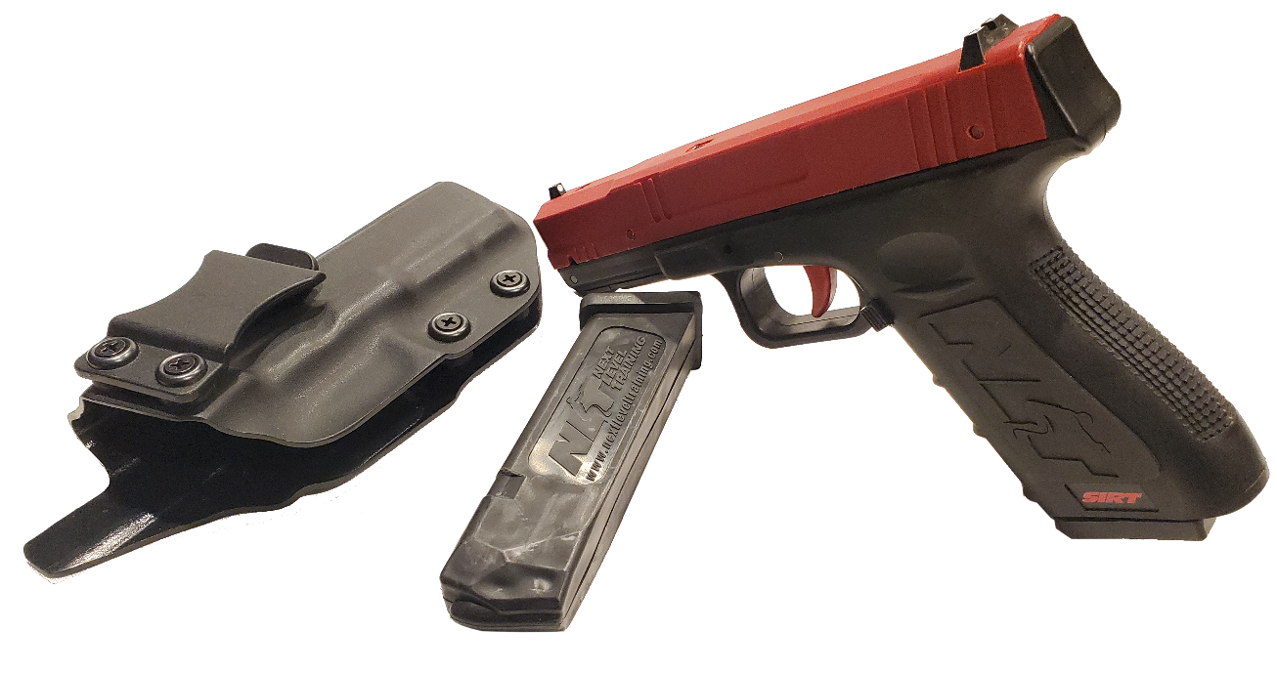
Additional Training Opportunities
Dry Practice
Conditions of the dry practice area
Precautions

Slide 85
Lesson Summary
As a result of your participation in this lesson, you can now:
Identify organizations, associations, clubs and businesses that may help hone, enhance, and expand your personal protection skills
Explain methods and precautions for dry-fire practice.

Slide 86
What ARE Your Questions?

Slide 87
Lesson VII
Course Review and Examination

Slide 88
Learning Objectives
Upon completion of this lesson you should be able to:
Successfully complete the NRA Personal Protection In The Home Course written examination.

Slide 89
TEST
Review
Grade Exams
Evaluations

Slide 90

NRA History and Goals
The NRA was established in 1871, originally to promote marksmanship training.
NRA’s basic goals are to:
Protect and defend the Constitution of the United States, especially in regard to the Second Amendment.
Promote public safety, law and order, and the national defense.
Train members of law enforcement agencies, the armed forces, and people of good repute in the safe handling and effective use of firearms.
Foster and promote the shooting sports at local, state, regional, national and international levels.
Promote hunter safety and proper wildlife management.

Slide 91

NRA Clubs & Associations
The NRA Clubs & Associations Department provides services and assistance to a network of over 15,000 NRA affiliated clubs, associations,
and businesses. Visit their website, clubs.nra.org, for more activities, information and a way to search for an NRA affiliated club near you.
It is at the NRA affiliated clubs where you can find not only a place to shoot but also NRA classes, competitions and other event and activities.

Slide 92
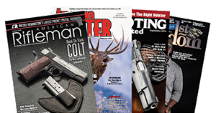

Benefits of NRA Membership
Magazine Choice: Subscription to American Rifleman, American Hunter, Shooting Illustrated, or America's 1st Freedom.
Members Only Discounts and Services: Discounts for travel through NRA Travel Center, NRA Coffee Club, and NRA Identity Protection.
SPECIAL SAVINGS from NRA Member Partners
FREE ADMISSION to NRA’s Guns, Gear & Outfitter Show
AND MORE!
More benefits may be found at http://benefits.nra.org

Slide 93
NRA Rules for Safe Gun Handling (POP-QUIZ)
1
ALWAYS Keep The Gun Pointed In A Safe Direction
ALWAYS Keep Your Finger Off The Trigger Until Ready To Shoot
ALWAYS Keep The Gun Unloaded Until Ready To Use
2
3

Slide 94
Dismissal
We want to thank you for your participation in this course, as well as the NRA Foundation and its generous donors for helping make this course possible.

