Slide 1
BoRS Version Control Worksheet Rev. 7-20
(This slide is hidden and should not show in the presentation to students)
Overall Design layout overhaul.
New Color scheme.
Pictures Updated & cleaned up.
Minimal Click-thru slides (Click-thru appropriately placed).
Hyperlinked Lesson Numbers.
Lesson Plan is built-in to each slide, in the Instructor Notes.
BoRS Splash Screen should be used for Gathering period & End of class.
3 Rules of Firearm Safety slides placed for Repeated Review, for the students, as the slide before each lesson summary.
Tutorial Slides added to help familiarize you with the new features of the slides. Best viewed in Presentation Mode.
KNOWN ISSUES
  Slide 58 – Rear notch is not even. Right side is slightly below left side. Will fix in future update.
Notes:
“In-Person” definition is made here to help define later slides as to when & where those Objectives MUST be met.

Slide 2
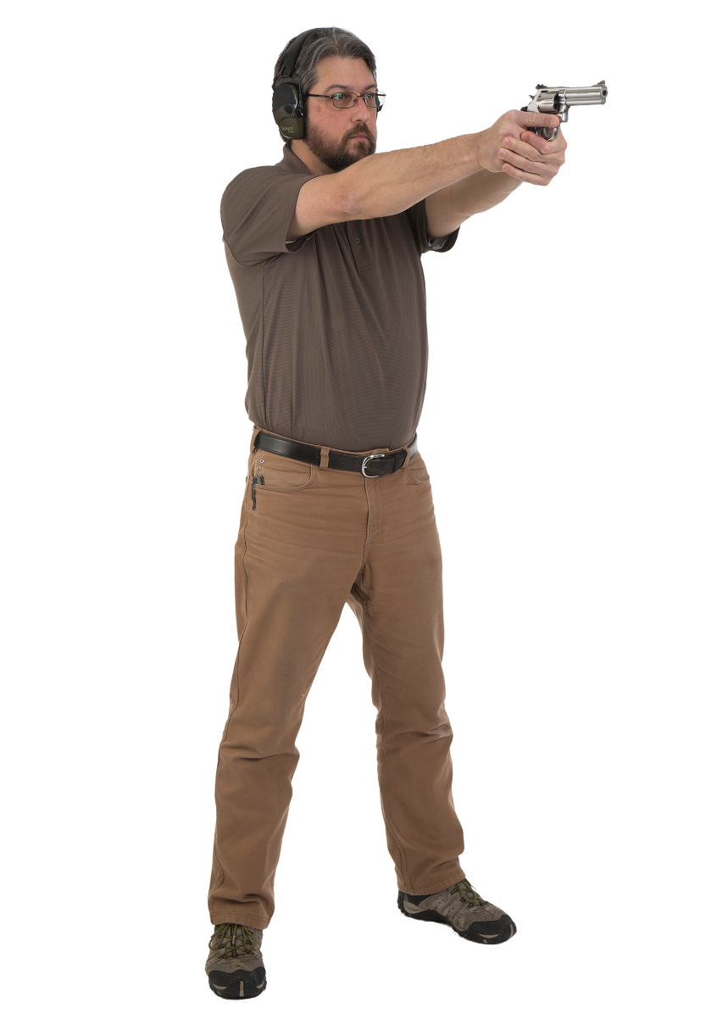
Tutorial Slide 1
Fewer Click-Thru lists, facilitating more efficient instructing.
NRA Training logo & Course Name on all slides
PISTOL HELD WITH PROPER GRIP
FEET SHOULDER WIDTH APART
WEIGHT EVENLY DISTRIBUTED
LEGS STRAIGHT
BACK STRAIGHT OR LEANING SLIGHTLY FORWARD
HEAD ERECT
ARMS FULLY EXTENDED
PISTOL BROUGHT TO EYE LEVEL
SHOOTER IS RELAXED AND COMFORTABLE
Hyperlinked Lessons available directly from within slide presentation mode.
Cleaner pictures throughout the slides
Notes:
*** Instructor Note: If possible, transition from the Benchrest position to the isosceles position by simply having the student(s) stand up from the Benchrest position.
Demonstrate the Isosceles shooting position. Explain that both hands are used to grip and support the pistol.
Have the students learn this position using the proper sequence of steps.
Study position
Demonstrate and describe the key points of the position, referring students to the pictures of the position in the handbook.
Describe and demonstrate the two-handed grip presented in the text.
Practice position without a pistol
Assist students in achieving the proper foot, arm and body position without a pistol.
Practice position with a pistol
Assist students in achieving the position with a pistol.
Check for:
Proper grip
Feet shoulder width apart and body weight distributed evenly
Legs straight
Back straight or bent slightly forward
Head erect
Arms fully extended
Pistol brought to eye level
Shooter should be relaxed and comfortable

Slide 3
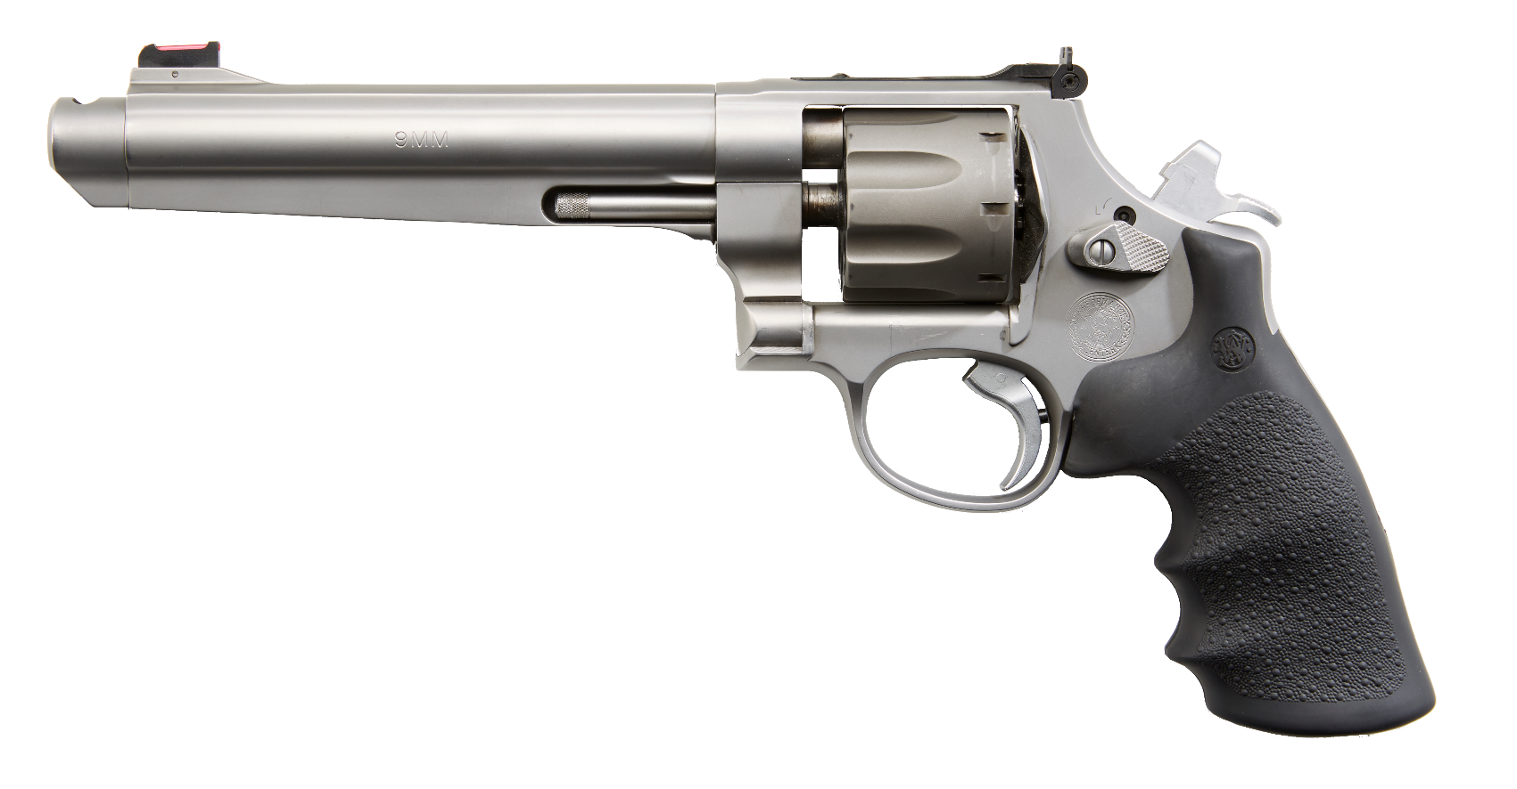
Tutorial Slide 2
Pictures re-touched.
Barrel
Action
(CONTAINED WITHIN FRAME)
Frame
New Description & Arrows
Curriculum Version number on all slides
Notes:
Define a revolver for the students: A revolver is a pistol that has a rotating cylinder containing a number of firing chambers. The action of the trigger or hammer will line up a chamber with the barrel and firing pin.
Explain that a revolver consists of three main parts:
Frame (The frame is the backbone to which all other parts are attached)
Barrel (The barrel is the metal tube through which the bullet passes)
Action (The action is a group of moving parts used to load, fire and unload a pistol)

Slide 5
Administrative Items
Policy Regarding:
Ammunition In The Classroom
Security Of Firearms
Restrooms And Drinking Fountains
Telephones And Emergency Exits
Refreshments & Snacks
Smoking Policy
Breaks And Lunch
Air Conditioning And Heating Adjustments
Cell Phones And Pagers
NO LIVE AMMUNITION IN THE CLASSROOM!
Notes:
Introduce the following:
Chief instructor
Assistants/staff
Cover the following administrative items with the students:
Policy regarding ammunition in the classroom.
Security of firearms
Restrooms and drinking fountains
Phones and emergency exits
Refreshments/snack policy
Smoking policy
Breaks and lunch
Air conditioning and heating adjustments
Cell phones and pagers

Slide 6
Gun Owner’s Responsibilities
Americans enjoy a right that citizens of many other countries do not—the right to own firearms. But with this right come responsibilities. It is the gun owner’s responsibility to store, operate and maintain his or her firearms safely. It is the gun owner’s responsibility to ensure that unauthorized or untrained individuals cannot gain access to his or her firearms. And it is the gun owner’s responsibility to learn and obey all applicable laws that pertain to the purchase, possession and use of a firearm in his or her locale. Guns are neither safe nor unsafe by themselves. When gun owners learn and practice responsible gun ownership, guns are safe.
Notes:
Read the “Gun Owner’s Responsibilities” in The NRA Guide to the Basics of Rifle Shooting to the class or TPI

Slide 7
LESSON I:
Rifle Knowledge
&
Safe Gun Handling
Notes:
Length: 2 hours (a 10-minute break should be given after 50 minutes of instruction)
Facility: Classroom
Required Materials:
The NRA Guide to the Basics of Rifle Shooting handbook
NRA Gun Safety Rules brochure
NRA Basic Rifle Shooting Course Wall Charts
Bolt-action, semi-automatic, lever-action and slide-action rifles
Dummy ammunition for the rifles mentioned above (All dummy rounds must be clearly distinguishable from live ammunition—no live ammunition can be present in the training classroom. See special note to the instructor on page 4 of the Introduction)
Notepads and pens or pencils—one per student
Other training aids as appropriate
References: The NRA Guide to the Basics of Rifle Shooting handbook

Slide 8
LESSON I:
Rifle Knowledge And Safe Gun Handling
Learning Objectives:
  As a result of your participation in this lesson you will be able to:
    State The Course Goal And Any Special Requirements For The Lessons
    Identify The Principal Parts Of A Rifle And The Types Of Rifle Actions, And Demonstrate How They Function
    State, Explain And Apply The NRA Rules For Safe Gun Handling
    Demonstrate How To Handle A Rifle In A Safe Manner
Notes:
Review the learning objectives for this lesson.
Learning Objectives:
As a result of their participation in this lesson, students will be able to:
State the course goal and any special requirements for the lessons.
Identify the principal parts of a rifle and the types of rifle actions, and demonstrate how they function.
State, explain and apply the NRA Rules for Safe Gun Handling.
Demonstrate how to handle a rifle in a safe manner.

Slide 9
Course Goal
To Teach The Basic Knowledge, Skills And Attitude Necessary For Owning And Using
A Rifle Safely.

Slide 10
Reasons Americans Choose To Own A Rifle
What are some reasons Americans choose to own a rifle?
Notes:
Ask the students for some of the reasons Americans choose to own rifles. Their responses should include:
Recreational shooting
Competitive shooting
Hunting
Protection of self and family
Collecting
Exercise of a constitutional right

Slide 11
Reasons Americans Choose To Own A Rifle
RECREATIONAL SHOOTING
COMPETITIVE SHOOTING
HUNTING
PROTECTION OF SELF AND FAMILY
COLLECTING
EXERCISE OF A CONSTITUTIONAL RIGHT
Notes:
Ask the students for some of the reasons Americans choose to own rifles. Their responses should include:
Recreational shooting
Competitive shooting
Hunting
Protection of self and family
Collecting
Exercise of a constitutional right

Slide 12
Common Rifle Action Types
Most Common
Bolt-Action
Semi-Automatic
Lever-Action
Slide-Action
Less Common
Falling Block
Rolling Block
Hinge-Action
Notes:
Explain that the four most common rifle types that will be discussed in this course are:
Bolt-action
Semi-automatic
Lever-action
Slide-action
There are several other, less commonly encountered rifle action types:
Falling block
Rolling block
Hinge-action
over/under
side-by-side
single barrel
drilling (a multi-barrel gun combining, usually, one or more shotgun barrels with one or more rifle barrels)

Slide 13
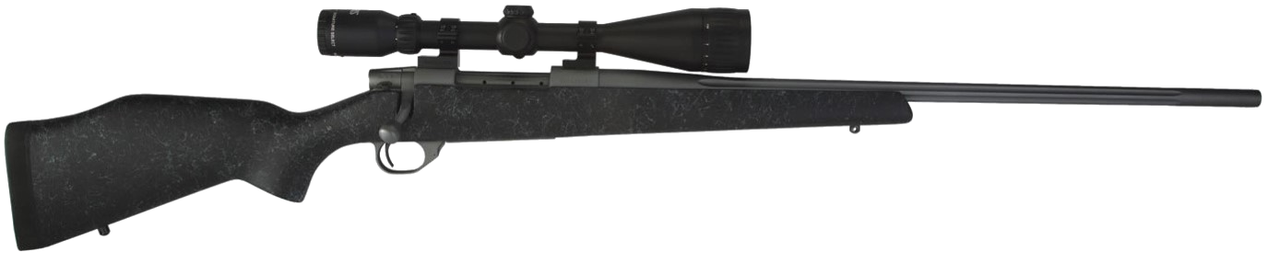
Main Parts Of A Rifle
ACTION
(Group of Moving Parts Used to Load, Fire and Unload A Rifle)
BARREL
STOCK
A rifle is a type of firearm designed to be fired with two hands, having a relatively long rifled barrel and a buttstock intended to be placed against the shoulder.
Notes:
DISPLAY RIFLE WALL CHARTS
Define a rifle for the students:
A rifle is a type of firearm designed to be fired with two hands, having a relatively long rifled barrel and a buttstock intended to be placed against the shoulder.
Explain that all rifles consist of three main parts: the action, the barrel, and the stock.

Slide 14
Rifle Action Parts
Receiver
Trigger
Firing pin
Sear
Hammer
Hammer spur
Breech bolt or breech block
Extractor
Notes:
The action is a group of moving parts used to load, fire and unload a rifle.
Point out and describe the functions of the following action parts common to all rifles:
Receiver (the component that houses the other action parts, and to which the barrel and stock and, often, the scope or rear sights, are also attached)
Trigger (when pulled it activates the hammer)
Firing pin (the component having a needle-shaped projection that impacts the primer or case rim to fire the cartridge)
Sear (on some guns, a part that releases the hammer or firing pin when the trigger is pulled)
Hammer (on some guns, causes the firing pin to strike and fire the cartridge)
Hammer spur (the projection on the hammer that may be gripped by the thumb)
Breech bolt or breech block (the component that seals the breech end of the barrel and is usually mechanically locked in the closed position)
Extractor (pulls an empty cartridge case or unfired cartridge from the chamber when the action is opened)
Ejector (throws empty cases or unfired rounds from the action)
Ejection port (an opening in the receiver through which spent cases or live rounds may be ejected from the action)
Trigger guard (the component that surrounds the trigger and helps prevent inadvertent trigger contact)
Rear sight/scope (rear iron sights, such as aperture sights, as well as telescopic and red-dot sights, are commonly mounted on the receiver)
Safety (a mechanical device that is intended to prevent firing by blocking the trigger, sear, hammer or firing pin).
Magazine (a device that holds cartridges for feeding into the chamber as the action is cycled; may be of box, tube or rotary design)
Magazine release (a button or lever that releases the magazine when activated)
Demonstrate the functions of the action parts using the sample rifles.
When using an actual gun in a demonstration, verify that it is unloaded, have a student perform a secondary verification that it is unloaded, and ensure that it is pointed in a safe direction at all times.
Emphasize that a safety is a mechanical device that can fail. A safe shooter is the most reliable safety.

Slide 15
Rifle Action Parts
Ejector
Ejection port
Trigger guard
Rear sight/scope
Safety
Magazine
Magazine release
Notes:
Ejector (throws empty cases or unfired rounds from the action)
Ejection port (an opening in the receiver through which spent cases or live rounds may be ejected from the action)
Trigger guard (the component that surrounds the trigger and helps prevent inadvertent trigger contact)
Rear sight/scope (rear iron sights, such as aperture sights, as well as telescopic and red-dot sights, are commonly mounted on the receiver)
Safety (a mechanical device that is intended to prevent firing by blocking the trigger, sear, hammer or firing pin).
Magazine (a device that holds cartridges for feeding into the chamber as the action is cycled; may be of box, tube or rotary design)
Magazine release (a button or lever that releases the magazine when activated)
Demonstrate the functions of the action parts using the sample rifles.
When using an actual gun in a demonstration, verify that it is unloaded, have a student perform a secondary verification that it is unloaded, and ensure that it is pointed in a safe direction at all times.
Emphasize that a safety is a mechanical device that can fail. A safe shooter is the most reliable safety.

Slide 16
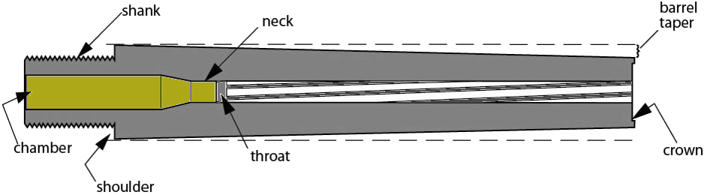
Parts Of A Rifle Barrel
A barrel is the metal tube through
which the bullet passes.
Rifling
Land
Rifling
Groove
Muzzle
Bore/
Measure Caliber
Front Sight Not Shown
Notes:
The barrel is the metal tube through which the bullet passes.
Point out and describe the functions of the following barrel parts or characteristics common to all rifles:
Bore (the hole inside the barrel)
Rifling (the spiral lands and grooves cut into the bore. Rifling imparts a spin to the bullet, which stabilizes its flight.)
Muzzle (the front end of the barrel where the bullet exits)
Front sight (used with the rear sight in aiming; both front and rear sights are sometimes mounted on the barrel)
Caliber (the diameter of the bore, measured across the lands or, sometimes, across the grooves, in decimal fractions of an inch or in millimeters)
Demonstrate the functions of the barrel components using the sample rifles.

Slide 17
Lands and Grooves
RIFLING
SPIRALING LANDS AND GROOVES
THAT ENGRAVE THE BULLET AND
GIVE IT SPIN AS IT TRAVELS
THROUGH THE BORE
CALIBER
MEASUREMENT OF DIAMETER OF BARREL
MM/CAL 6 mm Remington = .244 Remington
LAND
GROOVE
GROOVE
LAND
Notes:
Rifling (the spiral lands and grooves cut into the bore. Rifling imparts a spin to the bullet, which stabilizes its flight.)

Slide 18
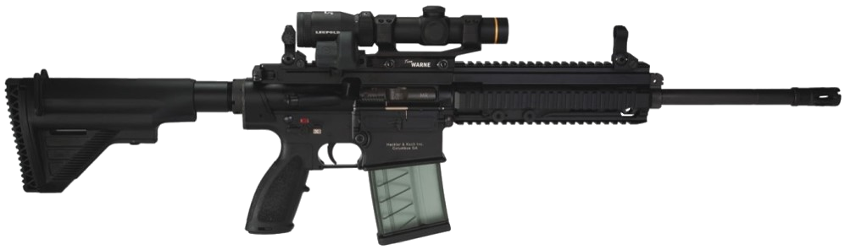
Rifle Stock
Fore-end / Forearm
Comb
Butt
Buttpad /
Buttplate
Pistol Grip
Notes:
The stock is the component that is held by the hands and positioned against the shoulder. Modern rifle stocks may be made of wood, fiberglass and other synthetic materials, or aluminum, or combinations of these materials.
Point out and describe the functions of the following stock components common to all rifles:
Butt (the rear end of the stock that sits against the shoulder)
Buttpad (the cushioned pad, made of rubber or similar materials, that is affixed to the end of the butt and contacts the shoulder)
Buttplate (on guns lacking a buttpad, the thin metal plate that is affixed to the end of the butt and sits against the shoulder)
Comb (the upper surface of the butt that the face rests against)
Wrist (the part of the stock, just to the rear of the receiver, that is gripped by the firing hand)
Pistol grip (on some stocks, the part shaped like the grip of a pistol, that is gripped by the firing hand)
Fore-end or forearm (the forward-extending part of the stock that sits under the barrel, and which rests on the support hand or sandbag)
Demonstrate the functions of the stock components using the sample rifles.

Slide 19

Rifle Stock
Fore-end / Forearm
Comb
Wrist
Butt
Buttpad /
Buttplate
Notes:
Define a bolt-action rifle for the students:
A bolt-action rifle is a firearm in which a cylindrical bolt with a protruding handle is manually moved forward and rearward to feed, chamber, extract and eject cartridges, as well as cock the action. The bolt handle is most commonly turned down to lock the action, and lifted to unlock and open it.
Point out the following specific features of bolt-action rifles:
Comb
Fore-end / Forearm
Wrist
Butt
Buttpad / Buttplate
Explain the function of these components, and demonstrate their use with the sample bolt-action rifle.

Slide 20
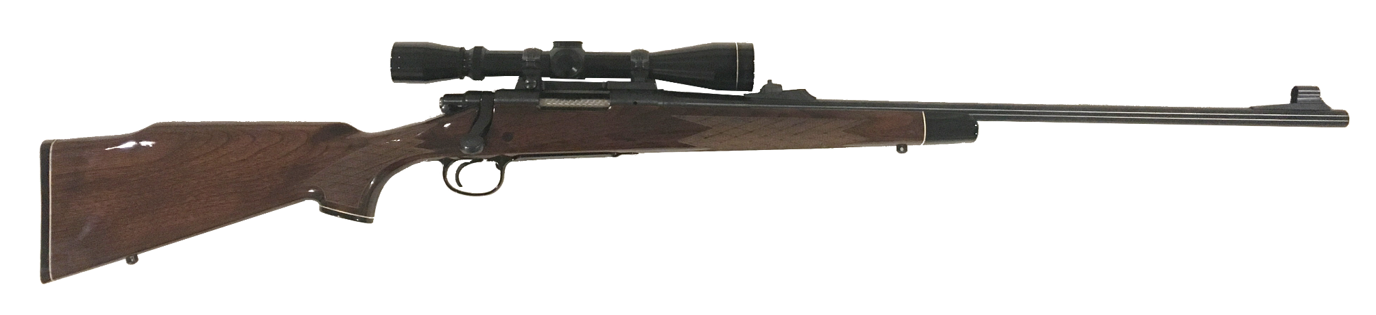
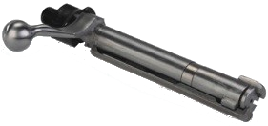
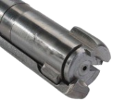
Parts of a Bolt Action Rifle
A Bolt-action rifle is a firearm in which a cylindrical bolt with a protruding handle is manually moved forward and rearward to feed, chamber, extract and eject cartridges, as well as cock the action. The bolt handle is most commonly turned down to lock the action, and lifted to unlock and open it.
Bolt/Bolt Handle
RECEIVER
FLOORPLATE
BOLT SHROUD
BOLT HANDLE
BOLT
LOCKING LUGS
Notes:
Point out the additional following specific features of bolt-action rifles:
Bolt
Bolt handle
Bolt lugs
Bolt shroud
Floorplate
Explain the function of these components, and demonstrate their use with the sample bolt-action rifle.

Slide 21
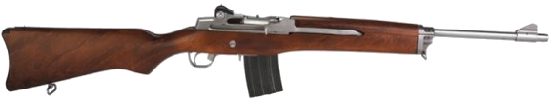
Parts of a Semi-Automatic Rifle
A semi-automatic rifle is a firearm that, each time the trigger is pulled, fires a single cartridge, automatically extracts and ejects the empty case, and inserts a new cartridge into the chamber.
FRONT
SIGHT
REAR SIGHT
BARREL
MAGAZINE
TRIGGER
MAGAZINE RELEASE
TRIGGER GUARD
Gas-operated and blowback-operated
Notes:
DISPLAY RIFLE WALL CHARTS
Define a semi-automatic rifle for the students:
A semi-automatic rifle is a firearm that, each time the trigger is pulled, fires a single cartridge, automatically extracts and ejects the empty case, and inserts a new cartridge into the chamber.
Point out the following specific features of semi-automatic rifles:
Breech bolt
Bolt handle/charging handle
Bolt lugs
Bolt lock/release
Gas system
Recoil/buffer spring
Explain the function of these components, and demonstrate their use with the sample semi-automatic rifle.
Explain that the vast majority of modern semi-automatic rifles have one of two types of actions.
Gas-operated rifles utilize a high-pressure propellant gas bled from the barrel to actuate the mechanism that cycles the action. This is the type of action used with center-fire rifle cartridges.
Blowback-operated rifles are used with lower-pressure cartridges, such as .22 rimfire. In such actions, the breech is not mechanically locked, but is closed by the bolt, which is held against the breech end of the barrel only by recoil spring pressure. Blowback-operated actions, therefore, lack the gas system found in gas-operated actions.

Slide 22
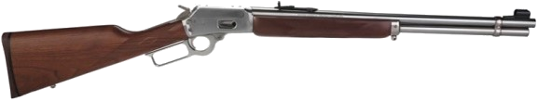
Parts of a Lever-Action Rifle
A lever-action rifle is a firearm in which a lever positioned below the buttstock is manually lowered and raised to feed, chamber, extract and eject cartridges, as well as cock the action.
FRONT
SIGHT
Loading Port
REAR SIGHT
TRIGGER
MAGAZINE
FINGER LEVER
Notes:
Define a lever-action rifle for the students:
A lever-action rifle is a firearm in which a lever positioned below the buttstock is manually lowered and raised to feed, chamber, extract and eject cartridges, as well as cock the action.
Demonstrate the functioning of a lever-action rifle using a sample rifle and dummy ammunition.
Point out the following specific features of lever-action rifles:
Bolt
Bolt lug/lugs
Lever
Magazine
Loading port in receiver (in rifles with tubular magazines)
Explain the function of these components, and demonstrate their use with the sample lever-action rifle.

Slide 23
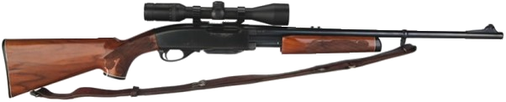
Parts of a Slide-Action Rifle
A slide-action rifle is a firearm in which the fore-end is manually slid rearward and forward to feed, chamber, extract and eject cartridges, as well as cock the action.
FRONT
SIGHT
REAR SIGHT
SAFETY
MAGAZINE
TRIGGER
Notes:
Define a slide-action rifle for the students:
A slide-action rifle is a firearm in which the fore-end is manually slid rearward and forward to feed, chamber, extract and eject cartridges, as well as cock the action.
Demonstrate the functioning of a slide-action rifle using a sample rifle and dummy ammunition.
Point out the following specific features of slide-action rifles:
Bolt
Bolt carrier
Bolt lug/lugs
Slide (fore-end)
Action bar/bars
Magazine
Loading port in receiver (in rifles with tubular magazines)
Explain the function of these components, and demonstrate their use with the sample slide-action rifle.

Slide 24
Instructor Practical Demonstration
Demonstration on the following Actions:
  Bolt-Action Rifle
  Semi-Automatic
  Lever-Action
  Slide-Action
Notes:
Explain, demonstrate and discuss how to load, cock, uncock and unload bolt-action, semi-automatic, lever-action and slide-action rifles.
No live ammunition is to be used during this part of the lesson. Only dummy ammunition is to be used to demonstrate loading and unloading procedures.
Note that you, as the instructor, will be handling the rifles constantly. Always be sure, when picking up any rifle, to keep the gun pointed in a safe direction, and your trigger finger off the trigger, alongside the frame. Constantly observe all safe gun handling rules—set a good example for your students.
1. Bolt-action rifle
Explain and demonstrate the following procedures with the bolt-action rifle:
Loading
Cocking
Uncocking
Unloading
Use only dummy ammunition when demonstrating these procedures.
Explain that some safeties allow the action to be cycled for unloading with the safety on, while others lock the trigger and bolt.
2. Semi-automatic rifle
Explain and demonstrate the following procedures with the semi-automatic rifle:
Loading
Cocking
Uncocking
Unloading
Use only dummy ammunition when demonstrating these procedures.
Remind students that different semi-automatic rifles vary in their uncocking procedures. The specific uncocking procedure for a specific model of semi-automatic rifle is found in the rifle’s instruction manual.
Emphasize that when unloading any semi-automatic rifle, the magazine must be removed first. Then the action may be worked to eject any live cartridge in the chamber. Ask students why this is necessary.
3. Lever-action rifle
Explain and demonstrate the following procedures with the lever-action rifle:
Loading
Cocking
Uncocking
Unloading
Use only dummy ammunition when demonstrating these procedures.
4. Slide-action rifle
Explain and demonstrate the following procedures with the slide-action rifle:
Loading
Cocking
Uncocking
Unloading
Use only dummy ammunition when demonstrating these procedures.

Slide 25
Safe Gun Handling
What are two major causes of firearm accidents?
Notes:
Distribute NRA Gun Safety Rules brochures to students.
Ask what the major causes of firearm accidents are. Discuss their responses. There are two major causes of firearm accidents:
Ignorance (a lack of knowledge)
Ignorance of the rules of safe gun handling
Ignorance of the proper and safe way to operate a rifle
Carelessness (poor or improper attitude)
Failure to apply the rules of safe gun handling
Failure to observe proper procedures for safely operating a rifle

Slide 26
Safe Gun Handling
Ignorance (a lack of knowledge)
    Ignorance of the rules of safe gun handling
    Ignorance of the proper and safe way to operate a rifle.
Carelessness (poor or improper attitude)
    Failure to apply the rule of safe gun handling
    Failure to observe proper procedures for safely operating a rifle
Notes:
Distribute NRA Gun Safety Rules brochures to students.
Ask what the major causes of firearm accidents are. Discuss their responses. There are two major causes of firearm accidents:
Ignorance (a lack of knowledge)
Ignorance of the rules of safe gun handling
Ignorance of the proper and safe way to operate a rifle
Carelessness (poor or improper attitude)
Failure to apply the rules of safe gun handling
Failure to observe proper procedures for safely operating a rifle

Slide 27
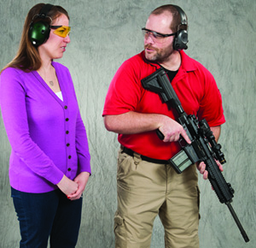
NRA Rules For Safe Gun Handling
ALWAYS Keep The Gun Pointed In A Safe Direction
Notes:
ALWAYS keep the gun pointed in a safe direction
Emphasize that this is the single most important rule of gun safety. This rule means that a gun must ALWAYS be pointed so that even if it were unintentionally discharged, it would not cause injury or damage.
Ask what a “safe direction” might be under different circumstances. Discuss the responses.

Slide 28
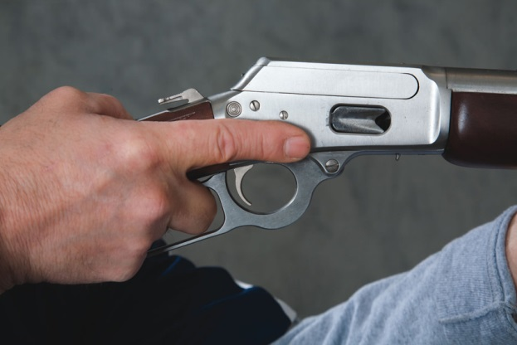
NRA Rules For Safe Gun Handling
ALWAYS Keep Your Finger Off The Trigger Until Ready To Shoot
Notes:
ALWAYS keep your finger off the trigger until ready to shoot
Instruct the students that while continuing to point the rifle in a safe direction, they should place the index finger alongside the receiver of the rifle, above and away from the trigger guard.

Slide 29
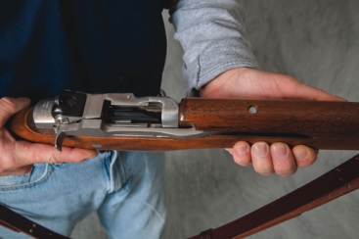
NRA Rules For Safe Gun Handling
ALWAYS Keep The Gun Unloaded Until Ready To Use
Notes:
ALWAYS keep the gun unloaded until ready to use
A rifle cannot fire if it is unloaded. Tell the students that whenever they pick up a firearm, they must immediately point it in a safe direction, with the trigger finger off the trigger, and then check to make sure it is unloaded.

Slide 30
NRA Rules For Safe Gun Handling
Safety is Everyone's responsibility!

Slide 31
Student Practical Exercise
Safe Handling
Safe Loading
Safe Unloading
NO LIVE AMMUNITION IN THE CLASSROOM!
Notes:
Practical exercise set-up
Use a table in the classroom as a firing line. Lay the various rifles on the table so that they are pointed safely downrange, in different operating modes (action open or closed, magazine inserted or out, hammer cocked or down, etc).
NOTE: Although in Lesson III you will thoroughly discuss the details of a range layout and the various range commands, you should provide the students now with rudimentary knowledge of range layouts and the basic commands necessary for the conduct of the exercise.
2. Safe gun handling exercise
Have the students practice all of the safe gun handling rules while they pick up the rifles. Observe the students closely and evaluate their performance. Be sure that each student, when picking up a gun, immediately checks to make sure the gun is unloaded while keeping it pointed in a safe direction and maintaining his or her trigger finger off the trigger.
3. Gun operating procedures exercise
Have the students practice unloading, cocking, uncocking and loading the rifles. Use the range command, “Load,” during this part of the exercise. Watch the students carefully and offer helpful suggestions. Make your corrections in a positive manner.
Finally, have each student pick up a rifle and hand it to another student. Ensure that the students observe the rules for safe gun handling at all times.
When conducting this practical exercise, remember—safety first! Always make sure that the students observe the gun safety rules at all times, and ensure that there are no live cartridges in the classroom.

Slide 32
NRA Rules For Safe Gun Handling
ALWAYS KEEP THE GUN POINTED IN A
SAFE DIRECTION
ALWAYS KEEP YOUR FINGER OFF THE
TRIGGER UNTIL READY TO SHOOT
ALWAYS KEEP THE GUN UNLOADED UNTIL
READY TO USE

Slide 33
Lesson I Summary & Review
As a result of your participation in this lesson, you are now able to:
  State the course goal.
  Identify the principal parts of a rifle and the types of rifle actions, and demonstrate how they function.
  State, explain and apply the NRA Rules for Safe Gun Handling.
  Demonstrate how to handle a rifle in a safe manner.
Notes:
Highlight the most important points of the lesson:
State the course goal and any special requirements for the lessons
Identify the principal parts of a rifle and the types of rifle actions, and demonstrate how they function
State, explain and apply the NRA Rules for Safe Gun Handling
Demonstrate how to handle a rifle in a safe manner

Slide 34
Questions
What Are Your Questions?
The Next Lesson will be:
Ammunition Knowledge and the Fundamentals of Rifle Shooting
Notes:
Ask the students if they have any questions. Answer questions.
Briefly preview the next lesson.

Slide 35
LESSON II:
Ammunition Knowledge and the Fundamentals of Rifle Shooting
Notes:
Length: 2 hours (a 10-minute break should be given after 50 minutes of instruction)
Facility: Classroom
Required Materials:
The NRA Guide to the Basics of Rifle Shooting handbook
NRA Basic Rifle Shooting Course Wall Charts
Bolt-action, semi-automatic, lever-action and slide-action rifles
Appropriate dummy ammunition (All dummy rounds must be clearly distinguishable from live ammunition—no live ammunition can be present in the training classroom. See special note to the instructor in the Introduction)
An empty ammunition box and a fired cartridge case for at least one of the above rifles
Notepads and pens or pencils—one per student
Other training aids as appropriate
References:
The NRA Guide to the Basics of Rifle Shooting handbook

Slide 36
LESSON II: Ammunition Knowledge and the Fundamentals of Rifle Shooting
Learning Objectives:
  As a result of your participation in this lesson you will be able to:
    Identify the different components of a rifle cartridge.
    Explain the firing sequence of a cartridge.
    Explain how to properly identify and store ammunition.
    State the major types of cartridge malfunctions, and how to react to them.
    Explain the fundamentals of rifle shooting.
Notes:
State the learning objectives for this lesson.

Slide 37

Cartridge Components
Bullet
Case
Powder Charge
Primer Compound
Notes:
A cartridge has four components:
Bullet—the projectile.
Case—a metal cylinder usually made of brass, closed at one end, which contains the other three components.
Powder charge—a fast-burning chemical compound used as a propellant.
Priming compound—an impact-sensitive chemical compound used for ignition.
Point out that “cartridges” are commonly and incorrectly called “bullets.”

Slide 38
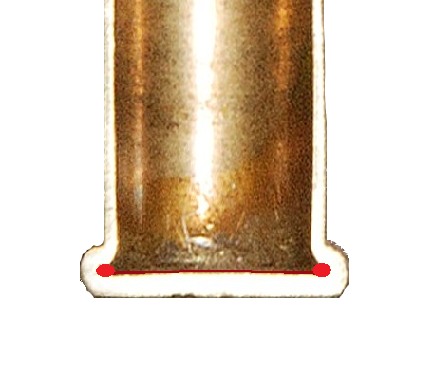
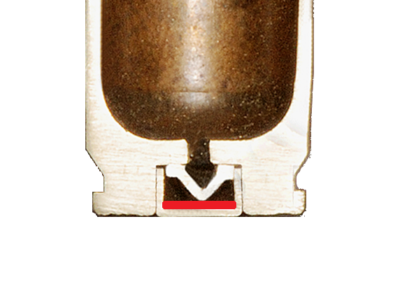
Cartridge Components
RIMFIRE CARTRIDGE
Priming compound is contained in the inside of the rim of the case head
CENTERFIRE CARTRIDGE
Priming compound is contained in a metal cup, called a primer, in the center of the case head
Priming compound is shown in Red.
Notes:
Explain the difference between a rimfire and a center-fire cartridge.
In a rimfire cartridge, the priming compound is contained in the folded rim around the circumference of the case head.
In a center-fire cartridge, the priming compound is contained in a metal cup, called a primer, located in the center of the case head.

Slide 39
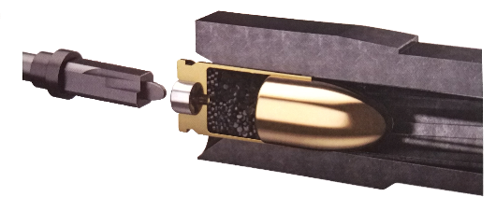
Cartridge Firing Sequence
1
A cartridge is loaded in the chamber and the breech closed. The trigger is pulled, causing the firing pin to hit the cartridge primer or cartridge rim, in the case of the rimfire cartridges.
Notes:
The firing pin strikes the primer or case rim and ignites the priming compound.
The flame generated by the priming compound ignites the powder charge.
The powder burns rapidly and generates a large volume of hot, high-pressure gas.
The high-pressure gas propels the bullet out of the barrel at a high velocity.

Slide 40
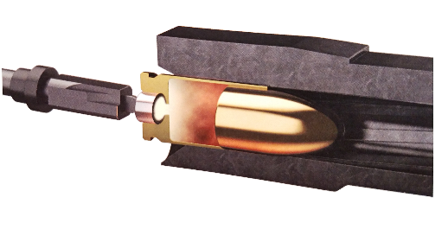
Cartridge Firing Sequence
2
The primer explodes with a hot spark that ignites the powder in the case.
Notes:
The firing pin strikes the primer or case rim and ignites the priming compound.
The flame generated by the priming compound ignites the powder charge.
The powder burns rapidly and generates a large volume of hot, high-pressure gas.
The high-pressure gas propels the bullet out of the barrel at a high velocity.

Slide 41
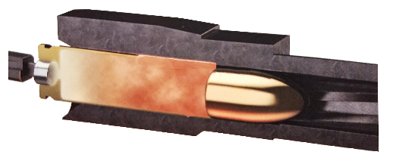
Cartridge Firing Sequence
3
As the powder burns, it creates high-pressure gas that begins to push the bullet down the bore. Increasing pressure in the chamber also causes the case to expand outward tightly against the chamber walls, preventing gas leakage to the rear.
Notes:
The firing pin strikes the primer or case rim and ignites the priming compound.
The flame generated by the priming compound ignites the powder charge.
The powder burns rapidly and generates a large volume of hot, high-pressure gas.
The high-pressure gas propels the bullet out of the barrel at a high velocity.

Slide 42
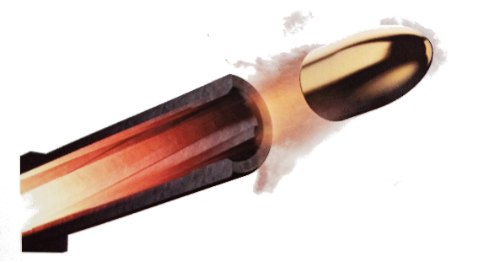
Cartridge Firing Sequence
4
Continued combustion of the powder accelerates the bullet through the bore until it leaves the muzzle. The hot, high-velocity gas exiting the muzzle makes a loud “bang” when it hits the surrounding atmosphere.
Notes:
The firing pin strikes the primer or case rim and ignites the priming compound.
The flame generated by the priming compound ignites the powder charge.
The powder burns rapidly and generates a large volume of hot, high-pressure gas.
The high-pressure gas propels the bullet out of the barrel at a high velocity.

Slide 43
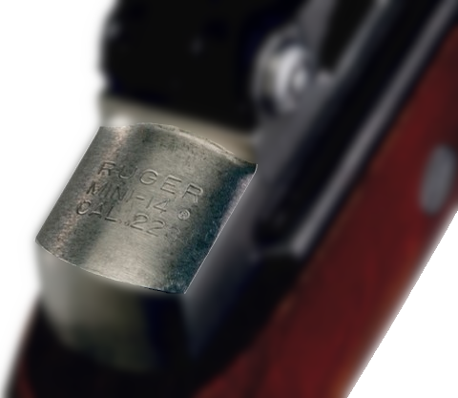
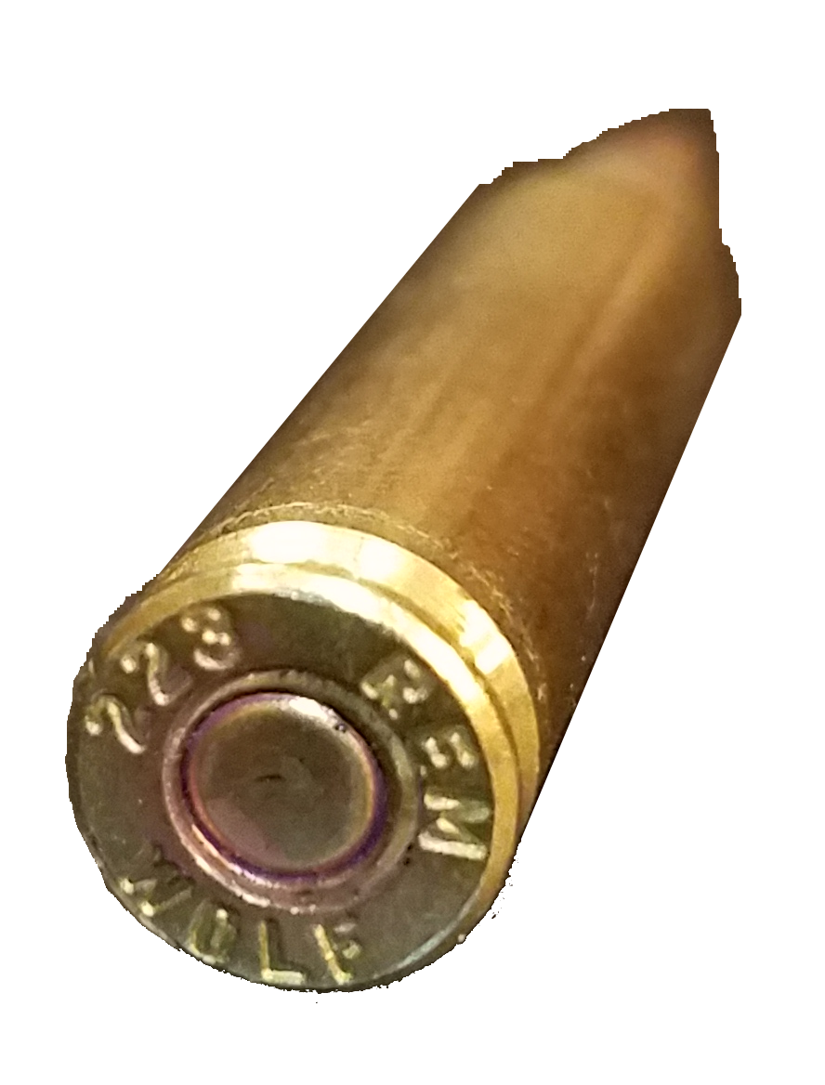
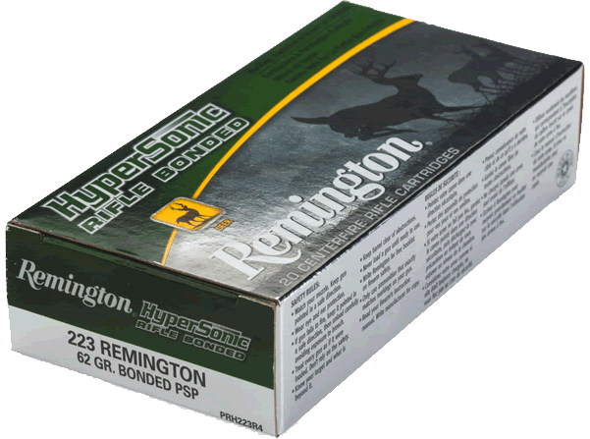
Cartridge Designation and Identification
Notes:
The shooter must know how to identify a cartridge to load the proper cartridge in the rifle.
The shooter should match the cartridge designations:
Marked on the rifle Receiver
Stamped on the head of the case of a centerfire cartridge (called the headstamp)
Printed on the factory ammunition box
Show the students the cartridge designation on a rifle, on the head of a fired case, and printed on an empty ammunition box.

Slide 44
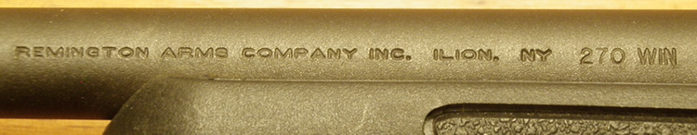

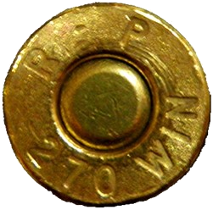
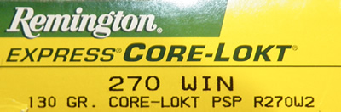
Cartridge Designation and Identification
Check
the Barrel,
the Box
and the cartridge.
Notes:
NOTE: Different from the previous slide, cartridge designation may be roll stamped on the barrel as well.
Show the students the cartridge designation on a rifle, on the head of a fired case, and printed on an empty ammunition box.
Some cartridges may have more than one name (e.g., 7.62X51 and .308 Winchester are the same cartridge). Sometimes one name may be found on the gun and another on the cartridge headstamp.
Some rifle cartridges used in certain rifles have Magnum designations. Such cartridges are loaded to higher pressures than standard cartridges of the same name.
The shooter should consult the rifle’s owner’s manual, the rifle’s manufacturer, or a knowledgeable person (such as an NRA Certified Rifle Instructor) to determine what cartridge may be fired in a rifle, or if the rifle is approved for Magnum cartridges.

Slide 45
Ammunition Storage
Ammunition should be stored in a cool, dry place
Always keep the ammunition in the original factory box or carton
Store ammunition in a location where children or other unauthorized persons cannot access it
Do not expose ammunition to water, solvents, petroleum products or other materials that can cause cartridge deterioration and malfunctions
Wipe fingerprints off cartridges to avoid corrosion due to salty residue
Notes:
Explain the following regarding the proper storage of ammunition:
Ammunition should be stored in a cool, dry place. Avoid storage in a high-temperature location such as an attic or trunk of a car.
Always keep the ammunition in the original factory box or carton. Ask why this is important.
Store ammunition in a location where children or other unauthorized persons will not have access to it.
Do not expose ammunition to water or solvents, petroleum products, bore cleaner, ammonia or other chemicals. These materials can cause deterioration of the powder and priming compound, resulting in a cartridge malfunction.
Wipe fingerprints off cartridges. The salty residue may cause corrosion.

Slide 46
Cartridge Malfunctions
What are different types of cartridge malfunctions?

Slide 47
Types Of Cartridge Malfunctions
MISFIRE
HANGFIRE
SQUIB LOAD
Notes:
Cartridge malfunctions:
There are three types of cartridge malfunctions: misfire, hangfire, and squib load.

Slide 48
Misfire
A misfire is the failure of a cartridge to ignite when the primer or case rim is struck by the firing pin.
CAUSES:
  Defect in the cartridge
  Defect in the pistol
What should you do if you encounter this malfunction?
STOP FIRING IMMEDIATELY!!
Safely open the action, after waiting 30 seconds and check the bore for obstructions.
Notes:
Misfire:
A misfire is the failure of a cartridge to ignite when the primer or case rim has been struck by the firing pin. This situation may be caused by a defect in the cartridge or by a defect in the pistol that causes a weak firing pin hit.

Slide 49
Hangfire
A HANGFIRE is a perceptible delay in the ignition of a cartridge after the primer or case rim has been struck by the firing pin. This delay may last several seconds.
When a cartridge fails to fire immediately, it will not be known if the problem is a misfire or hangfire. Because a hangfire condition can cause the rifle to fire after a substantial delay, the rifle should be kept pointed in a safe direction for at least 30 seconds before the action is opened to remove the cartridge.
What should you do if you encounter this malfunction?
STOP FIRING IMMEDIATELY!!
Safely open the action, after waiting 30 seconds and check the bore for obstructions.
Notes:
Hangfire:
A hangfire is a perceptible delay in the ignition of a cartridge after the primer or case rim has been struck by the firing pin. This delay may last several seconds.
When a cartridge fails to fire immediately, it will not be known at first if the problem is a misfire or a hangfire. The shooter must keep the rifle pointed in a safe direction, as a hangfire condition might exist and cause the rifle to fire after a substantial delay. The shooter should wait at least 30 seconds before opening the action to remove the cartridge.

Slide 50
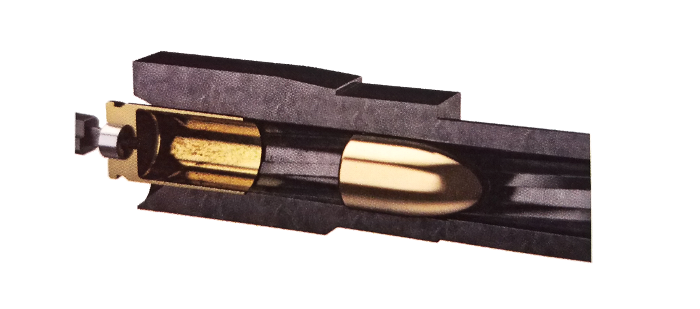
Squib Load
A Squib Load is a cartridge developing less than normal pressure or velocity upon ignition. A squib load can cause a bullet to fail to exit the muzzle and lodge in the bore.
SIGNS OF A SQUIB LOAD:
  REDUCED NOISE
  REDUCED MUZZLE FLASH
  REDUCED RECOIL
What should you do if you encounter this malfunction?
STOP FIRING IMMEDIATELY!!
Safely open the action, after waiting 30 seconds and check the bore for obstructions.
Notes:
Squib Load:
A squib load occurs when the cartridge develops less than normal pressure or velocity after the ignition of a cartridge. Squib loads can cause a bullet to fail to exit the muzzle and become lodged in the bore. If anything unusual is noticed upon firing a shot, such as a reduction in noise, muzzle flash or recoil, a squib load should be suspected. The shooter should stop firing immediately and, keeping the muzzle pointed in a safe direction, unload the pistol, checking to ensure that all chambers are empty. Then, with the action open, he or she should visually inspect the barrel to make sure that it is not obstructed. If a bullet is lodged in the barrel, the firing of another shot could cause serious injury or
damage to the gun.

Slide 51
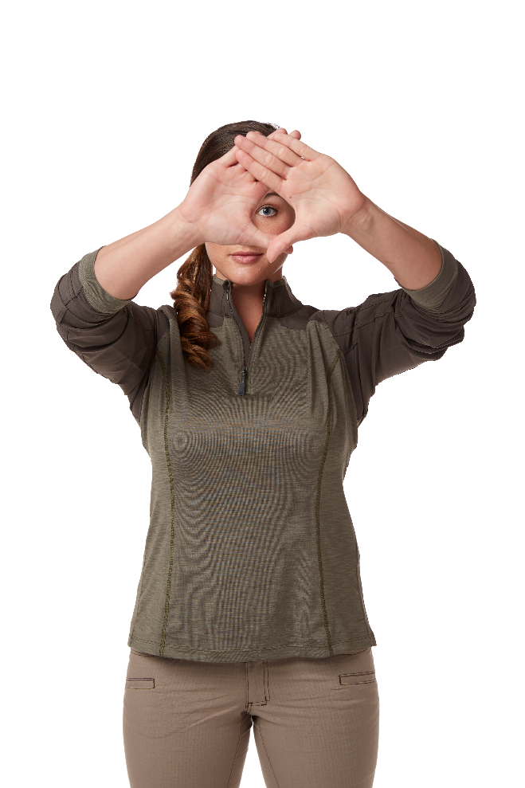
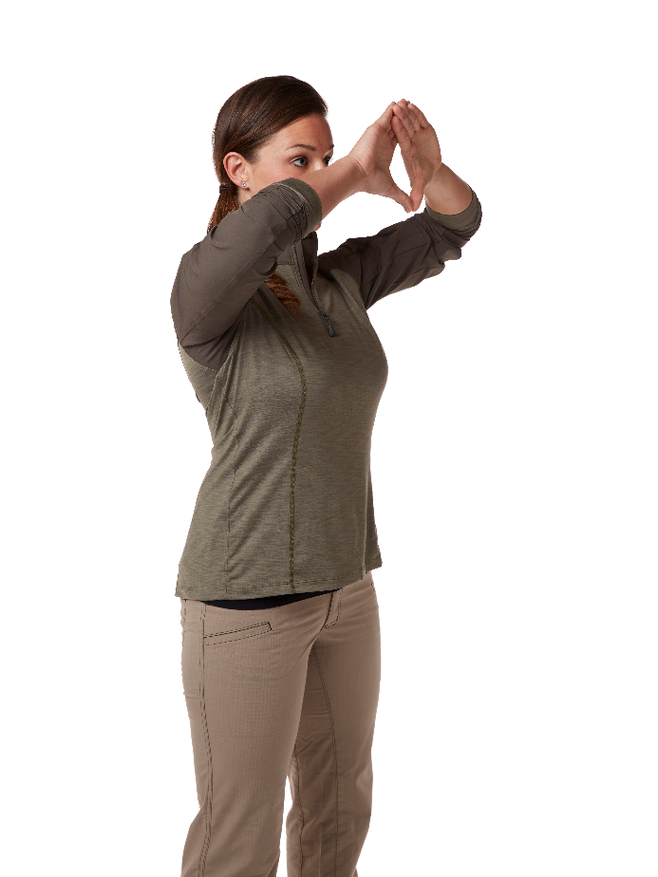
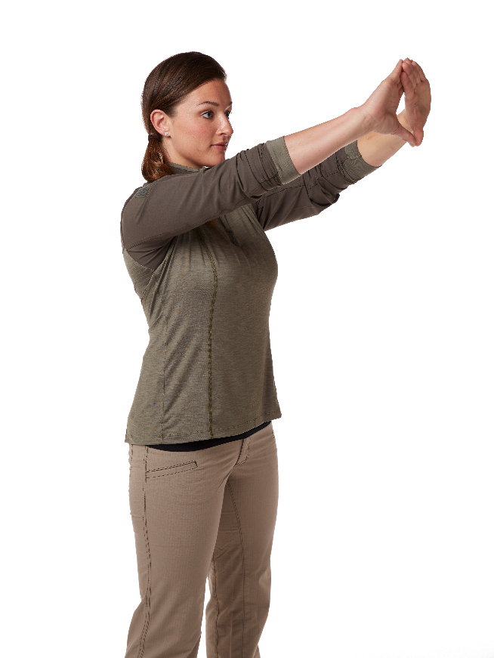
Dominant Eye
Dominant Eye Exercise as described in your Basics of Rifle Shooting handbook
Notes:
The rifle shooter should aim with the dominant eye. Establish the dominant eye for each student by using the exercise described in The NRA Guide to the Basics of Rifle Shooting handbook. It is recommended that the rifle be shouldered on the same side of the body as the dominant eye, if possible.

Slide 52
Position
A Position is the platform from which all the shooting fundamentals are executed.
A Position should be comfortable, balanced, relaxed and properly aligned with the target.
Notes:
A position is the platform from which all the shooting fundamentals are executed.
A position should be comfortable, balanced, relaxed and properly aligned with the target.

Slide 53
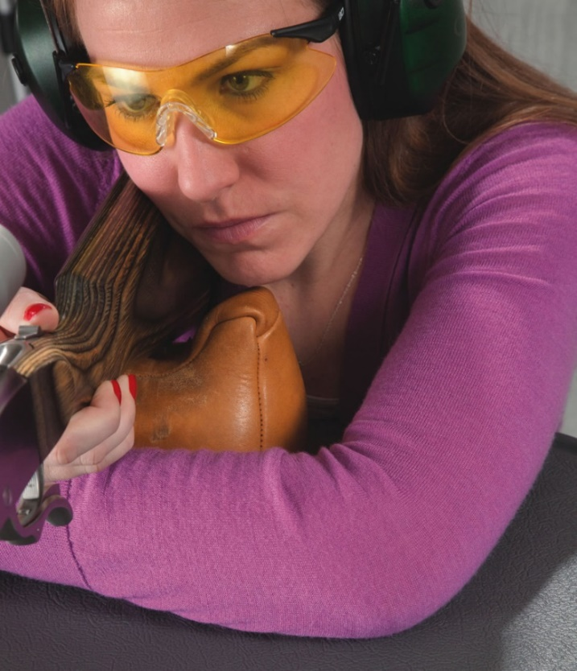
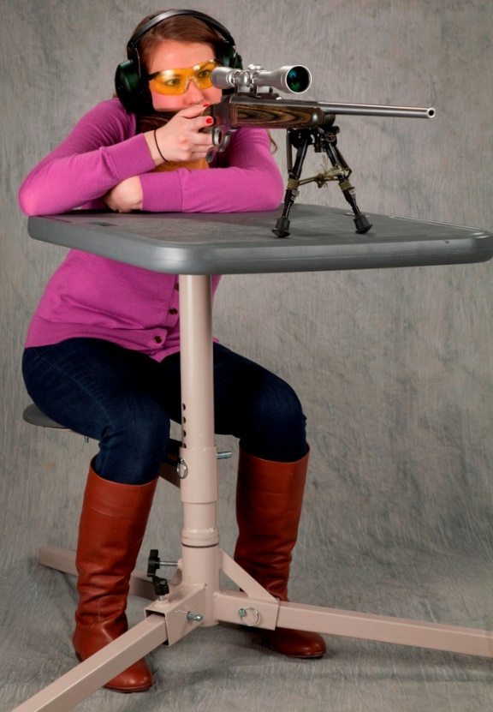
Benchrest Position
The Benchrest Position is the initial position taught in this course.
Notes:
1. Benchrest position
The benchrest position is the initial position that will be taught in this course. Explain and demonstrate the elements of the benchrest position, as described below and in The NRA Guide to the Basics of Rifle Shooting handbook:
Body Position
Sit behind the bench or table, facing the target.
The feet should be flat on the ground.
Both elbows are on the bench top.
The rifle fore-end lies in the support (non-firing) hand, which is supported by the sandbag.
The firing hand grips the rifle stock around the wrist or pistol grip.
The back should be straight or leaning slightly forward.
The head is erect. If necessary, raise the sandbags to allow an erect head position.
b. Rifle Position
The butt of the stock is positioned against the shoulder so that the rifle sights are at eye level and aligned with the dominant eye.
The cheek should rest firmly against the comb of the stock.
The stock wrist or pistol grip should be grasped with the lower three fingers, lightly resting the thumb on top of the stock. The firing hand should be positioned so that the index finger is clear of the stock and can squeeze the trigger straight to the rear. The firing hand wrist must remain straight.
The fore-end should lie across the palm of the non-shooting or support hand between the thumb and index finger with the other fingers relaxed. It is best not to grip or squeeze the fore-end, though this may be necessary with larger-caliber or heavy-recoiling rifles in order to maintain control when firing.

Slide 54
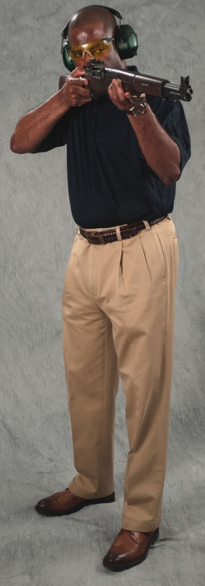
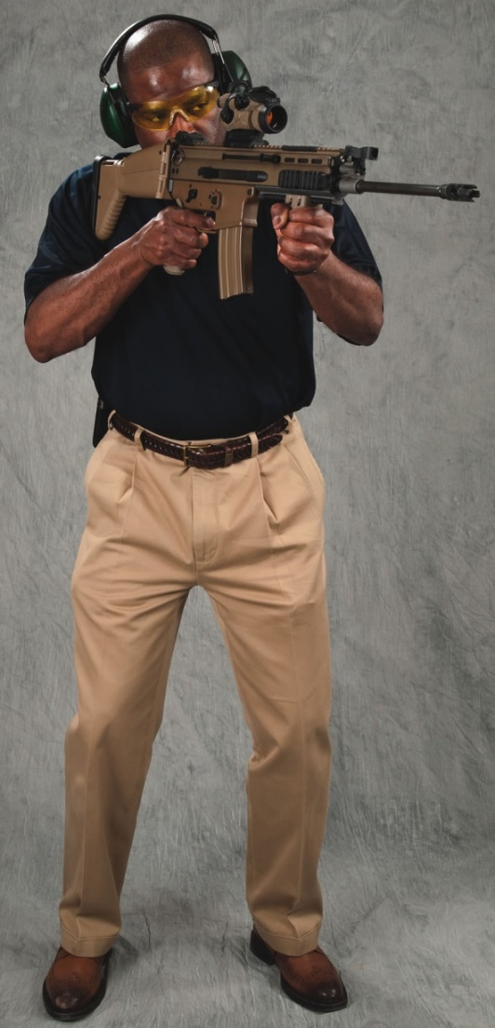
Standing Shooting Positions
The Free Arm Position is first of two standing positions taught in this course.
Notes:
The standing shooting position is the other position taught in this course. Explain that there are two types of standing positions: the arm rest and free arm positions.
Free Arm Position
To assume the free arm position:
With the rifle held in both hands, stand at the firing point and turn the body roughly 90o away from the target, toward the firing-hand side.
Place the feet shoulder width apart, with the weight distributed evenly on both feet.
Keep the head and body erect.
Grasp the rifle fore-end with the support hand..
Grasp the stock wrist or pistol grip with the firing hand
Raise the rifle to the shoulder so that the sights are aligned with the dominant eye.
The support arm should be free of the body, with the hand under the rifle fore-end, supporting the weight of the gun.
The free arm position is used when there is little time to shoot, or when the target is moving, as in a hunting situation. Shooters using the free arm position should have enough arm strength (or a sufficiently light gun) to comfortably hold up the rifle.

Slide 55
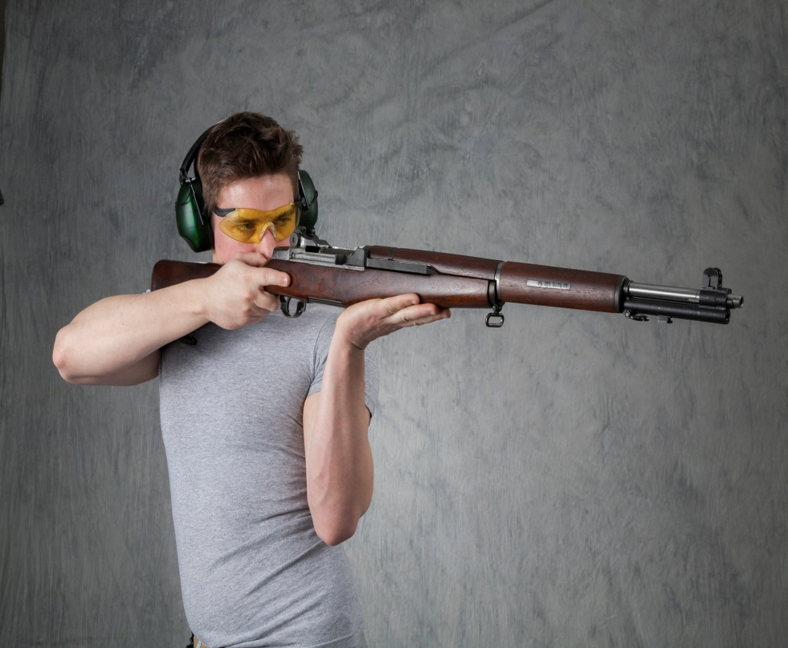
Standing Shooting Positions
The Arm Rest Position is the second of two standing positions taught in this course.
Notes:
b. Arm Rest Position
With the rifle held in both hands, stand at the firing point and turn the body roughly 90o away from the target, toward the firing-hand side.
Place the feet shoulder width apart, with the weight distributed evenly on both feet.
Bend the body rearward away from the rifle, and rest the support arm on the side or hip.
Keep the head erect.
Grasp the rifle fore-end between the thumb and forefinger of the support hand.
Grasp the stock wrist or pistol grip with the firing hand
Raise the rifle to the shoulder so that the sights are aligned with the dominant eye.
The arm rest position is used when maximum stability and steadiness in the standing position are desired, as in some target disciplines. The arm rest position should also be used when the shooter has difficulty in holding the rifle comfortably in the free arm position.
Explain that there are a number of ways of positioning the support hand under the fore-end in the arm rest position.

Slide 56
Fundamentals of Rifle Shooting
The five fundamentals of rifle shooting are:
      Aiming
        Sight Alignment
        Sight Picture
      Hold Control
      Breath Control
      Trigger Control
      Follow-Through
These five fundamentals should be
performed with every shot.
Notes:
Discuss the fundamentals of rifle shooting and why they are important. The fundamentals should be performed every time a person fires a shot from any position. Position and grip are the platform from which the fundamentals are executed.
The five fundamentals of rifle shooting are aiming (Which includes Sight Alignment & Sight Picture), hold control, breath control, trigger control and follow-through.

Slide 57
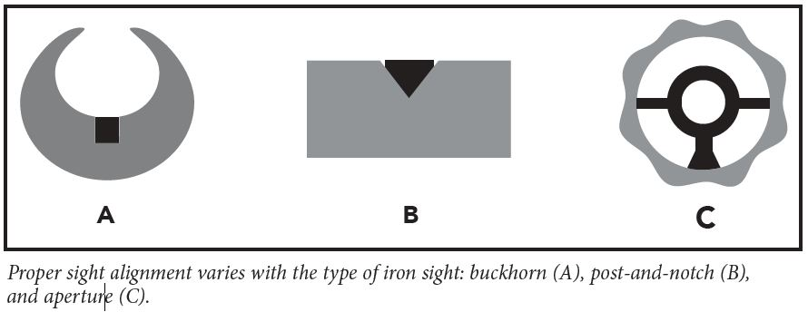
Aiming
Aiming consists of two stages: sight alignment and sight picture. Sight Alignment refers to the proper positioning of the shooting eye the rear sight, and the front sight in relation to each other.
Notes:
Aiming
Aiming is the process of achieving the proper relationship between the target, the front sight and the rear sight (or the target and the reticle of a telescopic sight, with guns having a scope mounted). Aiming consists of two components: sight alignment and sight picture.

Slide 58


Sight Alignment
Sight alignment refers to the proper relationship of the pistol’s front and rear sights.
With post-and-notch sights:
The tops of the front and rear sights are even
The front post is centered in the rear notch
Front Sight Rear Sight
Notes:
Sight Alignment
Sight alignment refers to the proper relationship of the rifle’s front and rear sights.
With post-and-notch sights, the top of the front sight is even with the top of the rear sight, and the post is centered in the notch, with equal amounts of light on both sides.
With buckhorn or express-type sights, front sight bead is centered up in the bottom of the “V” of the rear sight.
With peep sights, the front post or aperture is placed in the center of the aperture of the rear sight.
Proper sight alignment is the key to accurate shooting. Any misalignment of the eye, the front sight or the rear sight introduces an angular error that multiplies with distance.

Slide 59
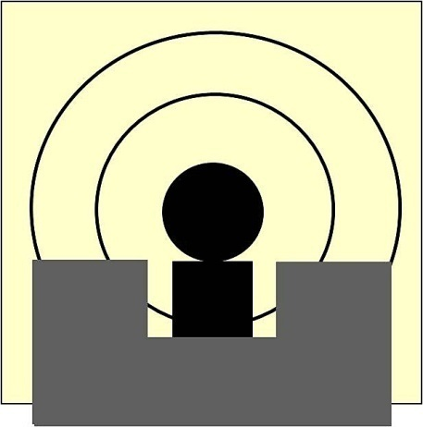

Sight Picture
Proper sight picture is obtained when the aligned sights are put into their proper relationship with the target.
Focus Should Be On The FRONT Sight.
SIX O’CLOCK HOLD
CENTER HOLD
Notes:
Sight Picture
Sight picture refers to the proper positioning of the aligned sights on the target.
Sight picture is obtained by achieving proper sight alignment and then putting the aligned sights into their proper relationship with the target.
The eye can only focus on one object at a time. The rifle shooter using iron sights should concentrate on the front sight, which will appear sharp and clear, while the rear sight and the target will appear less sharp or blurred.
When using a telescopic sight or red-dot sight, proper sight picture is achieved when the center of the crosshair, or the red dot, is placed at the desired impact point of the target.
It is best to keep both eyes open while aiming, as more light is available to the eyes, depth perception is better, and facial contortions and muscle tension are eliminated. Note: a small piece of frosted tape on the inside of the lens of the shooting glasses in front of the non-shooting eye can relieve eye strain, if evident.

Slide 60
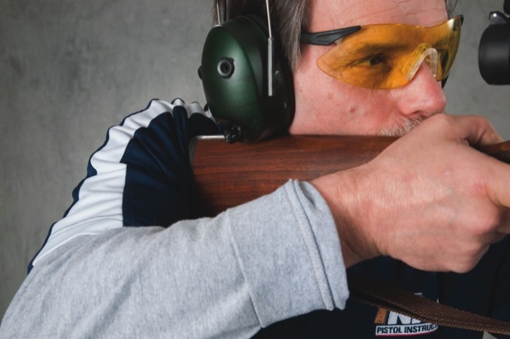
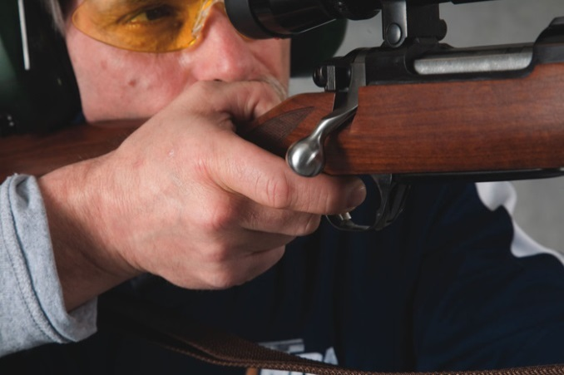
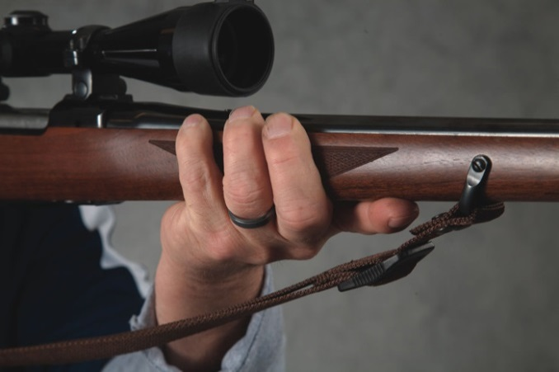
Hold Control
Exercising Hold Control allows the shooter to maintain the proper sight picture and sight alignment during the process of firing the shot.
An important factor in hold control is the way in which the rifle is gripped.
Notes:
Hold control
Exercising hold control allows the shooter to maintain the proper sight picture and sight alignment during the process of firing the shot.
grip
An important factor in hold control is the way in which the rifle is gripped. Reinforce the proper method of assuming a proper firing grip, as described above and in The NRA Guide to the Basics of Rifle Shooting.

Slide 61
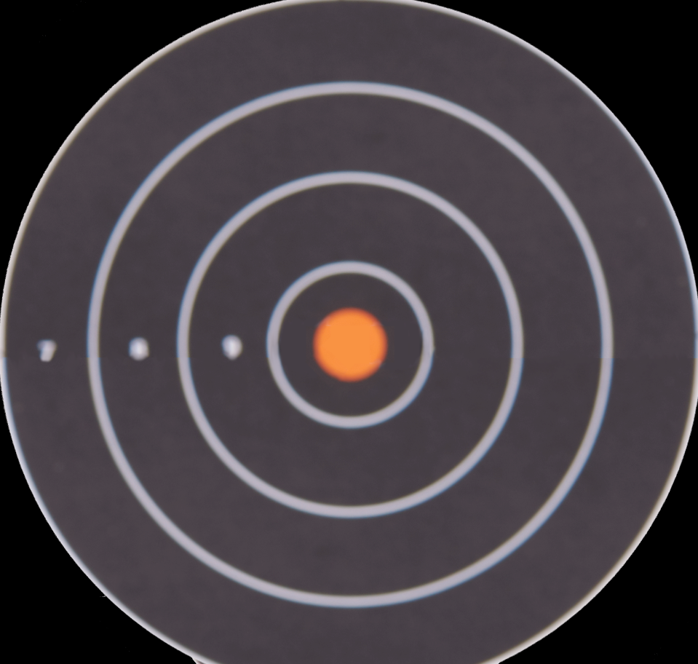
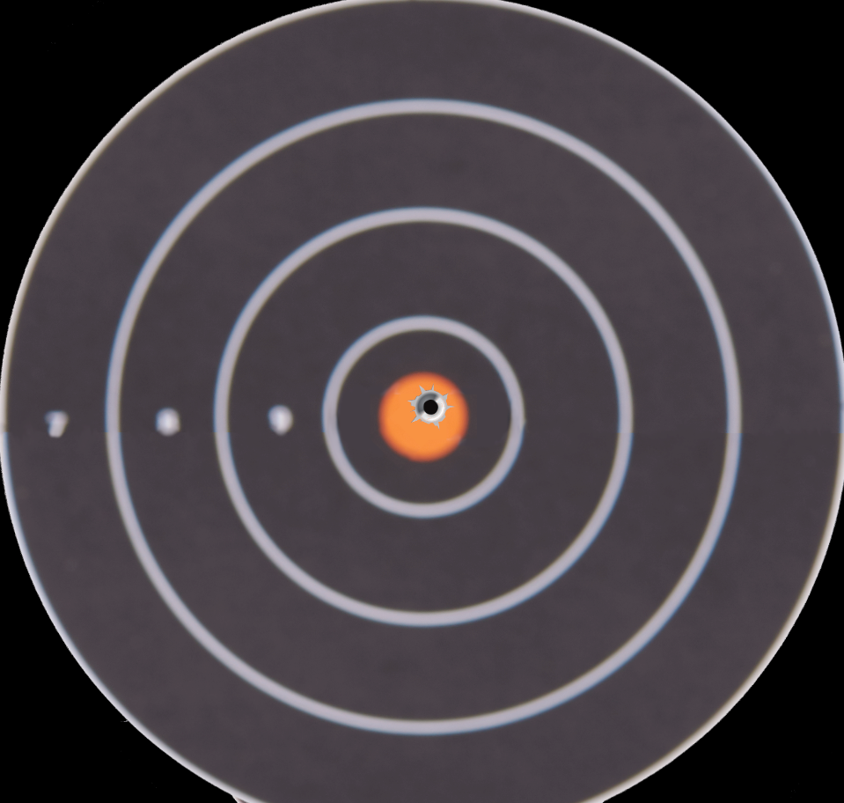

Hold Control
It is impossible to hold a rifle without some motion; this motion is called…
“Arc of Movement.”
One should try to maintain proper sight alignment and sight picture while minimizing the arch of movement. With practice, the arch of movement will decrease.
Notes:
Instructor NOTE: After TPI, click to start the animation example at right.
Arc of movement
It will be impossible to hold the rifle in most shooting position without some motion; this is called the “arc of movement.” The shooter should try to maintain proper sight alignment and sight picture while minimizing the arc of movement. With practice, the arc of movement will decrease.

Slide 62
Breath Control
The body moves when breathing. Use breath control to minimize such movement.
Take a breath before each shot, let enough air out to be comfortable, and stop breathing while firing the shot.
Holding your breath for too long can result in muscle tremors. If this occurs, stop, remove your finger from the trigger, lower your rifle, relax and take a few breaths and begin the firing cycle again.
Notes:
Breath control
Body movement while breathing can produce gun movement which impairs shooting. For maximum accuracy, the shooter uses breath control to minimize such movement.
To minimize body movement, the shooter should take a breath before each shot, let enough air out to be comfortable, and stop breathing while firing the shot.
Holding the breath too long can result in muscle tremors. If this occurs, the trigger finger should be removed from the trigger, the gun should be lowered (while pointed in a safe direction), and the shooter should relax, take a few breaths, and then begin the firing cycle again.

Slide 63
Trigger Control
Trigger control refers to the proper method of activating the trigger to minimize movement that can misalign the sights.
The index finger is placed so that the trigger is halfway between the tip of the finger and the first joint.
The trigger is squeezed straight to the rear in a smooth, continuous manner without disturbing sight alignment. Pressure should be applied evenly, not in a start-and-stop manner.
The shooter should not be able to predict when the gun will fire. Each shot should come as a surprise.
Trigger squeeze and sight alignment must be done simultaneously while maintaining a minimum arc of movement.
Notes:
Trigger control
Trigger control refers to the proper method of activating the trigger to minimize movement that can misalign the sights.
The index finger is placed so that the trigger is halfway between the tip of the finger and the first joint.
The trigger is squeezed straight to the rear in a smooth, continuous manner without disturbing sight alignment. Pressure should be applied evenly, not in a start-and-stop manner.
The shooter should not be able to predict when the gun will fire. Each shot should come as a surprise.
Trigger squeeze and sight alignment must be done simultaneously while maintaining a minimum arc of movement.

Slide 64
Follow-Through
Follow-through is the continuation of the application of the shooting fundamentals through and immediately after the shot. Follow-through enables the shooter to integrate, maintain and continue all the shooting fundamentals, before, during and immediately after firing the shot.
Notes:
Follow-Through
Follow-through is the continuation of the application of the shooting fundamentals through and immediately after the shot. Follow-through enables the shooter to integrate, maintain and continue all the shooting fundamentals before, during and immediately after firing the shot.
Relate the importance of follow-through to other sports such as golf, baseball, etc.

Slide 65
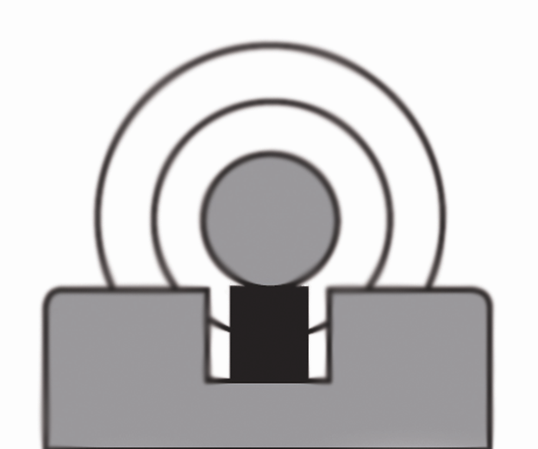
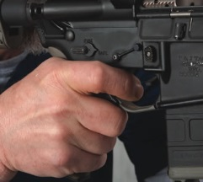
Most Important
Shooting Fundamentals
The two most important fundamentals are:
Aiming
Trigger Control
Notes:
Conclusion
Summarize the lesson by emphasizing that the two most important fundamentals in rifle shooting are aiming and trigger control. The other fundamentals all contribute to achieving these.

Slide 66
NRA Rules For Safe Gun Handling
ALWAYS KEEP THE GUN POINTED IN A
SAFE DIRECTION
ALWAYS KEEP YOUR FINGER OFF THE
TRIGGER UNTIL READY TO SHOOT
ALWAYS KEEP THE GUN UNLOADED UNTIL
READY TO USE

Slide 67
Lesson II Summary & Review
As a result of your participation in this lesson, you are now able to:
  Identify the different components of a rifle cartridge and explain the firing sequence
  Explain how to properly identify and store ammunition
  Identify the major types of cartridge malfunctions, and how to react to them
  Explain the fundamental of rifle shooting
Notes:
Lesson summary
Highlight the most important points of the lesson:
Identify the different components of a rifle cartridge
Explain the firing sequence of a cartridge
Explain how to properly identify and store ammunition
Identify the major types of cartridge malfunctions, and how to react to them
Explain the fundamentals of rifle shooting

Slide 68
Questions
What Are Your Questions?
The Next Lesson will be:
Firing the First Shots
Notes:
Ask the students if they have any questions. Answer questions.
Briefly preview the next lesson.

Slide 69
LESSON III:
Firing the First Shots
Notes:
Length: 2 hours (a 10-minute break should be given after 50 minutes of instruction)
Facility: Classroom/Range
Required Materials:
The NRA Guide to the Basics of Rifle Shooting handbook
NRA Basic Rifle Shooting Course Wall Charts
Eye protection
Hearing protection
Rifles
Sufficient ammunition per student to complete instruction
Targets
Sandbags, benches (tables), and chairs
Small screwdrivers or other tools for adjusting rifle sights
Other training aids as appropriate
References:
The NRA Guide to the Basics of Rifle Shooting handbook

Slide 70
LESSON III: Firing the First Shots
Learning Objectives:
As a result of your participation in this lesson you will be able to:
    Safely demonstrate the Knowledge, skills and attitude necessary to assume the benchrest position with a rifle.
    Safely shoot a rifle from a benchrest position, using the fundamentals of rifle shooting, at a target on a range.
    Safely demonstrate the knowledge, skills and attitude necessary to assume the free arm and arm rest standing shooting positions with a rifle.
    Safely shoot a rifle from the free arm and arm rest standing shooting position, using the fundamentals of rifle shooting, at a target on a range.
Notes:
State the learning objectives for this lesson.

Slide 71
Range Layout & Limits
Ready Line
Firing Line
Target Area
Backstop/Impact Area
Left & Right Range Limits
Firing Points
Target & Firing Line Numbers
Downrange
Safety Berms
Entry & Exit Routes
Range Flags
Warning Markers
First-aid Kit
Phone
Fire Extinguishers
Rest Rooms
Notes:
Range Safety Briefing
Purpose of the shooting event
Live-fire exercise for NRA Basic Rifle Shooting Course
Introduce range staff (if appropriate):
Chief range officer
Range safety officers and instructors
Any other range personnel
Administrative briefing
Review any administrative procedures for the range facility (parking, sign-in, sign-out, etc.)
Range layout and limits
For the range you are using, identify and explain the significance of the following:
Ready line
Firing line
Target area
Backstop/impact area
Left and right range limits
Firing points
Target and firing line numbers
Downrange
Safety berms
Entry and exit routes
Range flags
Warning markers or other physical safety features of the range
First-aid kit
Phone (indicate whether 911 service is available and if any special dialing procedures are needed to access an outside line)
Fire extinguishers
Rest rooms
Any other applicable equipment

Slide 72

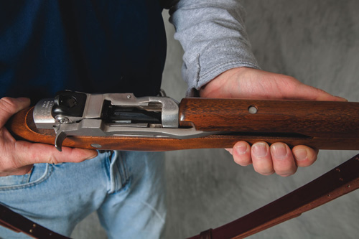
NRA Rules for
Safe Gun Handling
ALWAYS Keep The Gun Pointed In A Safe Direction
ALWAYS Keep Your Finger Off The Trigger Until Ready To Shoot
ALWAYS Keep The Gun Unloaded Until Ready To Use
Notes:
Review general safety rules
Review the NRA Rules for Safe Gun Handling.
ALWAYS keep the gun pointed in a safe direction.
ALWAYS keep your finger off the trigger until ready to shoot.
ALWAYS keep the gun unloaded until ready to use.
Review the NRA Rules for Using and Storing a Gun.
Know your target and what is beyond.
Be sure the gun is safe to operate.
Know how to use the gun safely.
Use only the correct ammunition for your gun.
Wear eye and ear protection as appropriate.
Never use alcohol or drugs before or while shooting.
Store guns so that they are not accessible to unauthorized persons.

Slide 73
Additional NRA Rules for
Using or Storing a Gun
Know your target and what is beyond.
Be sure the gun is safe to operate.
Know how to use the gun safely.
Use only the correct ammunition for your gun.
Wear eye and ear protection as appropriate.
Never use alcohol or drugs before or while shooting.
Store guns so that they are not accessible to unauthorized persons.
Notes:
Review the NRA Rules for Using and Storing a Gun.
Know your target and what is beyond.
Be sure the gun is safe to operate.
Know how to use the gun safely.
Use only the correct ammunition for your gun.
Wear eye and ear protection as appropriate.
Never use alcohol or drugs before or while shooting.
Store guns so that they are not accessible to unauthorized persons.

Slide 74
General Range Safety Rules
Know and obey all range rules. (Wait for each command to be given during each exercise.)
Know where others are at all times.
Shoot only at authorized targets.
Stop shooting immediately if you think you may have experienced a malfunction.
Notes:
General range safety rules
Review the range safety rules for the particular facility being used. Note that most ranges have their own range rules, which are usually posted.
Know and obey all range rules (wait for each command to be given during each exercise).
Know where others are at all times.
Shoot only at authorized targets.
Stop shooting immediately if you think you may have experienced a malfunction.
Ask students to define, and state the proper action for, a misfire, hangfire and squib load. If necessary, review the content on these malfunctions given in Lesson II.

Slide 75
Questions/Problems on the Firing Line
A shooter having any questions or problems during any of the range exercises should:
  Stop firing immediately.
  Keep the gun pointed downrange.
  Raise the non-shooting hand to signify there is a problem. Range personnel will provide assistance.
Notes:
A shooter having any questions or problems during any of the range exercises should:
Stop firing immediately.
Keep the gun pointed downrange.
Raise the non-shooting hand to signify there is a problem. Range personnel will provide assistance.

Slide 76
Hygiene Guidelines
Shooting or cleaning guns can expose a person to airborne lead particulate, powder residue, solvents and other chemicals.
  Refrain from eating, drinking, smoking or placing hands close to your mouth.
  After shooting or cleaning a gun, wash your hands and face thoroughly with soap and water prior to eating, drinking, smoking, or otherwise placing your hands near your mouth, eyes or nose.
  Change and wash clothing as soon as possible after shooting or cleaning a gun so that possible exposure to lead particulate or solvent residue may be minimized.
Notes:
Hygiene guidelines
Shooting or cleaning guns can expose a person to airborne lead particulate, powder residue, solvents, and other chemicals. Although casual exposure to these elements is minimal compared to daily activities and exposures (such as exposure to household chemicals), the shooter should still follow certain precautions:
Refrain from eating, drinking, smoking, or placing hands close to your mouth.
Keep your hands away from your face to prevent ingestion of lead particulate and chemical residues. This precaution includes refraining from applying lip balm or makeup.
After shooting or cleaning a gun, wash your hands and face thoroughly with soap and cold water prior to eating, drinking, smoking, or otherwise placing your hands near your mouth eyes or nose. (Cold water shrinks the pores in the skin, thus reducing the chance of absorption.)
Change and wash clothing as soon as possible after shooting or cleaning a gun so that possible exposure to lead particulate or solvent residue may be minimized.
The safety rules in this lesson apply to shooting rifles at the particular facility where this course is being conducted. Other facilities may have different rules and other activities—such as hunting and shooting other types of firearms—have additional rules and precautions.
Whenever visiting a new range, confer with the range personnel regarding range rules and procedures.

Slide 77
Range Commands
LOAD: Students may load their rifles. This command authorizes the students to load their rifles – nothing else. Fingers off Triggers!
COMMENCE FIRE: Students may begin firing when they are ready.
CEASE FIRE: All shooting must stop IMMEDIATELY. Wait for instructions.
Notes:
Site-specific range rules
Review the range safety rules for the specific range that you are going to use.
Range commands
Load
On the “Load” command, the students may load their rifles. This command authorizes the students to load their rifles—nothing else. Students must still keep their fingers off the trigger.
Commence Firing
When the “Commence Firing” command is given, students may begin firing when they are ready.
Cease Firing
When the “Cease Firing” command is given, all shooting must stop immediately. Even a shooter who is in the process of squeezing the trigger must stop, remove his or her finger from the trigger while keeping the muzzle pointed in a safe direction, and wait for further instructions from the range officer. These instructions could include such commands as:
UNLOAD
MAGAZINES OUT
ACTIONS OPEN
GUNS ON THE BENCH
The “Cease firing” command can be used during normal range procedures or in an emergency situation.
The “Cease Firing” command is not restricted to use by the range officer. Anyone observing an unsafe situation may and should call “cease firing.”

Slide 78
Range Commands
The “Cease Fire” command is not restricted to use by the range officer.
Anyone observing an unsafe situation may and should call
“Cease Fire.”
Notes:
The “Cease firing” command can be used during normal range procedures or in an emergency situation.
The “Cease Firing” command is not restricted to use by the range officer. Anyone observing an unsafe situation may and should call “cease firing.”
Firearm Problems
A student who has any type of problem with his or her rifle should take the index finger off the trigger, keep the gun pointed in a safe direction, and raise the non-shooting hand for assistance from one of the range personnel.

Slide 79
Learning a Shooting Position
(Eight-Step Method)
Study the benchrest position.
Practice the position without a rifle.
Practice the position with a rifle.
Align position with target.
Dry-fire the rifle at the target.
Shoot at targets using live ammunition.
  Single-shot exercise
  Five-shot exercise
Adjust the rear sight to center a group on the target.
Continue firing five-shot groups from the bench.
Notes:
Firing the First Shot
Follow the step-by-step sequence outlined below. Benches/tables, chairs and sandbags or other appropriate solid supports should be in place. Coordinate these exercises with the Winchrster/NRA Rifle Marksmanship Qualification Program. By doing so, the shooters will be on their way to earning the Pro-Marksman Award.
Targets should be paper with solid bullseyes without any scoring rings. Such targets can easily be made from scrap paper. Solid bullseyes with no scoring rings encourage shooters to focus on group size and placement rather than score.
Rimfire rifle: 1-inch bullseye at 50 feet.
Centerfire rifle: 6-inch bullseye at 100 yards.
The rifle’s sights should be placed slightly off zero to allow shooters the opportunity to learn how to adjust the sights and center a group.
Instructors may wish to pair the students and use the coach/pupil training method explained in Appendix 3.

Slide 80

Benchrest Position
Sit behind the bench facing the target
Both elbows rest on the bench
The firing hand grasps the stock wrist or pistol grip
The head is erect
The butt of the stock is positioned against the shoulder so that the Rifle sights are at eye level.
Notes:
Study the benchrest position
Study the characteristics of the benchrest position.
Position of the body:
The body sits behind the bench facing the target
Both elbows rest on the bench
The support hand rests on the sandbag
The rifle lies in the support hand
The firing hand grasps the stock wrist or pistol grip
The head is erect
Position of the rifle:
The butt of the stock is positioned against the shoulder so that the rifle sights are at eye level

Slide 81
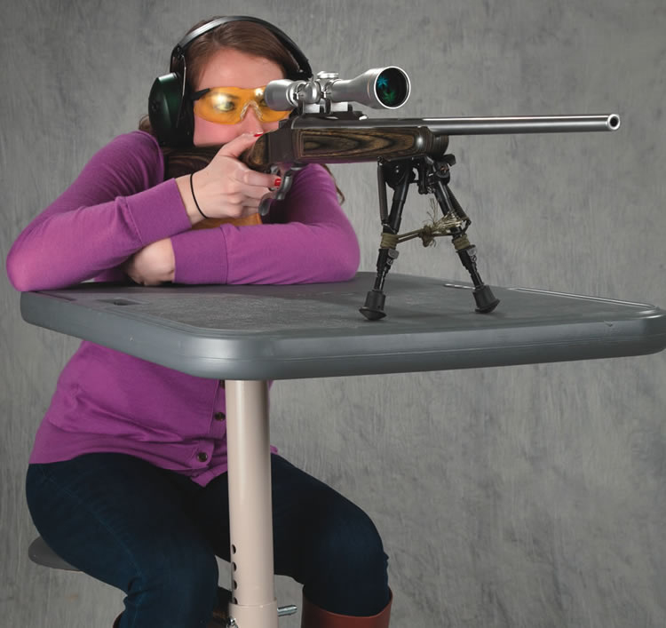
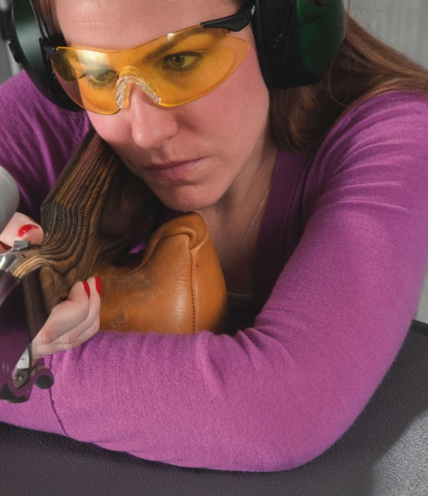
Assuming the Benchrest Position
Take a seat at the bench facing the target.
Grasp rifle at the wrist or pistol grip with the firing hand, and positions elbows on the bench.
Lay the rifle across the support and rest this hand on the sandbag or other support.
Position the rifle against the face and shoulder so that the dominant eye can look through the sights comfortably and naturally.
Notes:
Practice the position without a rifle
Have the students focus on attaining a proper body position before adding the rifle.
Reaffirm eye dominance, using the eye dominance exercise described in The NRA Guide to the Basics of Rifle Shooting handbook. Establishing eye dominance is important because it determines which shoulder the gun butt should be placed against.
Practice the position with the rifle
Have the students follow the following steps to assume the position with the rifle:
Take a seat at the bench facing the target.
Grasp rifle at the wrist or pistol grip with the firing hand, and positions elbows on the bench.
Lay the rifle across the support and rest this hand on the sandbag or other support.
Position the rifle against the face and shoulder so that the dominant eye can look through the sights comfortably and naturally.
**Allow adequate time for students to become familiar and comfortable with the position.
Align position with target’
Make sure that the students are positioned so that their rifles naturally point at the center of the target.
Vertical adjustments can be made by adjusting the height of the support.
Horizontal adjustments can be made by moving the support either left or right on the bench.
Dry-practice the rifles at the target
Dry-fire the rifles at the target while applying the fundamentals:
Aiming
Hold control
Breath control
Trigger control
Follow-through
While the students practice shooting fundamentals by dry-firing their rifles, emphasize that they should concentrate on sight alignment and squeezing the trigger without disturbing the sights.
Dry-firing will familiarize the students with cocking and firing their rifles. Suggest that they use dry-fire practice at home.
The students must be able to execute the fundamentals of shooting during dry-firing before they are allowed to progress to live ammunition.
Shoot at targets using live ammunition
Ensure that everyone on the range has eye and hearing protection.
Have students shoot live ammunition at the targets using single-shot and then multiple-shot exercises. Emphasize the importance of applying the shooting fundamentals every time they fire a shot.
single-shot exercise
Have the students load and fire only one cartridge at a time. Have them fire five times at a target, and have coaches evaluate the shooters. Perform this exercise at least twice, for a total of 10 shots.
Emphasize the importance of shooting small groups at the same location on the target rather than hitting the center of the bullseye.
five-shot exercise
Have students load five rounds and fire at a target, at their own pace, to achieve a shot group. Be sure that the students rest between each shot. Use the coach/pupil method, and have the coaches evaluate the shooters after this five-shot string. Repeat the exercise at least once, and continue until you are satisfied with the students’ performance.

Slide 82
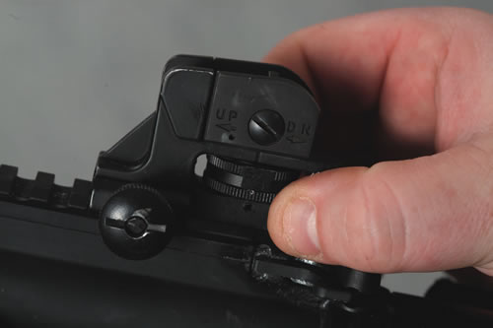
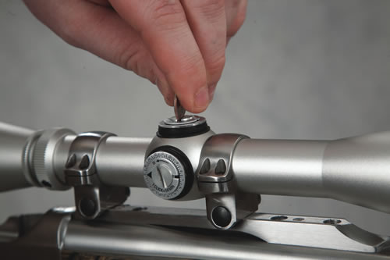
Adjusting the Sights
Shoot a group of shots.
Move the rear sight in the same direction you want the hits on the target to move.
Guns must be unloaded before making to sight adjustments.
Notes:
Adjust the rear sight to center a group on the target
Once the students are able to group their shots, instruct them how to make sight adjustments. Remind them to move the rear sight in the same direction that they want the hits on the target to move. Emphasize that the guns must be unloaded before any attempt is made to adjust the sights.
Continue firing five-shot groups from the bench
Continue to have the students load and fire five rounds from the bench.
The students should rest after each shot. Continue to make sight adjustments as necessary.
Remind the students that their eyes can focus on only one object at a time, and that (when using iron sights) the front sight should be in sharp focus, with the rear sight and target being less clear.
Repeat the exercise as necessary depending upon the time available and the number of students.

Slide 83


Free Arm Standing Position
Feet are shoulder width apart
Body at a right angle to the target
Body weight is distributed equally on both feet
Head and body are erect
Supporting arm is free from the body
Support hand is placed under the fore-end, supporting the weight of the rifle
The firing hand grasps the stock wrist or pistol grip
Rifle sights at eye level
Notes:
Free Arm Standing Shooting Position
Demonstrate the free arm standing shooting position.
Have the students learn the position using the proper sequence of steps.
1. Study position
Demonstrate and describe the key points of the position, referring students to the pictures of the position in the handbook.
Position of the body:
Feet are shoulder width apart
Body at a right angle to the target
Body weight is distributed equally on both feet
Head and body are erect
Support arm is free from the body
Support hand is placed under the fore-end, supporting the weight of the rifle
The firing hand grasps the stock wrist or pistol grip
Position of the rifle:
The butt of the stock is positioned against the shoulder so that the rifle sights are at eye level
If necessary, the instructor or student coach can assist in supporting the rifle for the shooter as he or she assumes the position. The instructor should emphasize comfort, relaxation, balance, bone support and proper alignment with the target.
2. Practice position without a rifle
Assist students in achieving the proper foot, arm and body position without a rifle.

Slide 84
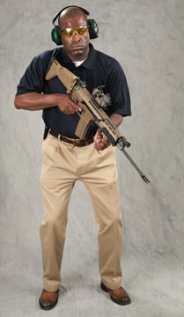


Assuming the
Free Arm Standing Position
Face the target
Shoulder the rifle
Align the sights
Notes:
3. Practice position with a rifle
Assist students in achieving the position with a rifle, using the following steps:
Hold rifle in both hands and move to the firing point
Turn body at a right angle to the target
Raise the rifle to eye level and position against the shoulder
4. Align position with target
Make sure that each student’s position is such that the rifle is naturally aligned with the target.
Vertical adjustments can be made by simply lifting or lowering the rifle
Horizontal adjustments can be made by moving the feet to rotate the body
5. Dry-fire rifle at target
Have students dry-fire their rifles at a target. Emphasize:
Sight alignment--aiming
Trigger squeeze—trigger control
Point out that nobody can hold a rifle perfectly still. The students must try to keep the sights aligned while maintaining a minimum arc of movement.
Emphasize that the trigger should be squeezed straight to the rear, and that the hammer fall should be a surprise.
6. Single-shot exercise
Have the students load and fire one round at a time. Have the students fire five shots at a bullseye target. Be sure that the students rest between each shot.
If the free arm position is maintained for eight seconds or more without firing a shot, the shooter should remove the trigger finger from the trigger, keep the gun pointed it in a safe direction, and lower it or rest it on the bench before attempting another shot.
Using the coach/pupil method, have coaches evaluate the shooters. Repeat the exercise, for a total of ten shots.
Five-shot exercise
Have the students load five rounds and fire them, at their own pace, at bullseye targets. The students should rest between shots.
Using the coach/pupil method, have coaches evaluate the shooters. Repeat the exercise until you are satisfied with the students’ performance.

Slide 85

The Arm Rest
Standing Position
Feet are shoulder width apart
Body at a right angle to the target
Body weight is distributed equally on both feet
Body bends back at the waist, away from the rifle
Head is erect
Upper part of support arm rests on side or hip
Support hand is placed under the fore-end, supporting the weight of the rifle, with a straight wrist
The firing hand grasps the stock wrist or pistol grip
There are a number of ways of placing the support hand under the fore-end
Notes:
Arm Rest Standing Shooting Position
Demonstrate the arm rest standing shooting position.
Have the students learn the position using the proper sequence of steps.
1. Study position
Demonstrate and describe the key points of the position, referring students to the pictures of the position in the handbook.
Position of the body:
Feet are shoulder width apart
Body at a right angle to the target
Body weight is distributed equally on both feet
Body bends back at the waist, away from he rifle
Head is erect
Upper part of support arm rests on side or hip
Support hand is placed under the fore-end, supporting the weight of the rifle, with a straight wrist
The firing hand grasps the stock wrist or pistol grip
There are a number of ways of placing the support hand under the fore-end
Position of the rifle:
The butt of the stock is positioned against the shoulder so that the rifle sights are at eye level
If necessary, the instructor or student coach can assist in supporting the rifle for the shooter as he or she assumes the position. The instructor should emphasize comfort, relaxation, balance, bone support and proper alignment with the target.
2. Practice position without a rifle
Assist students in achieving the proper foot, arm and body position without a rifle.

Slide 86


Assuming the Arm Rest Standing Position
Align with the target, shoulder the rifle and align the sights.
The weight of the rifle is on the support arm.
Notes:
3. Practice position with a rifle
Assist students in achieving the position with a rifle, using the following steps:
Hold rifle in both hands and move to the firing point
Turn body at a right angle to the target
Grasp fore-end between thumb and forefinger of support hand with wrist straight
Raise the rifle to eye level and position against the shoulder
4. Align position with target
Make sure that each student’s position is such that the rifle is naturally aligned with the target.
Vertical adjustments can be made by varying the position of the support arm against the body
Horizontal adjustments can be made by moving the feet to rotate the body
5. Dry-fire rifle at target
Have students dry-fire their rifles at a target. Emphasize:
Sight alignment--aiming
Trigger squeeze—trigger control
Point out that nobody can hold a rifle perfectly still. The students must try to keep the sights aligned while maintaining a minimum arc of movement.
Emphasize that the trigger should be squeezed straight to the rear, and that the hammer fall should be a surprise.
6. Single-shot exercise
Have the students load and fire one round at a time. Have the students fire five shots at a bullseye target. Be sure that the students rest between each shot.
If the free arm position is maintained for eight seconds or more without firing a shot, the shooter should remove the trigger finger from the trigger, keep the gun pointed it in a safe direction, and lower it or rest it on the bench before attempting another shot.
Using the coach/pupil method, have coaches evaluate the shooters. Repeat the exercise, for a total of ten shots.
7. Five-shot exercise
Have the students load five rounds and fire them, at their own pace, at bullseye targets. The students should rest between shots.
Using the coach/pupil method, have coaches evaluate the shooters. Repeat the exercise until you are satisfied with the students’ performance.

Slide 87
NRA Rules For Safe Gun Handling
ALWAYS KEEP THE GUN POINTED IN A
SAFE DIRECTION
ALWAYS KEEP YOUR FINGER OFF THE
TRIGGER UNTIL READY TO SHOOT
ALWAYS KEEP THE GUN UNLOADED UNTIL
READY TO USE

Slide 88
Lesson III Summary & Review
As a result of your participation in this lesson, you are now able to:
  Safely demonstrate the knowledge, skills and attitude necessary to assume the benchrest position with a rifle.
  Safely shoot a rifle from the benchrest position, using the fundamentals of rifle shooting at a target on a range.
  Safely demonstrate the knowledge, skills and attitude necessary to assume the free arm and arm rest standing shooting positions with a rifle.
  Safely shoot a rifle from the free arm and arm rest standing shooting position, using the fundamentals of rifle shooting at a target on a range.
Notes:
Highlight the most important points of the lesson:
Safely demonstrate the knowledge, skills and attitude necessary to assume the benchrest position with a rifle
Safely shoot a rifle from the benchrest position, using the fundamentals of rifle shooting at a target on a range
Safely demonstrate the knowledge, skills and attitude necessary to safely assume the free arm and arm rest standing shooting positions with a rifle
Safely shoot a rifle from the free arm and arm rest standing shooting positions, using the fundamentals of rifle shooting, at a target on a range

Slide 89
Questions
What Are Your Questions?
The Next Lesson will be:
Scoring Targets, and Selecting and Maintaining a Rifle
Notes:
Ask the students if they have any questions. Answer questions.
Preview the next lesson briefly.

Slide 90
LESSON IV:
Scoring Targets, and Selecting
and Maintaining a Rifle
Notes:
Length: 1 hour
Facility: Classroom
Required Materials:
The NRA Guide to the Basics of Rifle Shooting handbook
NRA Basic Rifle Shooting Course Wall Charts
Eye protection
Rifles
Targets used in Lesson III
Cleaning equipment
Other training aids as appropriate
References:
The NRA Guide to the Basics of Rifle Shooting handbook

Slide 91
LESSON IV: Scoring Targets, and Selecting and Maintaining a Rifle
Learning Objectives:
As a result of your participation in this lesson you will be able to:
    Properly score a rifle target.
    Explain the basic guidelines for selecting and
    purchasing a rifle.
    Identify the materials needed to clean a rifle.
    Demonstrate how to safely clean a rifle.
Notes:
State the learning objectives for this lesson.

Slide 92

Scoring Targets
Hits outside the scoring rings have a value of zero.
Hits that are completely or partially inside a scoring ring receive that rig’s value.
A hit that touches a scoring ring receives that ring’s value.
SCORE
A-0
B-9
C-6
Notes:
Explain the following about scoring targets:
Hits outside the scoring rings have a value of zero
Hits that are completely or partially inside a scoring ring receive that ring’s value
A hit that touches a scoring ring receives that ring’s value
Demonstrate as necessary with fired targets.

Slide 93
Selecting and Purchasing a Rifle
Information you should know:
Know the Law regarding
  Purchase
  Ownership
  Possession
  Carrying
Notes:
Emphasize that it is critical for students to know the laws in their jurisdiction regarding the purchase, ownership, use, possession and carrying of a rifle. Penalties for violation of firearms laws can be severe.

Slide 94
Types of Rifles
There are three basic types of rifles:
Air Rifles – provide opportunities for practice at home (the same safety rules apply to air rifles)
Rimfire Rifles – have low recoil and use less expensive ammunition; good for recreational shooting
Centerfire Rifles – available in a variety of calibers, making them useful for hunting, competition, home defense and more.
Notes:
There are three basic types of rifles:
Air rifles—provide opportunities for practice at home (the same safety rules apply to air rifles)
Rimfire rifles—have low recoil and use inexpensive ammunition; good for recreational shooting
Center-fire rifles—available in a variety of calibers, making them useful for hunting, competition, home defense and more.

Slide 95
Factors in Selecting a Rifle
Intended use of the rifle
Price and budget
Availability and price of ammunition
Rifle fit and ergonomics
Size/weight
Recoil
Notes:
Factors that should be considered when considering the purchase of a rifle include:
• Intended use of the rifle
• Price and budget
• Availability and price of ammunition
• Rifle fit and ergonomics
• Size/weight
• Recoil

Slide 96
Factors in Selecting a Rifle
Simplicity of operation and ease of cleaning
Reputation of manufacturer
Reliability record of the make and model
Warranty or guarantee
Availability of repair or aftermarket parts
Safety
Notes:
Continued…
Factors that should be considered when considering the purchase of a rifle include:
• Simplicity of operation and ease of cleaning
• Reputation of manufacturer
• Reliability record of the make and model
• Warranty or guarantee
• Availability of repair or aftermarket parts
• Safety

Slide 97

Selecting a Rifle
When considering purchasing a rifle:
Consult knowledgeable shooters
Research and, if possible, test-fire various makes and models
Purchase the rifle from a reputable dealer
Notes:
When considering purchasing a rifle:
Consult knowledgeable shooters
Research and, if possible, test-fire various makes and models
Purchase the rifle from a reputable dealer

Slide 98
Caring for the Rifle
It is important that you take proper care of the rifle through preventive maintenance.
The rifle should be cleaned and lubricated at the end of each shooting session.
The rifle must always be checked to ensure it is unloaded before it is cleaned.
NO ammunition should be present when the rifle is cleaned.
Notes:
Discuss the importance of taking proper care of the rifle through preventive maintenance. The rifle should be cleaned and lubricated at the end of each shooting session.
The rifle must always be checked to ensure it is unloaded before it is cleaned.
No ammunition should be present when a rifle is cleaned. (Ask students what this means to them and how they would resolve this issue in their home)
Their answer should be: Ammunition would be left in another room

Slide 99

Cleaning Equipment
Cleaning rod
Bronze or nylon brush and jag of the proper size
Bore solvent
Cotton patches
Small brush (for cleaning residue out of crevices)
Soft cloth
Gun oil
No ammunition should be present when cleaning your rifle.
Notes:
A proper firearm cleaning kit contains at minimum the following:
Cleaning rod
Bronze or nylon brush and jag of the proper size
Bore solvent
Cotton patches
Small brush (for cleaning residue out of crevices)
Soft cloth

Slide 100

Gun Cleaning Procedure
Unload
Notes:
Explain and demonstrate to the students the proper use of the components of a gun cleaning kit to properly clean a rifle. Show them how to use daylight, a bore scope, or a white piece of paper to visually examine the bore for remaining powder, lead or copper residue.
Have the students demonstrate that they know and can perform each step of the cleaning procedure using the items in the cleaning kit.
Monitor the students’ activities as they do the exercise, and make corrections as needed.
Emphasize to the students that rifle repairs should only be performed by the factory, or by a qualified and experienced gunsmith.

Slide 101

Gun Cleaning Procedure
Remove Bolt
Notes:
Explain and demonstrate to the students the proper use of the components of a gun cleaning kit to properly clean a rifle. Show them how to use daylight, a bore scope, or a white piece of paper to visually examine the bore for remaining powder, lead or copper residue.
Have the students demonstrate that they know and can perform each step of the cleaning procedure using the items in the cleaning kit.
Monitor the students’ activities as they do the exercise, and make corrections as needed.
Emphasize to the students that rifle repairs should only be performed by the factory, or by a qualified and experienced gunsmith.

Slide 102

Gun Cleaning Procedure
Apply Solvent
Notes:
Explain and demonstrate to the students the proper use of the components of a gun cleaning kit to properly clean a rifle. Show them how to use daylight, a bore scope, or a white piece of paper to visually examine the bore for remaining powder, lead or copper residue.
Have the students demonstrate that they know and can perform each step of the cleaning procedure using the items in the cleaning kit.
Monitor the students’ activities as they do the exercise, and make corrections as needed.
Emphasize to the students that rifle repairs should only be performed by the factory, or by a qualified and experienced gunsmith.

Slide 103

Gun Cleaning Procedure
Clean Bore
Notes:
Explain and demonstrate to the students the proper use of the components of a gun cleaning kit to properly clean a rifle. Show them how to use daylight, a bore scope, or a white piece of paper to visually examine the bore for remaining powder, lead or copper residue.
Have the students demonstrate that they know and can perform each step of the cleaning procedure using the items in the cleaning kit.
Monitor the students’ activities as they do the exercise, and make corrections as needed.
Emphasize to the students that rifle repairs should only be performed by the factory, or by a qualified and experienced gunsmith.

Slide 104

Gun Cleaning Procedure
Attach Jag
Notes:
Explain and demonstrate to the students the proper use of the components of a gun cleaning kit to properly clean a rifle. Show them how to use daylight, a bore scope, or a white piece of paper to visually examine the bore for remaining powder, lead or copper residue.
Have the students demonstrate that they know and can perform each step of the cleaning procedure using the items in the cleaning kit.
Monitor the students’ activities as they do the exercise, and make corrections as needed.
Emphasize to the students that rifle repairs should only be performed by the factory, or by a qualified and experienced gunsmith.

Slide 105

Gun Cleaning Procedure
Use Patch
Notes:
Explain and demonstrate to the students the proper use of the components of a gun cleaning kit to properly clean a rifle. Show them how to use daylight, a bore scope, or a white piece of paper to visually examine the bore for remaining powder, lead or copper residue.
Have the students demonstrate that they know and can perform each step of the cleaning procedure using the items in the cleaning kit.
Monitor the students’ activities as they do the exercise, and make corrections as needed.
Emphasize to the students that rifle repairs should only be performed by the factory, or by a qualified and experienced gunsmith.

Slide 106

Gun Cleaning Procedure
Use Brush
Notes:
Explain and demonstrate to the students the proper use of the components of a gun cleaning kit to properly clean a rifle. Show them how to use daylight, a bore scope, or a white piece of paper to visually examine the bore for remaining powder, lead or copper residue.
Have the students demonstrate that they know and can perform each step of the cleaning procedure using the items in the cleaning kit.
Monitor the students’ activities as they do the exercise, and make corrections as needed.
Emphasize to the students that rifle repairs should only be performed by the factory, or by a qualified and experienced gunsmith.

Slide 107

Gun Cleaning Procedure
Flush Action
Notes:
Explain and demonstrate to the students the proper use of the components of a gun cleaning kit to properly clean a rifle. Show them how to use daylight, a bore scope, or a white piece of paper to visually examine the bore for remaining powder, lead or copper residue.
Have the students demonstrate that they know and can perform each step of the cleaning procedure using the items in the cleaning kit.
Monitor the students’ activities as they do the exercise, and make corrections as needed.
Emphasize to the students that rifle repairs should only be performed by the factory, or by a qualified and experienced gunsmith.

Slide 108

Gun Cleaning Procedure
Inspect Your Firearm
Notes:
Explain and demonstrate to the students the proper use of the components of a gun cleaning kit to properly clean a rifle. Show them how to use daylight, a bore scope, or a white piece of paper to visually examine the bore for remaining powder, lead or copper residue.
Have the students demonstrate that they know and can perform each step of the cleaning procedure using the items in the cleaning kit.
Monitor the students’ activities as they do the exercise, and make corrections as needed.
Emphasize to the students that rifle repairs should only be performed by the factory, or by a qualified and experienced gunsmith.

Slide 109

Gun Cleaning Procedure
Oil Bolt
Notes:
Explain and demonstrate to the students the proper use of the components of a gun cleaning kit to properly clean a rifle. Show them how to use daylight, a bore scope, or a white piece of paper to visually examine the bore for remaining powder, lead or copper residue.
Have the students demonstrate that they know and can perform each step of the cleaning procedure using the items in the cleaning kit.
Monitor the students’ activities as they do the exercise, and make corrections as needed.
Emphasize to the students that rifle repairs should only be performed by the factory, or by a qualified and experienced gunsmith.

Slide 110

Gun Cleaning Procedure
Oil Breech Block
Notes:
Explain and demonstrate to the students the proper use of the components of a gun cleaning kit to properly clean a rifle. Show them how to use daylight, a bore scope, or a white piece of paper to visually examine the bore for remaining powder, lead or copper residue.
Have the students demonstrate that they know and can perform each step of the cleaning procedure using the items in the cleaning kit.
Monitor the students’ activities as they do the exercise, and make corrections as needed.
Emphasize to the students that rifle repairs should only be performed by the factory, or by a qualified and experienced gunsmith.

Slide 111

Gun Cleaning Procedure
Lubricate Hammer
Notes:
Explain and demonstrate to the students the proper use of the components of a gun cleaning kit to properly clean a rifle. Show them how to use daylight, a bore scope, or a white piece of paper to visually examine the bore for remaining powder, lead or copper residue.
Have the students demonstrate that they know and can perform each step of the cleaning procedure using the items in the cleaning kit.
Monitor the students’ activities as they do the exercise, and make corrections as needed.
Emphasize to the students that rifle repairs should only be performed by the factory, or by a qualified and experienced gunsmith.

Slide 112

Gun Cleaning Procedure
Lubricate Lever Mechanism
Notes:
Explain and demonstrate to the students the proper use of the components of a gun cleaning kit to properly clean a rifle. Show them how to use daylight, a bore scope, or a white piece of paper to visually examine the bore for remaining powder, lead or copper residue.
Have the students demonstrate that they know and can perform each step of the cleaning procedure using the items in the cleaning kit.
Monitor the students’ activities as they do the exercise, and make corrections as needed.
Emphasize to the students that rifle repairs should only be performed by the factory, or by a qualified and experienced gunsmith.

Slide 113



Rifle Storage
Store guns and ammunition so that they are not accessible to unauthorized persons.
Store guns and ammunition separately.
Store guns and ammunition in a cool, dry place.
Soft Case
Safe
Hard Case
Notes:
Make the following points to the students in regard to rifle storage:
Store guns and ammunition so that they are not accessible to unauthorized persons.
Store guns and ammunition separately.
Store guns and ammunition in a cool, dry place.
Briefly describe some of the more common rifle storage devices, such as rifle cases, gun safes, etc.

Slide 114
NRA Rules For Safe Gun Handling
ALWAYS KEEP THE GUN POINTED IN A
SAFE DIRECTION
ALWAYS KEEP YOUR FINGER OFF THE
TRIGGER UNTIL READY TO SHOOT
ALWAYS KEEP THE GUN UNLOADED UNTIL
READY TO USE

Slide 115
Lesson IV Summary & Review
As a result of your participation in this lesson, you are now able to:
  Properly score a rifle target
  Explain the basic guidelines for selecting and purchasing a rifle
  Identify the materials needed to clean a rifle
  Demonstrate how to safely clean a rifle
Notes:
Highlight the important points of the lesson:
Properly score a rifle target
Explain the basic guidelines for selecting and purchasing a rifle.
Identify the materials needed to clean a rifle
Demonstrate how to safely clean a rifle

Slide 116
End Of Lesson IV
What Are Your Questions?
The Next Lesson will be:
Continued Opportunities for
Skill Development
Notes:
Ask the students if they have any questions. Answer questions.
Preview the next lesson briefly.

Slide 117
LESSON V:
Continued Opportunities for
Skill Development
Notes:
Length: 1 hour
Facility: Classroom
Required Materials:
The NRA Guide to the Basics of Rifle Shooting (one per student)
Winchester/NRA Marksmanship Qualification Program booklet
NRA Basic Rifle Shooting Course examinations (one per student)
NRA Basic Rifle Shooting Course evaluations (one per student)
Pens or pencils
Exam key
NRA Basic Rifle Shooting Course completion certificates (one per student)
Optional Materials:
Other training aids as appropriate
References:
The NRA Guide to the Basics of Rifle Shooting handbook

Slide 118
LESSON V: Continued Opportunities for
Skill Development
Learning Objectives:
As a result of your participation in this lesson you will be able to:
    Identify several ways to pursue rifle shooting activities after the course.
    Successfully complete the NRA Basic Rifle Shooting Course written examination.
Notes:
Briefly review key points of the NRA Basic Rifle Shooting Course.
Administer the examination, which is conducted in an open-book manner. However, students may not ask other students or course graduates for answers.
Note to Instructors: The most important element is the student’s attitude. As an instructor, you must make a subjective judgment as to whether the student has gained the requisite knowledge, skills and attitude in order to receive a completion certificate.

Slide 119


NRA Marksmanship
Qualification Program
The NRA Marksmanship Qualification Program is a self-paced skill development program which allows shooters to earn awards while practicing by themselves or with others.
Notes:
Encourage students to participate in any of the numerous NRA activities that can enhance their skills.
Describe the Winchester/NRA Rifle Marksmanship Qualification Program. Explain that the program is a self-paced skill development program which allows shooters to earn awards while practicing by themselves or with others.
Distribute Winchester/NRA Marksmanship Qualification Program booklets.

Slide 120
NRA Training Opportunities
Non-Live Fire
  Range Safety Officer
  Home Firearm Safety
  Refuse To Be A Victim
  NRA Online Hunter Education
  Basic Shotgun Shell Reloading
  Basic Metallic Cartridge Reloading
Notes:
Describe the firearm training opportunities offered by the NRA. NRA courses are taught by thousands of Certified Instructors worldwide, and include:
Describe how NRA student and instructor courses can be found at www.nrainstructors.org.

Slide 121
NRA Training Opportunities
Live Fire Courses
NRA CCW
Defensive Pistol
Basic Muzzleloading
Basic Rifle Shooting
Basic Pistol Shooting
Basic Shotgun Shooting
Basic Shotgun Shell Reloading
Basic Personal Protection In The Home
Basic Personal Protection Outside The Home
Notes:
Describe the firearm training opportunities offered by the NRA. NRA courses are taught by thousands of Certified Instructors worldwide, and include:
Describe how NRA student and instructor courses can be found at www.nrainstructors.org.

Slide 122

Competitive Shooting
NRA's Competitive Shooting Division offers a wide range of activities in all types of shooting, for everyone from the novice to the world-class competitor. The NRA sanctions over 11,000 shooting tournaments and sponsors over 50 national championships each year.
NRA’s Competitive Shooting website, compete.nra.org, lists the different types of NRA Competitive Shooting Programs.
The website also contains a link to the NRA’s Shooting Sports USA digital magazine along with links to other NRA digital publications.
Notes:
The NRA Competitive Shooting Division sanctions rifle shooting tournaments and leagues throughout the country. Each competitor, after firing a prescribed number of shots in NRA-sponsored matches, will receive a national classification card indicating their skill level.
The NRA also publishes Shooting Sports USA, a magazine for competitive shooters that has articles on equipment and shooting techniques, as well as listings of NRA-sponsored matches throughout the country.
Students interested in competition should contact the NRA Competitive Shooting Division.

Slide 123

NRA Clubs & Associations
The NRA Clubs & Associations Department provides services and assistance to a network of over 15,000 NRA affiliated clubs, associations,
and businesses. Visit their website, clubs.nra.org, for more activities, information and a way to search for an NRA affiliated club near you.
It is at the NRA affiliated clubs where you can find not only a place to shoot but also NRA classes, competitions and other event and activities.
Notes:
Encourage students to join one of the more than 15,000 clubs nationwide that are enrolled in or affiliated with the NRA.
For information on these clubs, have the students contact the Clubs and Associations Department.

Slide 124
NRA Programs
This course and the materials you have used have all been developed by the NRA. Your instructors have been trained and certified by the NRA and they are part of a worldwide team of thousands of NRA Certified Instructors.
The NRA offers programs that include basic and advanced firearms training programs for every shooting discipline, Instructor and Coach training, numerous youth programs and activities, Competitive shooting programs, Women’s programs, Law enforcement training and much more!
Notes:
The NRA developed this course. Note also that this course was conducted by instructors trained and certified by the NRA, part of a team of thousands of NRA Certified Instructors worldwide.
NRA programs include:
NRA Basic Firearm Training Programs for every shooting discipline—rifle, pistol and shotgun
NRA Instructor and Coach training
Numerous youth programs and activities
Competitive shooting programs
Women’s programs
Law enforcement training
And much more!

Slide 125

NRA History and Goals
The NRA was established in 1871, originally to promote marksmanship training.
NRA’s basic goals are to:
  Protect and defend the Constitution of the United States, especially in regard to the Second Amendment.
  Promote public safety, law and order, and the national defense.
  Train members of law enforcement agencies, the armed forces, and people of good repute in the safe handling and effective use of firearms.
  Foster and promote the shooting sports at local, state, regional, national and international levels.
  Promote hunter safety and proper wildlife management.
Notes:
The NRA was established in 1871, originally to promote marksmanship training.
NRA’s basic goals are to:
Protect and defend the Constitution of the United States, especially in regard to the Second Amendment.
Promote public safety, law and order, and the national defense.
Train members of law enforcement agencies, the armed forces, and people of good repute in the safe handling and effective use of firearms.
Foster and promote the shooting sports at local, state, regional, national and international levels.
Promote hunter safety and proper wildlife management.

Slide 126


Benefits of NRA Membership
Magazine Choice: Subscription to American Rifleman, American Hunter, Shooting Illustrated, or America's 1st Freedom.
Members Only Discounts and Services: Discounts for travel through NRA Travel Center, NRA Coffee Club, and NRA Identity Protection.
SPECIAL SAVINGS from NRA Member Partners
FREE ADMISSION to NRA’s Guns,
Gear & Outfitter Show
AND MORE!
More benefits may be found at http://benefits.nra.org
Notes:
Note the following benefits of NRA membership:
Subscription to American Rifleman, American Hunter or America’s 1st Freedom magazines.
NRA InSights magazine for junior shooters (under 18)
Firearm insurance.
Discount programs for airline tickets, rental cars, hotels, etc.
A watchful eye and a powerful voice in our nation’s legislatures, at all levels of government.
Encourage students to join the NRA.

Slide 127
Course Review & Exam
Review
Grade Exams
Evaluations

Slide 128
NRA Rules For Safe Gun Handling
ALWAYS KEEP THE GUN POINTED IN A SAFE DIRECTION
ALWAYS KEEP YOUR FINGER OFF THE TRIGGER UNTIL READY TO SHOOT
ALWAYS KEEP THE GUN UNLOADED UNTIL READY TO USE
Notes:
POP-QUIZ students and ask them to name the 3 rules in order that the learned them, before revealing in order which they state them.
ie.
What is the first rule for safe gun handling?
Students: Always keep the gun pointed in a safe direction.
Instructor: Reveal that first Rule and praise them for getting it correct. Then ask what the second rule is, and so on.

Slide 129
LESSON V: Continued Opportunities for
Skill Development
Learning Objectives:
As a result of your participation in this lesson you will be able to:
  Identify several ways to pursue rifle shooting activities after the course.
  Successfully complete the NRA Basic Rifle Shooting Course written examination.
Notes:
Briefly review key points of the NRA Basic Rifle Shooting Course.
Administer the examination, which is conducted in an open-book manner. However, students may not ask other students or course graduates for answers.
Note to Instructors: The most important element is the student’s attitude. As an instructor, you must make a subjective judgment as to whether the student has gained the requisite knowledge, skills and attitude in order to receive a completion certificate.

Slide 130
What Are Your Questions?

Slide 131
Dismissal
We would like to thank the NRA Foundation and its generous donors for helping make this course possible.
We want to thank you for your participation in this course
Notes:
Special thanks should go to the NRA Foundation and its generous donors for helping make this course possible.
Thank the students for their participation in your course and for displaying the proper attitude by seeking training.
Encourage the students to continue their education, training, and participation in the shooting sports, and to introduce others to the shooting sports as well, so that they may continue the American tradition of safe and responsible gun ownership.
Dismiss the class.
Distribute course evaluations and ask your students to complete and return them to you. Explain that these evaluations are valuable in improving the course and the performance of the instructors. Issue course completion certificates to those individuals who successfully complete the course.
OR Continue onto Lesson VI

Slide 133
LESSON VI:
Kneeling, Sitting
and Prone Positions
Notes:
NOTE: This lesson on shooting positions is completely Optional, at the Instructor and Students discretion. If time allows, it is a valuable lesson to the student(s).
Length: 2 hours
Facility: Range
Required Materials:
• The NRA Guide to the Basics of Rifle Shooting handbook
• NRA Basic Rifle Shooting Course Wall Charts
• Eye protection
• Hearing protection
• Rifles
• Sufficient ammunition per student to complete instruction
• Targets
• Other training aids as appropriate
References:
• The NRA Guide to the Basics of Rifle Shooting handbook

Slide 134
LESSON VI: Kneeling, Sitting and Prone Positions
Learning Objectives:
As a result of your participation in this lesson you will be able to:
  Safely demonstrate the knowledge, skills and attitude necessary to assume the; Kneeling, Sitting, and Prone shooting positions.
  Safely shoot a rifle for the Kneeling, Sitting, and Prone shooting positions, using the fundamentals of rifle shooting, at a target on range.
Notes:
State the learning objectives for this lesson
Review NRA Rules of Safe Gun Handling, range safety rules, hygiene guidelines and range commands presented in Lesson III, as needed.

Slide 135



Elements of
Kneeling Shooting Position
Face the target with the rifle in both hands
Turn toward the firing-hand side
Drop to that knee,
sitting on the foot
Notes:
In addition to being an important target shooting position, the kneeling position is particularly useful in the field. It is quick to assume, steadier than the standing position, and provides the clearance necessary to shoot over tall weeds, brush, and uneven terrain.
Demonstrate the proper kneeling position as described in The NRA Guide to the Basics of Rifle Shooting.

Slide 136


Elements of
Kneeling Shooting Position
Move the support-side foot so that the lower leg on that side is vertical and place the support-arm elbow on the knee.
Bring the rifle to eye level and place the butt of the gun firmly into the shoulder.

Slide 137


Elements of
Kneeling Shooting Position
High foot position
Low foot position

Slide 138


Elements of
Kneeling Shooting Position
A kneeling roll may also be used for support.

Slide 139



Elements of
Sitting Shooting Position
Face the target with the rifle in both hands.
Turn away from the target toward your firing-hand side.
With the rifle in the support hand, sit
on the ground.

Slide 140


Elements of
Sitting Shooting Position
Extend the legs forward and cross the support-side ankle over the ankle on the firing-hand side.
Place your elbows forward
of your knees.

Slide 141

Elements of
Sitting Shooting Position
Bring the rifle to eye level and place the butt of the gun firmly into the shoulder.

Slide 142



Elements of
Prone Shooting Position
Face the target with the rifle in both hands.
With the rifle in the shooting hand, lower your body to your knees.
Extend your firing hand forward and lower your
body fully to the ground.

Slide 143



Elements of
Prone Shooting Position
Lower your body fully to the ground.
Extend your firing hand forward.
Extend your support arm forward.

Slide 144


Elements of
Prone Shooting Position
Flat Prone
Rollover Prone

Slide 145
NRA Rules For Safe Gun Handling
ALWAYS KEEP THE GUN POINTED IN A
SAFE DIRECTION
ALWAYS KEEP YOUR FINGER OFF THE
TRIGGER UNTIL READY TO SHOOT
ALWAYS KEEP THE GUN UNLOADED UNTIL
READY TO USE

Slide 146
Lesson VI Summary & Review
As a result of your participation in this lesson, you are now able to:
  Safely demonstrate the knowledge, skills and attitude necessary to assume the; Kneeling, Sitting, and Prone shooting positions.
  Safely shoot a rifle for the Kneeling, Sitting, and Prone shooting positions, using the fundamentals of rifle shooting, at a target on range.

Slide 147
Questions
What Are Your Questions?

Slide 148
Dismissal
We would like to thank the NRA Foundation and its generous donors for helping make this course possible.
We want to thank you for your participation in this course

